Slide 1
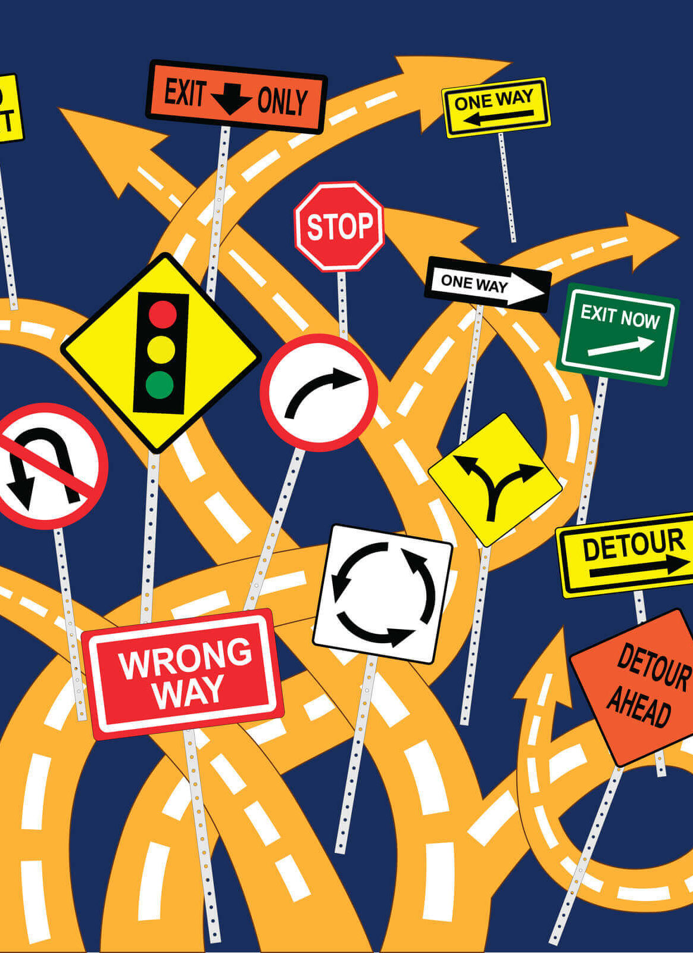
American Rescue Plan Act of 2021 Coronavirus State and Local Fiscal Recovery Fund: THE BASICS OF COMPLIANCE
Kara A. Millonzi, Robert W. Bradshaw, Jr. Distinguished Professor of Public Law and Government, UNC Chapel Hill School of Government
millonzi@sog.unc.edu
Rebecca Badgett, Assistant Teaching Professor of Public Law and Government, UNC Chapel Hill School of Government
rbadgett@sog.unc.edu

Slide 2
ARP/CSLFRF Spending Categories
ADDRESS COVID PUBLIC HEALTH & NEGATIVE ECONOMIC IMPACT
Support public health expenditures, by funding COVID-19 mitigation efforts, medical expenses, behavioral healthcare, and certain public health and safety staff;
Address negative economic impacts caused by the public health emergency, including economic harms to workers, households, small businesses, impacted industries, and the public sector;
Support disproportionately impacted communities
REPLACE LOST REVENUE
Replace lost public sector revenue, using this funding to provide government services to the extent of the reduction in revenue experienced due to the pandemic;
$10 million standard allowance OR formula approach
PREMIUM PAY
Provide premium pay for essential workers, offering additional support to those who have borne and will bear the greatest health risks because of their service in critical infrastructure sectors;
Target low-and moderate- income employees or employees who face(d) added risks during pandemic
INFRASTRUCTURE INVESTMENTS
Invest in water, sewer, and broadband infrastructure, making necessary investments to improve access to clean drinking water, support vital wastewater and stormwater infrastructure, and to expand access to broadband internet.
ARP/CSLFRF FLEX
Disaster response/mitigation
Certain CDBG (Title I) projects
Certain Surface Transportation Projects
Know Your Category!
NEW

Slide 3
Federal Compliance Requirements
Award Terms | Prohibited Expenditures | Uniform Guidance (UG)
All funds obligated by December 31, 2024 & fully expended by December 31, 2026 Reporting requirements Project & Expenditure reports (quarterly or yearly, depending on size) -- Document data elements for certain EC’s Performance Plan reports (for largest units only) Civil rights compliance / nondiscrimination policy Compliance with all applicable Uniform Guidance provisions Records retention policy with retention for at least 5 years after award term ends Special audit requirements Other federal laws | NO: Pension fund contributions NO: Borrowing money NO: Financial reserves / rainy day fund NO: Settlement/judgement/consent decree NO: Undermines or discourages compliance with CDC guidelines NO: Violates conflict of interest provisions NO: Violates state law or other federal laws and regulations, including applicable Uniform Guidance | General Financial Management Internal Controls Eligible Projects Determination & Documentation Policy Cost Principles/Allowable Costs Policy Procurement, Suspension, & Debarment Policy Subaward Policy Program Income Policy Property Management Policy
Applies to ALL projects
Applies ONLY TO SOME projects and DOES NOT apply to Revenue Replacement
What local government agreed to as condition of receiving funds. Applies to ALL categories.
The Final Rule prohibits certain expenditures no matter what. Applies to ALL categories
Set of federal compliance regulations that apply to federal awards.

Slide 4
Documenting Compliance & Oversight
Policies
Internal controls to help local officials comply with all legal requirements
Documentation
Records of decisions, transactions, justifications, and more documenting how grant funds were spent and what processes were followed
Reporting
P&E Report [$0-$10million]: recording obligations & expenditures by project
Performance Plan Report [Only for Units Over 250,000 population]
P&E Report [Over $10million]: recording obligations & expenditures by project; recording certain additional data elements for some projects; recording certain information about contractors and subrecipients
Retained by local government and (potentially) reviewed during audit process
Information provided in report(s) to US Treasury

Slide 5
ARP/CSLFRF Timing
March 3, 2021:
ARP/CLFRF Effective Date
January 27,
2020:
Pandemic Begins
Obligation means an order placed for property and services and entering into contracts, subawards, and similar transactions that require payment.
May 2021:
Interim Final Rule
Premium Pay: May be applied retroactively to beginning of pandemic but only through April 10, 2023
Assistance Programs: May address negative impacts from beginning of pandemic
Revenue Loss: Will be calculated from beginning of pandemic. May cover expenses from March 3, 2021 onward
Water/Wastewater/Broadband: May be used for projects that started before March 3, 2021, but only for expenses after that date
Fall 2021:
Various Compliance Guides
Summer 2021:
First ½ Distribution
January 2022: Final Rule
Summer 2022:
Second ½ Distribution
September 30, 2026:
Transportation & Title I Projects EXPENDED
December 31, 2024:
All Funds Obligated
December 31, 2026:
All Other Funds Expended

Slide 6
Revenue Replacement Compliance: Exempt from Some UG Provisions
Award Terms | Prohibited Expenditures | Uniform Guidance (UG)
All funds obligated by December 31, 2024 & fully expended by December 31, 2026 Reporting requirements Project & Expenditure reports (quarterly or yearly, depending on size) – Document data elements for certain ECs Performance Plan reports (for largest units only) Civil rights compliance / nondiscrimination policy Compliance with all applicable some Uniform Guidance provisions Records retention policy with retention for at least 5 years after award term ends Special audit requirements Other federal laws | NO: Pension fund contributions NO: Borrowing money NO: Financial reserves / rainy day fund NO: Settlement/judgement/consent decree NO: Undermines or discourages compliance with CDC guidelines NO: Violates conflict of interest provisions NO: Violates state law or other federal laws and regulations, including applicable Uniform Guidance | General Financial Management Internal Controls Eligible Projects Determination & Documentation Policy Cost Principles/Allowable Costs Policy (limited review) Procurement, Suspension, & Debarment Policy Subaward Policy Program Income Policy Property Management Policy

Slide 7
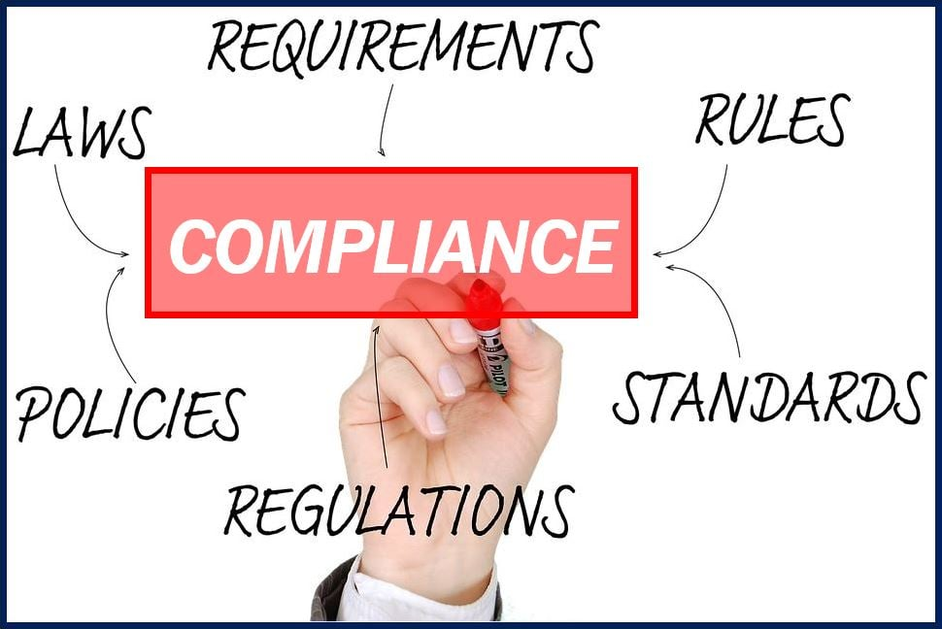
Basic Compliance (applies to every county and municipality & applies to every expenditure category)
Financial Management System
Internal Controls
Civil Rights Policy
Records Retention Addendum
Eligible Use Policy
Allowable Cost Policy
Conflicts of Interest Policy
Review for other Award Terms
Proper Budgeting
P&E Report

Slide 8
Revenue Replacement Compliance

Slide 9
Revenue Replacement: Reimbursements ONLY
1
Adopt and implement 5 BASIC policies
Adopt or amend general written internal controls
Have attorney review for compliance with Award Terms & Conditions
Identify eligible reimbursement expenditures (including salaries & benefits)
Complete eligible use and allowable cost review documentation (template here) and keep documentation of original expenditures (eg. contracts, invoices, payments, payroll records, etc.)
Adopt grant project ordinance making specific reimbursement appropriations (ARP funds are now both obligated and expended)
Do journal entry to move reimbursement cash from special revenue fund to general fund and/or enterprise fund (the cash is now unrestricted fund balance)
Track and report obligations and expenditures during reporting period (April-March) as EC 6.1 on P&E report, with brief description of reimbursement expenditures. [Or EC 6.2 if match on other federal grant]
Retain all documentation for at least 5 years after expenditure of final dollar of ARP/CSLFRF funds
2
3
4
5
Eligible reimbursement expenditures include everything except contract payments that would have violated federal conflict of interest provision, litigation/settlement payments, debt service (loan) payments or other debt-related payments, and expenditures that were specifically covered/reimbursed with other funds.
6
7
8
9

Slide 10
Revenue Replacement: Future Salaries / Benefit Expenditures
1
Adopt and implement 5 BASIC policies
Adopt or amend general written internal controls
Have attorney review for compliance with Award Terms & Conditions
Estimate salary/benefit expenditures by department
Complete eligible use and allowable cost review documentation (template here)
Adopt grant project ordinance appropriating transfer of ARP revenues to annual budget ordinance for estimated amounts that will be paid the rest of this fiscal year for salaries/benefits
Do journal entry to move cash from special revenue fund to general fund and/or enterprise fund(s)
Amend annual budget ordinance to recognize ARP revenue transfer to cover salaries/benefits for rest of fiscal year (to keep budget balanced, either reduce appropriated fund balance by same amount or add new appropriations to be paid from freed up non-grant revenues)
Retain payroll records for each covered pay period (DO NOT need individual employee effort certification forms)
Track obligations and expenditures by reporting period (April - March) and report as 6.1 EC on P&E report
Retain all documentation for at least 5 years after expenditure of final dollar of ARP/CSLFRF funds
Periodically review revenue estimates to actuals and make adjustments
Repeat each fiscal year until expend all ARP funds or grant period expires (Note that must incur all obligations by December 31, 2024)
2
3
4
5
6
7
A local government may use revenue replacement funds to cover any employee’s or official’s salaries and benefits, unless specifically covered or reimbursed with other earmarked funds.
Only documentation required is payroll records
8
9
10
11
12
13

Slide 11
Revenue Replacement: Future Other Expenditures
1
Adopt and implement 5 BASIC policies
Adopt or amend general written internal controls
Have attorney review for compliance with Award Terms & Conditions
Identify eligible project(s) and estimate costs
Complete eligible use and allowable cost review documentation (template here)
Adopt grant project ordinance appropriating ARP/CSLFRF funds for each project
Obligate and expend funds for project(s) directly out of grant project ordinance (or transfer to capital project ordinance)
Retain all documentation of contracts, agreements, invoices, expenditures, and other records
Track obligations and expenditures by reporting period (April - March) and report as 6.1 EC on P&E report
Retain all documentation for at least 5 years after expenditure of final dollar of ARP/CSLFRF funds
Periodically review revenue estimates to actuals to make adjustments to ensure all funds are obligated by December 31, 2024 and expended by December 31, 2026
2
3
4
5
Only INELIGIBLE EXPENDITURES ARE:
NO: Pension fund contributions
NO: Borrowing money
NO: Financial reserves / rainy day fund
NO: Settlement/judgement/consent decree
NO: Undermines or discourages compliance with CDC guidelines
NO: Violates conflict of interest provisions
NO: Not authorized by state law
6
7
8
9
10
11
Adv Compliance

Slide 12
General Compliance:
Adopt and Implement these Policies
Record Retention
This policy supplements a local government’s regular records retention policy to establish procedures to retain all ARP/CSLFRF-related information for at least 5 years after the end of the award term (through December 31, 2031). (Sample policy here.)
Civil Rights Compliance
This policy reaffirms the local government’s commitment to compliance with federal civil rights laws and establishes processes for reporting potential violations and tracking complaints and resolutions. (Sample policy here.)
Eligible Use
This is a simple policy that indicates allowable and unallowable projects, based on the expenditure categories in the ARP/CSLFRF Final Rule. It requires a local government to identify staff to document and review ARP/CSLFRF expenditures. That documentation must be retained according to the record retention requirements. (Sample policy here.)
Allowable Cost
This is a more complex policy that requires a local government to do a detailed review of each cost item and ensure compliance with special limitations and documentation mandates for certain cost items. (Sample policy here.) [If using Revenue Replacement ARP/CSLFRF, there will be a more limited allowable cost review.]
Conflict of Interest
The UG requires recipients and subrecipients of federal financial assistance to maintain written standards of conduct covering conflicts of interest and governing the actions of its employees engaged in the selection, award, and administration of contracts. (Sample policy here.)
BACK

Slide 13
Internal Control Process
Control Environment
Commitment to integrity & ethics
Risk Assessment
A process that involves the identification and analysis of relevant risks to the achievement of objectives.
Control Activities
Tools, policies, procedures, processes-designed and implemented to help ensure that management objectives are met.
Info & Communication
Monitoring Activities
Effective oversight by leadership
Clear structure and procedures
Commitment to competence
Enforces accountability
Communicates expectations and control activities clearly within and outside organization
Provides sufficient training for staff
Conducts ongoing monitoring
Identifies, evaluates, and communicates deficiencies
Addresses deficiencies in a timely manner
Help prevent or reduce the risks that can impede the accomplishment of objectives.
Internal controls should be modeled after the guidance in the Standards of Internal Control in the Federal Government (the Green Book) or the COSO Framework.

Slide 14
Written Policies
Establish who has the authority to review and approve projects, charge cost items, and take other compliance-related actions.
Segregation of Duties
Separate the responsibilities of key business processes by disturbing functions to multiple employees. No one person should have record-keeping and reconciliation functions.
Staff Training
Employees are trained on specific compliance requirement.
Documentation
Establish documentation processes and responsibilities.
Management Review
Management shall periodically check that the compliance requirements are being properly performed and documented.
Control Activities
Notes:
Authorization or approval, custody, record keeting and reconciliations.

Slide 15
Internal Controls Are Required Over Financial Management System
Accounting records must track:
Authorizations
Obligations
Expenditures
Program Income
Maintain source documentation
Paid invoices
Payrolls
Time and attendance records
Subaward agreements
Contracts
Documentation of the history of a procurement
Produce accurate, current, and complete financial reporting
Maintain records that identify the source and application of funds
Written Eligibility and Allowable Cost Policies
Compare actual expenses with budgeted expenses
Identify all Federal awards received and expended
Notes:
Non-federal entities must have procedures to protect PII and other sensitive information of federal awarding agencies or pass-through entities.

Slide 16
Audits Test Effectiveness of Internal Controls
Audit category is based on total funds expended, not the receipt of funds.
Financial Audit: All local governments must undergo an annual financial audit (G.S. 159-34)
Yellow Book Audit: Expend $100,000 or more in combined federal or state dollars
Alternative Compliance Engagement:
For local governments receiving $0-$10 million in ARP/CSLFRF
If only reason triggering Single Audit is ARP/CSLFRF, then can do this as alternative to Single Audit.
Federal Single Audit
Expend $750,000 or more in federal dollars during the non-federal entity’s fiscal year
Expenditures of ALL federal funds (even passed through from the State) count towards the totals!
2022 Compliance Supplement (treasury.gov)
BACK
Notes:
In other words, if the only reason you triggered a single audit is because of ARP/CSLFRF expenditures, and you received 10 million or less in ARP/CSLFRF funds, you are eligible for the alternative audit.
Yellow Book Audit: Expend $100,000 or more in combined federal or state dollars
Federal Single Audit: Expend $750,000 or more in federal dollars
Alternative compliance examination for qualifying recipients
1. Financial audit. generally accepted auditing standards (GAAS).
If you haven’t spent more than $100K in combined federal and state money, all that is required is the financial audit.
2. The Yello Book is an audit performed in accordance with the Generally Acceptable Government Auditing Standards (“GAGAS”). It is required if a unit expends$100,000 or more in combined federal or State financial assistance. This audit includes both financial and compliance components
The Single Audit requirement is triggered when the federal expenditures reported on the SEFA exceed $750,000 or more over the organization’s fiscal year.
-the federal funds are determined to be expended when the organization becomes obligated to the subrecipient for payment. Generally, that is when the disbursement is made to the subrecipient.
Schedule of expenditures of federal awards.
Use the Schedule of Expenditure of Federal Awards (SEFA) to determine if this threshold is met

Slide 17
Advanced Compliance
In addition to basic compliance, local governments receiving over $10 million and spending ARP/CSLFRF outside of Revenue Replacement have additional compliance and reporting requirements
Detailed cost item regulations
Direct vs. Indirect Cost Allocation
Federal Procurement
Federal Property Management
Federal Program Income
Federal Subawards
P&E Report: Additional Data Required for Certain ECs and FFATA Info for Contractors and Subrecipients

Slide 18
Allowable Costs / Cost Principles Policy
Recipient and subrecipient must adopt and implement an allowable cost policy that addresses (1) general controls; (2) direct vs. indirect costs; and (3) specific cost items
Adopts internal controls to ensure all cost items are
allowable,
reasonable,
allocable,
consistently treated, and
properly documented
Addresses direct vs indirect cost charges
Identifies de minimis indirect rate or NICRA
Apply rate to modified total project costs
Establishes review, eligibility determination, and documentation requirements for specific cost items
UG has 55 specific cost items, some of which are allowed, some of which are allowed with limitations, and some of which are disallowed.
https://canons.sog.unc.edu/2021/12/american-rescue-plan-act-of-2021-allowable-costs-and-cost-principles-including-sample-policy-and-implementation-tools/

Slide 19
External Contract for Construction, Goods, or Services?
The Final Rule and Uniform Guidance group external payments of ARP/CSLFRF funds into 3 categories.
Contracts | Subawards | Beneficiary Payments
If a local government uses ARP/CLSRF funds to pay for an agreement with another entity (government, nonprofit, for profit) whereby the other entity provides goods or services for the benefit of the local government, it is a contractor relationship. The agreement is referred to as a “contract.” | If a local government uses ARP/CSLFRF funds to pay for an agreement with another entity (government, nonprofit, for profit) whereby the other entity carries out an ARP/CSLFRF eligible project instead of the local government, it is a subrecipient relationship. The agreement is a “subaward.” | If the payment is made directly to the beneficiary of an ARP/CSLFRF eligible project, it is neither a contract nor a subaward for federal regulatory purposes.
A local government must document whether an external agreement is a contract or subaward, according to this checklist.
Note that Uniform Guidance “contract” and “subaward” requirements
DO NOT APPLY to Revenue Replacement expenditures.

Slide 20
Procurement
Written Procurement Policy!
“Must have and use documented . . . Procedures, consistent with State, local and tribal laws and regulations.” (2 C.F.R. § 200.318(a))
Local Rules
State
Law
Uniform Guidance and Agency Specific Rules
Notes:
Procurement-contracting for the purchase of goods, services, and construction and repair work. The UG specifics certain requirements when procuring items using federal funds. The goal of UG procurement is to allow for full and open competition. Therefore, the UG prohibits local preferences in contracting to encourage that open competition. All units must have a written procurement policy. You already have state-law policies, and maybe local procurement policy, but you must now think through how to incorporate federal procurement. You must follow the most restrictive rule. It’s not that federal law trumps state and local law.

Slide 21
UG: Procurement
Must Follow Highest Bidding Thresholds Applicable Under Local, State, and Federal Law

Slide 22
UG Contract Requirements
Documentation
Documentation includes:
Rationale for the method of procurement
Basis for contractor selection or rejection
Justification for lack of competition, when applicable
Basis for award cost or price
Supporting documentation includes:
Purchase orders showing quantity, cost, and model numbers
Evidence of pre-audit
Evidence of the allowable cost review
Document verification that parties are not suspended or debarred
Contract Terms & Conditions
Contract must include certain terms and conditions
Contracting Party UEI
Contracting party must have UEI
Notes:
Authorization
Training
Management create standard forms and templates for

Slide 23
Program Income
2 C.F.R. § 200.1
Program income must be tied to grant-funded asset and only applies through December 31, 2026
Program income means gross income earned by the non-Federal entity that is directly generated by a supported activity or earned as a result of the Federal award during the period of performance except as provided in § 200.307(f). (See the definition of period of performance in this section.)
Program income includes but is not limited to income from fees for services performed, the use or rental of real or personal property acquired under Federal awards, the sale of commodities or items fabricated under a Federal award, license fees and royalties on patents and copyrights, and principal and interest on loans made with Federal award funds.
Interest earned on advances of Federal funds is not program income. Except as otherwise provided in Federal statutes, regulations, or the terms and conditions of the Federal award, program income does not include rebates, credits, discounts, and interest earned on any of them. See also § 200.407.
What is fee for service?
Some good news! You can keep all your interest and it is not considered grant funds

Slide 24
Program Income
2 C.F.R. § 200.207
(a) General. Non-Federal entities are encouraged to earn income to defray program costs where appropriate.
(b) Cost of generating program income. If authorized by Federal regulations or the Federal award, costs incidental to the generation of program income may be deducted from gross income to determine program income, provided these costs have not been charged to the Federal award.
(c) Governmental revenues. Taxes, special assessments, levies, fines, and other such revenues raised by a non-Federal entity are not program income unless the revenues are specifically identified in the Federal award or Federal awarding agency regulations as program income.
(d) Property. Proceeds from the sale of real property, equipment, or supplies are not program income; such proceeds will be handled in accordance with the requirements of the Property Standards §§ 200.311, 200.313, and 200.314, or as specifically identified in Federal statutes, regulations, or the terms and conditions of the Federal award.
Some revenues are exempt!
The sale of real or personal property funded with ARP/CSLFRF is covered by UG property management requirements instead

Slide 25
Program Income
2 C.F.R. § 200.207
(e) Use of program income. If the Federal awarding agency does not specify in its regulations or the terms and conditions of the Federal award, or give prior approval for how program income is to be used, paragraph (e)(1) of this section must apply. …. In specifying alternatives to paragraphs (e)(1) and (2) of this section, the Federal awarding agency may distinguish between income earned by the recipient and income earned by subrecipients and between the sources, kinds, or amounts of income. When the Federal awarding agency authorizes the approaches in paragraphs (e)(2) and (3) of this section, program income in excess of any amounts specified must also be deducted from expenditures.
(1) Deduction. Ordinarily program income must be deducted from total allowable costs to determine the net allowable costs. Program income must be used for current costs unless the Federal awarding agency authorizes otherwise. Program income that the non-Federal entity did not anticipate at the time of the Federal award must be used to reduce the Federal award and non-Federal entity contributions rather than to increase the funds committed to the project.
(2) Addition. With prior approval of the Federal awarding agency (except for IHEs and nonprofit research institutions, as described in this paragraph (e)) program income may be added to the Federal award by the Federal agency and the non-Federal entity. The program income must be used for the purposes and under the conditions of the Federal award.
(3) Cost sharing or matching. With prior approval of the Federal awarding agency, program income may be used to meet the cost sharing or matching requirement of the Federal award. The amount of the Federal award remains the same.

Slide 26
Program Income
Treasury FAQs
13.11. How does Treasury treat program income?
Per 2 CFR 200.307, Treasury is specifying here that recipients may add program income to the Federal award. Any program income generated from SLFRF funds must be used for the purposes and under the conditions of the Federal award.
Program income includes but is not limited to income from fees for services performed, the use or rental of real or personal property acquired under federal awards, the sale of commodities or items fabricated under a federal award, license fees and royalties on patents and copyrights, and principal and interest on loans made with federal award funds. Interest earned on advances of federal funds is not program income. For more information on what constitutes “Program Income” please see 2 CFR 200.1.
13.15. Which requirements of the Uniform Guidance apply to revenue loss funds?
….
The program income requirements of 2 CFR 200.307 do not apply under revenue loss eligible use category. As such, recipients may maintain program income, which will not be considered an addition to the federal award.
Program income is subject to all the grant requirements, including eligible use, compliance, and obligation & expenditure deadlines

Slide 27
Program Income ARP/CSLFRF Compliance Requirements
Revenue Replacement
Exempt from program income
Units may use program income earned for any purpose (not limited to eligible uses of ARP/CSLFRF award).
COVID-19/Negative Economic Impacts & Investments in Infrastructure (Purple & Blue Categories)
Program income is tracked and ADDED back to the award to be used for eligible use during the period of performance.
No obligation to report after December 31, 2026.
Interest and payments on loans that mature on or before 12/31/26 is added back to the award to be used for an eligible purpose.

Slide 28
Property Management
Definitions of Property
2 CFR 200.1
Computing devices: machines used to acquire, store, analyze, process, and publish data and other information electronically, including accessories (or “peripherals”) for printing, transmitting and receiving, or storing electronic information. See also the definitions of supplies and information technology systems in this section.
Equipment: tangible personal property (including information technology systems) having a useful life of more than one year and a per-unit acquisition cost which equals or exceeds the lesser of the capitalization level established by the [county/City/Town/Village] for financial statement purposes, or $5,000. See also the definitions of capital assets, computing devices, general purpose equipment, information technology systems, special purpose equipment, and supplies in this section.
Information technology systems: computing devices, ancillary equipment, software, firmware, and similar procedures, services (including support services), and related resources. See also the definitions of computing devices and equipment in this section.
Intangible property: property having no physical existence, such as trademarks, copyrights, patents and patent applications and property, such as loans, notes and other debt instruments, lease agreements, stock and other instruments of property ownership (whether the property is tangible or intangible).
Personal property: property other than real property. It may be tangible, having physical existence, or intangible.
Property: real property or personal property.
Real property: land, including land improvements, structures and appurtenances thereto, but excludes moveable machinery and equipment.
Supplies: all tangible personal property other than those described in the definition of equipment in this section. A computing device is a supply if the acquisition cost is less than the lesser of the capitalization level established by the local government for financial statement purposes or $5,000, regardless of the length of its useful life. See also the definitions of computing devices and equipment in this section.

Slide 29
Property Management
Property Management Sample Policy
Real Property
Title vests in local government
Must be used for ARP/CSLFRF purpose, or disposed of according to US Treasury instructions and with repayment of federal share
Must not encumber during award term
Must be insured in same way as other local government property
Equipment
Title vests in local government
Must be used for ARP/CSLFRF purpose, used for other federal programs, or disposed of according to US Treasury instructions and with repayment of federal share
Must not encumber during award term
Must be insured in same way as other local government property
Must be tracked in property management system (with several required data elements) and inventoried at least every 2 years
Noncompetition provision
Supplies
Must be used for ARP/CSLFRF purpose or other federal award purpose
Any inventory of unused supplies exceeding $5000 in total aggregate value, local government may retain or sell, but must compensate US Treasury for federal share
Noncompetition provision

Slide 30
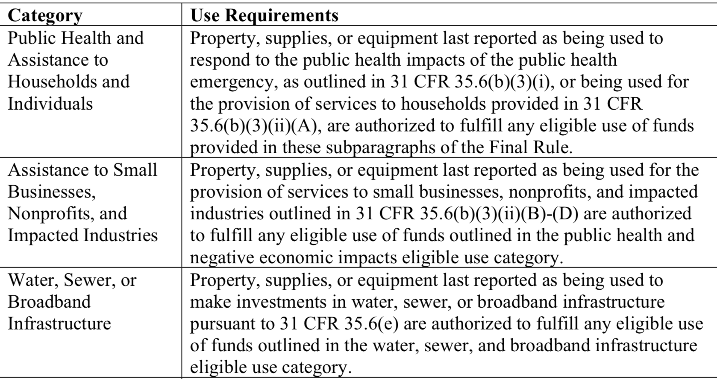
Use of Property
During Award Term
A local government “may use property, supplies, or equipment purchased or improved with [ARP/CSLFRF] funds for a purpose other than the purpose for which it was purchased or improved if such other purpose is also consistent with the eligible use requirements.”
After Award Term
“[T]he property, supplies, or equipment must be used consistent with the purpose for which it was purchased or improved or for any other eligible purpose in the same category as the purpose reported to Treasury as of the final reporting period, as set forth in the table below.”
Local governments are responsible for being able to substantiate their determinations on whether the use of an asset is authorized and maintain a record of that determination.
Local governments are not required to seek or obtain the approval of Treasury prior to changing the use within the parameters of the authorized purpose.

Slide 31
What if Sell Property or Change Use of Property Outside ARP/CSLFRF Parameters?
During Award Term
If a local government changes the use of an asset to an ineligible use or sells the asset prior to the end of the period of performance, then the local government must follow the disposition procedures in the Uniform Guidance. See 2 CFR 200.311, 200.313, 200.314, and 200.315.
After Award Term
If an asset’s use shifts outside the parameters of the eligible purpose according to the table after the grant term ends, then the local government (and any subrecipient) must follow the disposition procedures in the Uniform Guidance. See 2 CFR 200.311, 200.313, 200.314, and 200.315.
Real Property |  |  | Equipment |  |  | Supplies
Retain title and compensate US Treasury the “federal share” | Sell the property and compensate US Treasury the “federal share” | Transfer title to US Treasury or to a third party designated/ approved by US Treasury | If FMV of $5K or less, local government may retain, no compensation to US Treasury | If FMV over $5K must request disposition instructions from US Treasury. If US Treasury does not provide instructions within 120 days, may sell or use for different purpose, but must repay US Treasury “federal share” | Transfer title to US Treasury or to a third party designated/ approved by US Treasury | If there is a residual inventory of unused supplies exceeding $5,000 in total aggregate value upon termination or completion of the project and the supplies are not needed for any other Federal award, the local government must retain the supplies for use on other activities or sell them, but must, in either case, repay US Treasury “federal share”
Must get specific instructions from US Treasury on which option to take.

Slide 32
External Contract for Construction, Goods, or Services?
The Final Rule and Uniform Guidance group external payments of ARP/CSLFRF funds into 3 categories.
Contracts | Subawards | Beneficiary Payments
If a local government uses ARP/CLSRF funds to pay for an agreement with another entity (government, nonprofit, for profit) whereby the other entity provides goods or services for the benefit of the local government, it is a contractor relationship. The agreement is referred to as a “contract.” | If a local government uses ARP/CSLFRF funds to pay for an agreement with another entity (government, nonprofit, for profit) whereby the other entity carries out an ARP/CSLFRF eligible project instead of the local government, it is a subrecipient relationship. The agreement is a “subaward.” | If the payment is made directly to the beneficiary of an ARP/CSLFRF eligible project, it is neither a contract nor a subaward for federal regulatory purposes.
A local government must document whether an external agreement is a contract or subaward, according to this checklist.
Note that Uniform Guidance “contract” and “subaward” requirements
DO NOT APPLY to Revenue Replacement expenditures.

Slide 33
Subaward Process
Local Government “should develop written policies and procedures for subrecipient monitoring and risk assessment and maintain records of all award agreements identifying or otherwise documenting subrecipients’ compliance obligations.”
Sample Subaward Policy, Agreement, Risk Assessment, & Monitoring Plan
Determination of relationship: Subrecipient or Contractor
2 CFR 200.331
Risk Assessment
2 CFR 200-332(b)-(c)
Formation and issuance of subaward agreement
2 CFR 200.332(a)
Post-award monitoring
2 CFR 200.332(d)-(h)

Slide 34
Subaward Vocabulary
Recipient: Local government that received ARP/CLFRF award
Pass-through Entity: Local government that provides a subaward to a subrecipient to carry out part of the ARP/CLFRF award program
Subaward: Award provided by a pass-through entity to a subrecipient to carry out part of the ARP/CLFRF award received by the pass-through entity
Subrecipient: Entity the receives a subaward from a pass-through entity to carry out part of the ARP/CLFRF award program.

Slide 35
Subawards
Eligibility restrictions
Award terms and prohibitions
Uniform guidance requirements
Local Government
Partner Organization
Subawards are agreements between the pass-through entity (local government) and subrecipient (partner organization) setting the terms of the subrecipient’s performance duties.
All of the ARP/CSLFRF eligibility restrictions, award terms and prohibitions, and Uniform Guidance requirements flow down to the subrecipient.

Slide 36
Recipient (Local Government) / Subrecipient Relationship
A Subrecipient must:
Provide appropriate progress reports and financial reports to the LG
Be accountable to the LG for how it uses the federal funds provided under the subaward
Follow applicable federal rules regarding financial mgmt, internal controls, cost principles, and audit requirements
Collect and provide financial and performance data for the recipient to include in its reports to LG
A LG must require a subrecipient to comply with – and must monitor a subrecipient for compliance with – all the conditions and restrictions that apply to the ARP/CLFRF award.

Slide 37
Subrecipient Risk Assessment
Subrecipient must permit State agency and auditors to have access to the subrecipient's records and financial statements as necessary for the State agency to meet the risk assessment & monitoring requirements
1. CHECK SAM.GOV AND DOCUMENT THAT ENTITY IS NOT DISBARRED OR SUSPENDED
2. CHECK AND ADDRESS ANY CONFLICT OF INTEREST (2 C.F.R. 200.318(c)(1))
PRIOR AWARD EXPERIENCE
How familiar is State agency with entity?
How much experience does entity have implementing federal award programs?
How does entity’s experience relate to current program size?
PRIOR AUDIT EXPERIENCE
Has entity had a single audit or other recent audits?
Have any valid audit findings been corrected or resolved?
Risk Assessment
Does entity have personnel who are familiar with federal req’ts?
Does entity have seasoned finance directors and accounting staff?
Are entity’s systems for financial mgmt., purchasing, property mgmt., and records retention in place, well designed, and operational?
STAFFING & SYSTEMS
EXTENT OF ANY FEDERAL MONITORING
Can State agency build on existing monitoring framework of other federal awards?

Slide 38
Sample Mapping of Risk Assessment to Additional Compliance
Low Risk
Periodic review of financial and performance reports
Med. Risk
Payments on reimbursement basis
High Risk
Quarterly status meetings
Other action plans established by LG
Required technical training and assistance
More detailed financial reports
Review of financial mgmt. systems and policies and procedures to ensure adequacy to meet minimum requirements
Monthly financial, performance, and compliance reports
Follow-up an ensure timely action on all identified deficiencies detected through audits, on-site reviews, and other reports from subrecipient. (Document all follow-up)
Management decisions for applicable audit findings related to this award (2 CFR 200.521)
Arranging for procedures engagement, if subrecipient not subject to Single Audit (2 CFR 200.425)
Verify audits
Withholding authority to proceed to next phase until sign off on acceptable performance
Supporting documentation for all expenditures
Additional project monitoring
Minimum req’ts
All the above PLUS
Must notify subrecipient of add’l req’ts in subaward and state reason for them

Slide 39
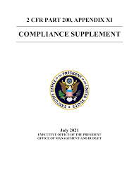
ARPA/CSLFRF & Audit Requirements
The Compliance Supplement dictates which UG compliance areas the auditors will test for each federal award.
BUT the auditee must still all award terms, even if not tested in the audit.
Compliance Supplement Appendix 2 includes examples of Control Activities
ARPA Compliance Supplement Resource
Notes:
Compliance supplement is a compendium of information available to auditors to identify the major compliance features of most federal award programs.
There are more than 220 in total, with guidance about how to audit those programs. The compliane requirements that are identified are ones that aduitors are required to check in conducting single audits. The procedures for doing so are up to them.
Part 6 focused on internal control responses to different compliance areas. This section procides

Slide 40
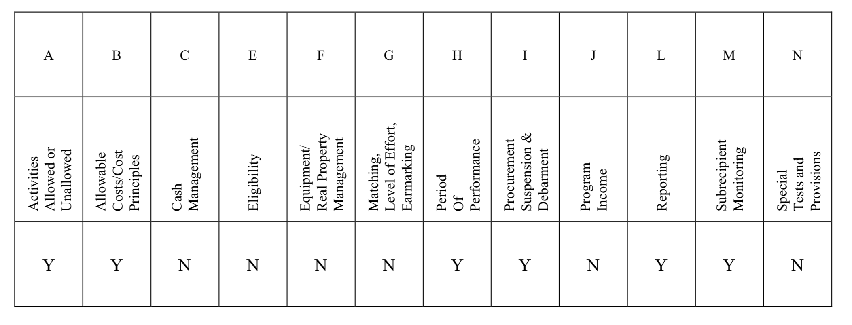
ARP/CSLFRF Alternative Compliance Examination
Not all UG compliance categories are tested, but compliance is still required
In other words, if the only reason you triggered a single audit is because of ARP/CSLFRF expenditures, and you received 10 million or less in ARP/CSLFRF funds, you are eligible for the alternative audit.
Notes:
Want to beef up internal control processes and procedures in all these areas.
If you have other fed
Auditor will issue a single compliance opinion
No required Schedule of Federal and State Awards (“SEFA”)
The submission deadline is the same as those for Single Audits
May elect to have a single audit
Compliance with the Uniform Guidance is required
eral awards, go to the compliance supplement and see what will be tested.

Slide 41
Single Audit ARP/CSLFRF Award
Not all UG compliance categories are tested, but compliance is still required
Notes:
You will need controls over all parts of the grant process, but you need really beefed up controls in the areas that will be tested in the single audit. For any federal grant, you can go to the compliance supplement and see which categories have a Y. This is for the ARP award. So we know the auditor will focus on these area of compliance.

Slide 42
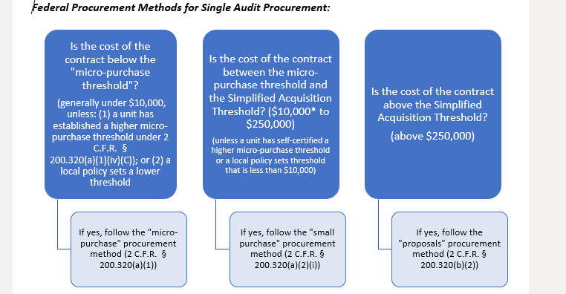
Procurement of Single Audit Services
Notes:
Three different procurement requirements based on the audit fee
Micro-purchase procurement is a non-competitive process, and a unit need not receive a certain number of proposals before awarding a contract. Even where the cost of a contract for audit services falls below the micro-purchase threshold, there is no minimum bid requirement. You must follow the other UG audit procurement requirements, but adequate number of binds in not one.
The non-Federal entity is required to solicit an “adequate number” of price or rate quotes before awarding a contract in this range.
Proposals requires the unit to undertake a formal request for proposal (“RFP”) process, which includes publicization of the RFP and receipt of proposals from an “adequate number” of “qualified offerors” (2-3 proposals, at minimum, are recommended).

Slide 43
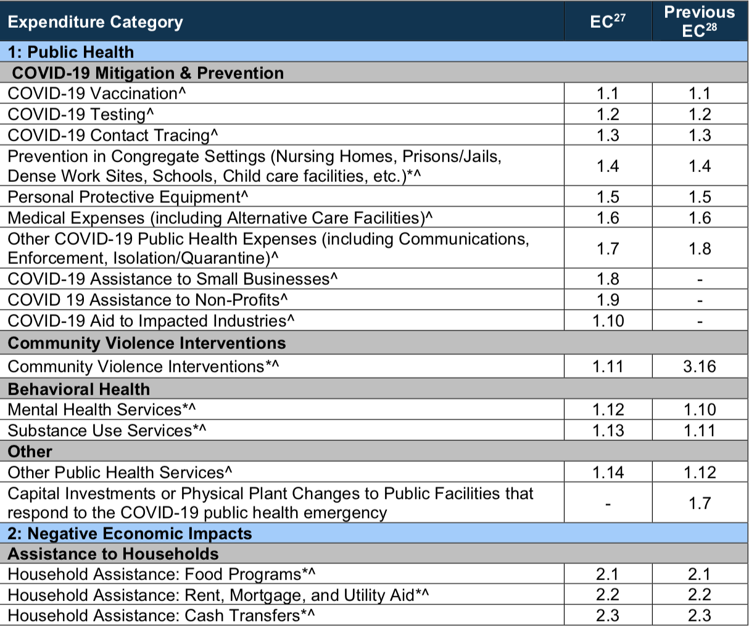
Project & Expenditure Report
Compliance Guide Lists Expenditure Categories (EC) within each broad grouping. Local government must align each project with one (and only one) EC
Must track data elements for certain ECs
* Projects that local government will report on amount of funds spent on evidenced-based projects
^ Projects that local government will report on number of disproportionately impacted beneficiaries

Slide 44
US Treasury Compliance Guidance
US Treasury Final Rule FAQs
US Treasury is routinely updating Final Rule FAQs, and compliance and reporting guidelines. Make sure you are relying on the most current guidance.
US Treasury Resource Page
Assistance Listing (21.027)
Final Rule
UG Compliance Supplement
SOG Resources
Coates Canons Blogs
ARP Website
US Treasury Final Rule Summary
ARP/CSLFRF
Where to go for the latest guidance on ARP/CLFRF

