Slide 1
Program Income for Water & Wastewater Projects
What constitutes program income?
How to manage program income?
Because some water and wastewater projects funded in whole or in part with ARP/CSLFRF will cause new revenues to be generated, UG program income requirements may apply.
When does program income apply?

Slide 2
ARP/CSLFRF Spending Categories
ADDRESS COVID PUBLIC HEALTH & NEGATIVE ECONOMIC IMPACT
Support public health expenditures, by funding COVID-19 mitigation efforts, medical expenses, behavioral healthcare, and certain public health and safety staff;
Address negative economic impacts caused by the public health emergency, including economic harms to workers, households, small businesses, impacted industries, and the public sector;
Support disproportionately impacted communities
REPLACE LOST REVENUE
Replace lost public sector revenue, using this funding to provide government services to the extent of the reduction in revenue experienced due to the pandemic;
$10 million standard allowance OR formula approach
PREMIUM PAY
Provide premium pay for essential workers, offering additional support to those who have borne and will bear the greatest health risks because of their service in critical infrastructure sectors;
Target low-and moderate- income employees or employees who face(d) added risks during pandemic
INFRASTRUCTURE INVESTMENTS
Invest in water, sewer, and broadband infrastructure, making necessary investments to improve access to clean drinking water, support vital wastewater and stormwater infrastructure, and to expand access to broadband internet.
Know Your Category!

Slide 3
Federal Compliance Requirements
Award Terms | Prohibited Expenditures | Uniform Guidance (UG)
All funds obligated by December 31, 2024 & fully expended by December 31, 2026 Reporting requirements Project & Expenditure reports (quarterly or yearly, depending on size) -- Document data elements for certain EC’s Performance Plan reports (for largest units only) Civil rights compliance / nondiscrimination policy Compliance with all applicable Uniform Guidance provisions Records retention policy with retention for at least 5 years after award term ends Special audit requirements Other federal laws | NO: Pension fund contributions NO: Borrowing money NO: Financial reserves / rainy day fund NO: Settlement/judgement/consent decree NO: Undermines or discourages compliance with CDC guidelines NO: Violates conflict of interest provisions NO: Violates state law or other federal laws and regulations, including applicable Uniform Guidance | General Financial Management Internal Controls Eligible Projects Determination & Documentation Policy Cost Principles/Allowable Costs Policy Procurement, Suspension, & Debarment Policy Subaward Policy Program Income Policy Property Management Policy
Applies to ALL projects
Applies ONLY TO SOME projects and DOES NOT apply to Revenue Replacement
What local government agreed to as condition of receiving funds. Applies to ALL categories.
The Final Rule prohibits certain expenditures no matter what. Applies to ALL categories
Set of federal compliance regulations that apply to federal awards.

Slide 4
ARP/CSLFRF Spending Categories & Compliance Requirements
ADDRESS COVID PUBLIC HEALTH & NEGATIVE ECONOMIC IMPACT
Basic compliance requirements
REVENUE REPLACEMENT
Basic compliance requirements
PREMIUM PAY
Basic compliance requirements
NECESSARY INFRASTRUCTURE INVESTMENTS
Basic compliance requirements
Award terms and conditions
Specific cost item regulations
UG procurement
UG program income
UG property management
UG subawards
Prohibited expenditures
Award terms and conditions
Prohibited expenditures
Award terms and conditions
Prohibited expenditures
Specific cost item regulations
UG procurement
UG program income
UG property management
UG subawards
Award terms and conditions
Prohibited expenditures
Specific cost item regulations
UG procurement
UG program income
UG property management
UG subawards

Slide 5
ARP/CSLFRF Spending Categories & Compliance Requirements
ADDRESS COVID PUBLIC HEALTH & NEGATIVE ECONOMIC IMPACT
Basic compliance requirements
REVENUE REPLACEMENT
Basic compliance requirements
PREMIUM PAY
Basic compliance requirements
NECESSARY INFRASTRUCTURE INVESTMENTS
Basic compliance requirements
Award terms and conditions
Specific cost item regulations
UG procurement
UG program income
UG property management
UG subawards
Prohibited expenditures
Award terms and conditions
Prohibited expenditures
Award terms and conditions
Prohibited expenditures
Specific cost item regulations
UG procurement
UG program income
UG property management
UG subawards
Award terms and conditions
Prohibited expenditures
Specific cost item regulations
UG procurement
UG program income
UG property management
UG subawards

Slide 6
Is there Program Income?
Program income does not apply to Revenue Replacement Category!
Did we fund at least part of water / wastewater project with necessary infrastructure category ARP/CSLFRF?
Did the ARP/CSLFRF-funded water / wastewater project cause the LG to generate NEW revenues?
Are the new revenues from “fees for services” or “rental fees”?
Is there an exemption that applies (taxes, special assessments, system development fees, and similar charges)?
If YES
Program income does not apply if no new revenues generated from project
If YES
If YES
If NO
PROGRAM INCOME

Slide 7
Program Income
2 C.F.R. § 200.1
Program income must be tied to grant-funded asset and only applies through December 31, 2026
Program income means gross income earned by the non-Federal entity that is directly generated by a supported activity or earned as a result of the Federal award during the period of performance except as provided in § 200.307(f). (See the definition of period of performance in this section.)
Program income includes but is not limited to income from fees for services performed, the use or rental of real or personal property acquired under Federal awards, the sale of commodities or items fabricated under a Federal award, license fees and royalties on patents and copyrights, and principal and interest on loans made with Federal award funds.
Interest earned on advances of Federal funds is not program income. Except as otherwise provided in Federal statutes, regulations, or the terms and conditions of the Federal award, program income does not include rebates, credits, discounts, and interest earned on any of them. See also § 200.407.
What is fee for service?
Some good news! You can keep all your interest and it is not considered grant funds

Slide 8
Program Income
2 C.F.R. § 200.207
(a) General. Non-Federal entities are encouraged to earn income to defray program costs where appropriate.
(b) Cost of generating program income. If authorized by Federal regulations or the Federal award, costs incidental to the generation of program income may be deducted from gross income to determine program income, provided these costs have not been charged to the Federal award.
(c) Governmental revenues. Taxes, special assessments, levies, fines, and other such revenues raised by a non-Federal entity are not program income unless the revenues are specifically identified in the Federal award or Federal awarding agency regulations as program income.
(d) Property. Proceeds from the sale of real property, equipment, or supplies are not program income; such proceeds will be handled in accordance with the requirements of the Property Standards §§ 200.311, 200.313, and 200.314, or as specifically identified in Federal statutes, regulations, or the terms and conditions of the Federal award.
Some revenues are exempt!
The sale of real or personal property funded with ARP/CSLFRF is covered by UG property management requirements instead

Slide 9
Program Income
2 C.F.R. § 200.207
(e) Use of program income. If the Federal awarding agency does not specify in its regulations or the terms and conditions of the Federal award, or give prior approval for how program income is to be used, paragraph (e)(1) of this section must apply. …. In specifying alternatives to paragraphs (e)(1) and (2) of this section, the Federal awarding agency may distinguish between income earned by the recipient and income earned by subrecipients and between the sources, kinds, or amounts of income. When the Federal awarding agency authorizes the approaches in paragraphs (e)(2) and (3) of this section, program income in excess of any amounts specified must also be deducted from expenditures.
(1) Deduction. Ordinarily program income must be deducted from total allowable costs to determine the net allowable costs. Program income must be used for current costs unless the Federal awarding agency authorizes otherwise. Program income that the non-Federal entity did not anticipate at the time of the Federal award must be used to reduce the Federal award and non-Federal entity contributions rather than to increase the funds committed to the project.
(2) Addition. With prior approval of the Federal awarding agency (except for IHEs and nonprofit research institutions, as described in this paragraph (e)) program income may be added to the Federal award by the Federal agency and the non-Federal entity. The program income must be used for the purposes and under the conditions of the Federal award.
(3) Cost sharing or matching. With prior approval of the Federal awarding agency, program income may be used to meet the cost sharing or matching requirement of the Federal award. The amount of the Federal award remains the same.

Slide 10
Program Income
Treasury FAQs
13.11. How does Treasury treat program income?
Per 2 CFR 200.307, Treasury is specifying here that recipients may add program income to the Federal award. Any program income generated from SLFRF funds must be used for the purposes and under the conditions of the Federal award.
Program income includes but is not limited to income from fees for services performed, the use or rental of real or personal property acquired under federal awards, the sale of commodities or items fabricated under a federal award, license fees and royalties on patents and copyrights, and principal and interest on loans made with federal award funds. Interest earned on advances of federal funds is not program income. For more information on what constitutes “Program Income” please see 2 CFR 200.1.
13.15. Which requirements of the Uniform Guidance apply to revenue loss funds?
….
The program income requirements of 2 CFR 200.307 do not apply under revenue loss eligible use category. As such, recipients may maintain program income, which will not be considered an addition to the federal award.
Program income is subject to all the grant requirements, including eligible use, compliance, and obligation & expenditure deadlines

Slide 11
Is there Program Income?
Did we fund at least part of water / wastewater project with necessary infrastructure category ARP/CSLFRF?
Did the ARP/CSLFRF-funded water / wastewater project cause the LG to generate NEW revenues?
Are the new revenues from “fees for services” or “rental fees”?
Is there an exemption that applies (taxes, special assessments, system development fees, and similar charges)?
If YES
If YES
If YES
If NO
PROGRAM INCOME

Slide 12
ARP/CSLFRF Spending Categories & Compliance Requirements
ADDRESS COVID PUBLIC HEALTH & NEGATIVE ECONOMIC IMPACT
Basic compliance requirements
REVENUE REPLACEMENT
Basic compliance requirements
PREMIUM PAY
Basic compliance requirements
NECESSARY INFRASTRUCTURE INVESTMENTS
Basic compliance requirements
Award terms and conditions
Specific cost item regulations
UG procurement
UG program income
UG property management
UG subawards
Prohibited expenditures
Award terms and conditions
Prohibited expenditures
Award terms and conditions
Prohibited expenditures
Specific cost item regulations
UG procurement
UG program income
UG property management
UG subawards
Award terms and conditions
Prohibited expenditures
Specific cost item regulations
UG procurement
UG program income
UG property management
UG subawards
Water & wastewater capital projects
Water & wastewater capital projects

Slide 13
Is there Program Income?
Did we fund at least part of water / wastewater project with necessary infrastructure category ARP/CSLFRF?
Did the ARP/CSLFRF-funded water / wastewater project cause the LG to generate NEW revenues?
Are the new revenues from “fees for services” or “rental fees”?
Is there an exemption that applies (taxes, special assessments, system development fees, and similar charges)?
If YES
If YES
If YES
If NO
PROGRAM INCOME

Slide 14
INFRASTRUCTURE INVESTMENTS
Presumed Eligible:
Projects allowed under Clean Water State Revolving Fund (CWSRF) and Drinking Water State Revolving Fund (DWSRF) programs
Must be Necessary

Slide 15
Infrastructure Investments: Additional Eligibility
Stormwater
Culvert repair, resizing, and removal, replacement of storm sewers, etc.
Residential Wells
Testing initiatives, and treatment/remediation strategies that address contamination
Lead Remediation
Eligible regardless of water quality benefit
Infrastructure to improve access to drinking water
Replacement of internal plumbing and fixtures in schools and childcare facilities
Projects regardless of pipe material, but full length of service line must be replaced
Lead testing, lead service line replacement, water quality testing, compliance monitoring, and remediation activities
Dam & Reservoir Remediation
Primary purpose of dam or reservoir is for drinking water supply
May consider reasonable population growth
Drinking Water Infrastructure
Designed to support reasonable growth only
Must be cost-effective to achieve a minimum level of service
Must be sustainable over its estimated useful life
Must be Necessary
Responsive to an identified need to achieve or maintain an adequate minimum level of service, which may include a reasonable projection of increased need, whether due to population growth or otherwise,
A cost-effective means for meeting that need, taking into account available alternatives, and
For investments in infrastructure that supply drinking water in order to meet projected population growth, projected to be sustainable over its estimated useful life.

Slide 16
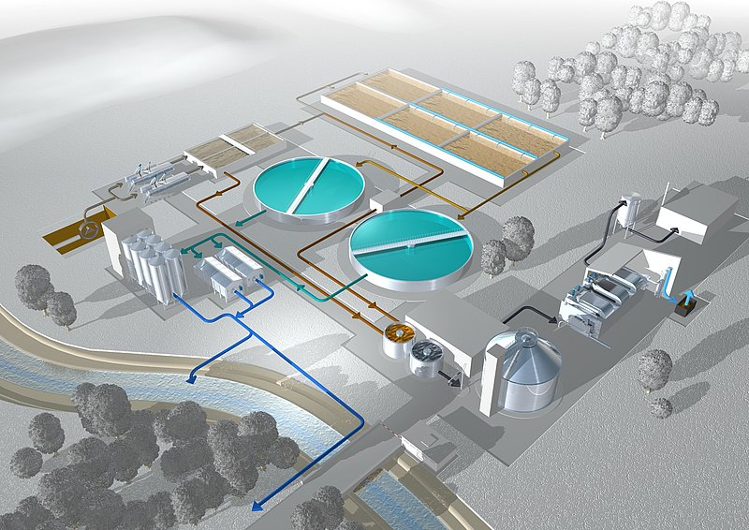
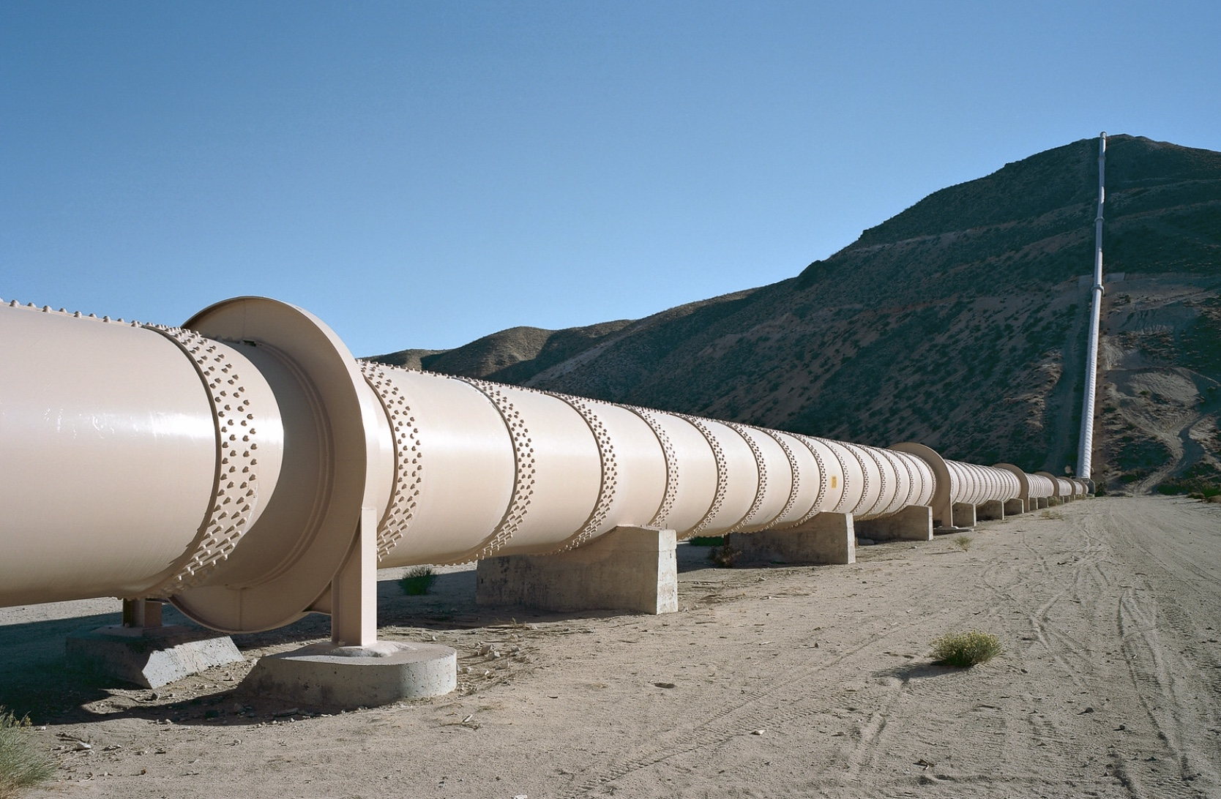
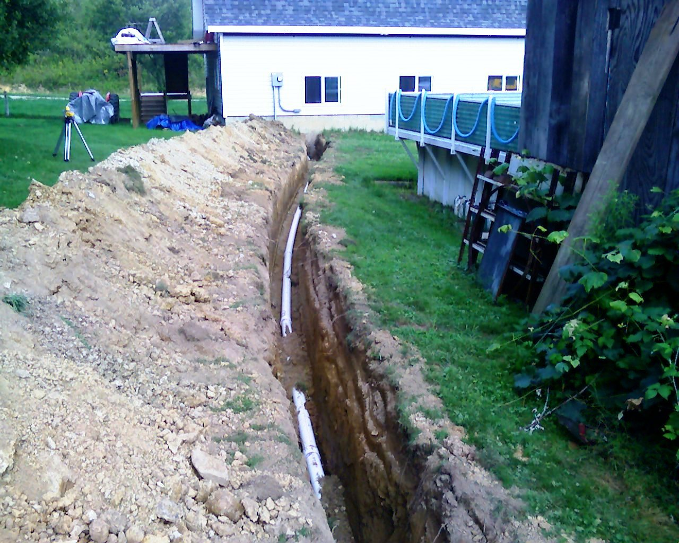
Energy efficiency improvements to wastewater treatment system?
Purchase of leak detection devices & equipment?
Installation of alternative interconnection in case of emergency or drought?
Existing Water/Wastewater System (with existing customer base)
ARP/CSLFRF-Funded Project Completed
New Customers OR
Higher Fees for Existing Customers DUE to ARP/CSLFRF project
January 1, 2027
Extension of water line to serve existing subdivision with well water contamination?
Program Income

Slide 17
What if we use ARP/CSLFRF funds only for preliminary costs of project – does program income still apply?
6.10. May recipients use funds for pre-project development for eligible water, sewer, and broadband projects?
Yes. To determine whether funds can be used on pre-project development for an eligible water or sewer project, recipients should consult whether the pre-project development use or cost is eligible under the Drinking Water and Clean Water State Revolving Funds (DWSRF and CWSRF, respectively). Generally, the CWSRF and DWSRF often allow for pre-project development costs that are tied to an eligible project, as well as those that are reasonably expected to lead to a project. For example, the DWSRF allows for planning and evaluations uses, as well as numerous pre-project development costs, including costs associated with obtaining project authorization, planning and design, and project start-up like training and warranty for equipment. Likewise, the CWSRF allows for broad pre- project development, including planning and assessment activities, such as cost and effectiveness analyses, water/energy audits and conservation plans, and capital improvement plans.
Similarly, pre-project development uses and costs for broadband projects should be tied to an eligible broadband project or reasonably expected to lead to such a project. For example, pre-project costs associated with planning and engineering for an eligible broadband infrastructure build-out is considered an eligible use of funds, as well as technical assistance and evaluations that would reasonably be expected to lead to commencement of an eligible project (e.g., broadband mapping for the purposes of finding an eligible area for investment).
All funds must be obligated by recipients within the statutory period between March 3, 2021 and December 31, 2024, and expended to cover such obligations by December 31, 2026.
If you can separate a project into distinct parts and only use ARP/CSLFRF funds for pre-project development, NO PROGRAM INCOME applies even if unit generates new fee for service revenue from completed project

Slide 18
Is there Program Income?
Program income does not apply to Revenue Replacement Category!
Did we fund at least part of water / wastewater project with necessary infrastructure category ARP/CSLFRF?
Did the ARP/CSLFRF-funded water / wastewater project cause the LG to generate NEW revenues?
Are the new revenues from “fees for services” or “rental fees”?
Is there an exemption that applies (taxes, special assessments, fines, and similar charges)?
If YES
Program income does not apply if no new revenues generated from project
If YES
If YES
If NO
PROGRAM INCOME

Slide 19
Water & Wastewater Fee Authority
General Fee Authority: A LG utility “may establish, revise and collect rates, fees or other charges and penalties for the use of or the services furnished or to be furnished by…. [the water and/or sewer utility system]”
But, there is specific fee authority & limitations for System Development Fees, Availability Fees, and Regulatory Fees

Slide 20
System Develop-ment Fees
Contractual Charges
Connection / Tap Fees
User Fees
Availability Fees
Regulatory Fees
Special Assess-ments
Assessed to cover costs of inspections, plan reviews, etc.
Assessed on property owner at time of connection to cover costs of connection
Assessed on “new development” to cover past or future capital costs necessary to serve/continue to serve “new development”
Reimbursement charges for capital projects that benefit assessed properties
Assessed pursuant to a contract with developer or property owner to extend water/sewer lines to property or do system changes / expansions to serve property
Assessed on water/sewer utility customers—typically has fixed and variable component
Assessed on certain properties when water/sewer available but property owners choose not to connect

Slide 21
What are Water / Wastewater ”Fees for Services?”
Program Income | Grey Area | NOT Program Income
Specified user fees* charged to new customers (due specifically to the ARP/CSLFRF funded project) Increased specified user fees* (due specifically to the ARP/CSLFRF funded project) for existing customers | Connection / hook-up charges | Special assessments Tax revenues System development fees Availability fees Regulatory fees Contractual charges for infrastructure Charges to other local governments to reserve capacity Penalty charges

Slide 22
*Program Income User Fees
Application/new account fee (to set up account)
Deposit fee (to mitigate risk if default occurs)
Monthly/bi-monthly fee (fixed and variable components)
Convenience fee (for payment by phone or electronically)
Credit card surcharge fee (for payment by credit card; only if credit card company allows)
Late fee(s)
Cut-off fee (assessed if service actually cut off)
Reconnection fee (to restore service after payment made)
Account change fee (to make changes on account)
Meter tampering fee
Inspection Fees
Other?

Slide 23
We’ve got Program Income, Now What?
Identify amount of gross proceeds of program income through December 31, 2026
Separately track and retain program income in separate fund
Report on program income earned per project in quarterly P&E report
Add program income amounts to total ARP/CSLFRF award
Budget program income for ARP/CSLFRF-eligible project(s)
Follow all award terms, timing, and compliance requirements
Eg. Must obligate program income by December 31, 2024 and expend it by December 31, 2026.
May be budgeted towards same project or a different eligible project
Local government must adopt and implement program income policy to ensure appropriate internal controls.
Will have to estimate amount of program income earned between December 31, 2024 and December 31, 2026

Slide 24
What if award funding to another local government for water / wastewater system that generates program income?
Eligibility restrictions
Award terms and prohibitions
Uniform guidance requirements
Local Government
Partner Local Government
UG Subaward Requirements Apply
Subawards are agreements between the pass-through entity (local government) and subrecipient (partner organization) setting the terms of the subrecipient’s performance duties.
All of the ARP/CSLFRF eligibility restrictions, award terms and prohibitions, and Uniform Guidance requirements flow down to the subrecipient.
The partner local government must separately track program income and return to the originating local government (or use towards original project costs if specified by originating local government). The originating local government must appropriate the program income for an ARP/CSLFRF-eligible purpose.

Slide 25
What if local government uses ARP/CSLFRF to fund water / waster project that generates program income and leases to another local government to operate?
If the project generates program income, the operating local government must segregate the program income (gross fee for service proceeds) and return to the originating local government for appropriation to another ARP/CSLFRF-eligible project.
Appropriate Revenue Replacement funds to operating local government to make up shortfall
Delay new customer connections until after December 31, 2026
Appropriate general fund (non-grant) monies to operating local government to make up shortfall
Subaward ARP/CSLFRF funds to operating local government for another ARP/CSLFRF-eligible project

