Slide 1
Budgeting
Kara A. Millonzi
millonzi@sog.unc.edu
Fall 2017

Slide 2
LGBFCA
Budgeting
Cash Management & Investments
Obligating & Disbursing Public Funds
Accounting & Financial Reporting
Auditing

Slide 3
Why Budget?

Slide 4
Annual Budget Ordinance
Capital Budget

Slide 5
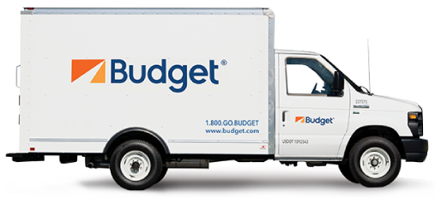
Annual Budget Ordinance
Single Fiscal Year
Operating and Capital Expenses
Grant Ordinance
Life of the Grant/Project
Project Ordinance
Life of the Project
Capital Projects Only
Projects Funded at Least in Part with Grant $ Only
Operating and Capital Expenses
Capital Expenses
Appropriations by Department, Function, or Project
Revenues by Major Source

Slide 6
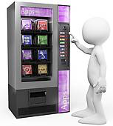
Vending Machine Rule
“[A]ll moneys received and expended by a local government or public authority should be included in the budget ordinance [or project ordinance]. . . No local government or public authority may expend any moneys, regardless of their source, except in accordance with a budget ordinance or project ordinance….”
Exceptions:
Moneys accounted for intragovernmental service fund
Moneys accounted for in a trust or agency fund

Slide 7
Area Authority for MH/DD/SA to support its work with those in the community suffering with substance abuse issues. The authority’s director deposits the money in the area authority’s bank account and directs the finance officer to expend the funds for a program targeted to teens with substance abuse issues.
Lawful?

Slide 8
A grateful senior citizen makes a $150 cash contribution to the city’s parks and recreation department. The citizen requests that the funds be used to purchase a new coffee machine for the department. The request is well documented. The department head orders the coffee machine. The expenditure is well documented, with appropriate receipts. It is reported to the governing board at their next meeting.
Lawful?

Slide 9
Annual Budget Ordinance
Estimated Net Revenues
Appropriations
Appropriated Fund Balance

Slide 10
Estimated Net Revenues
Appropriations
Appropriated Fund Balance
By Major Source
“Appropriated fund balance in any fund shall not exceed the sum of cash and investments minus the sum of liabilities, encumbrances, and deferred revenues arising from cash receipts, as those figures stand at the close of the fiscal year next preceding the budget year.”
By Department, Function, or Project

Slide 11
Budget Timeline
Budget Retreats / Pre-planning / Citizen Input
Department Heads Submit Budget Requests to Budget Officer (By April 30)
Budget Officer Submits Proposed Budget to Board (By June 1)
Clerk Publishes Notice of Public Hearing and Makes Copy Available for Inspection
Board Holds Public Hearing
Board Adopts Budget Ordinance (at least 10 days after proposed budget submitted)
Budget Ordinance Effective July 1
Budget Ordinance Expires June 30

Slide 12
The FY 2017-18 budget ordinance includes an appropriation authorizing the health department to spend $100,000 on supplies. As of June 2017, the department has $12,000 remaining in this appropriation. It orders goods in late June to spend most of the remaining money. The goods do not arrive until July and payment is due in August 2017.
May the department pay the bill based on the budgetary authorization in the FY 2017-18 budget ordinance?

Slide 13
Budget Requirements
Debt Service
Continuing Contracts
Levy Property Taxes*
Contingency Appropriations <=5%

Slide 14
Interim Budget
Authorizes the payment of “salaries, debt service payments, and usual ordinary expenses” of the unit until the budget ordinance is adopted.

Slide 15
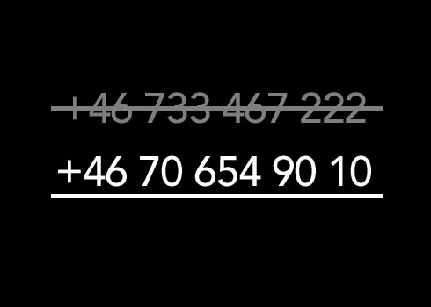
Budget Amendments
Board may amend at any time
Limits on property tax rate changes
Prohibitions against reducing school appropriations, with certain exceptions (counties only)
Prohibition against changing board members’ compensation

Slide 16
The board adopted the budget ordinance on June 12, 2017. It included a 2% property tax increase, as well as a increase in the compensation paid to board members. Within a few days, after hearing from many angry constituents, a majority of board members have changed their minds and want to amend the budget to reduce the property tax rate increase to 1% and eliminate the raise for board members.
Can the board amend the budget ordinance to make these changes? Does your answer depend on whether or not the amendment is done before or after July 1?

Slide 17
Why a separate budgeting process for capital projects?

Slide 18
Annual Budget Ordinance
Capital Budget
Single fiscal year | Life of the project
Short-term plan | Longer-term considerations
“Smooth” revenue/spending trend lines | Spikes in revenue/spending
Traditional revenue sources | Special revenue sources
Capital Budget Threshold

Slide 19
Annual Budget Ordinance
Single Fiscal Year
Operating and Capital Expenses
Grant Ordinance
Life of the Grant/Project
Project Ordinance
Life of the Project
Capital Projects Only
Projects Funded at Least in Part with Grant $ Only
Operating and Capital Expenses
Capital Expenses
Appropriations by Department, Function, or Project
Revenues by Major Source

Slide 20
Grant / Project Ordinance Adoption
Adopt ordinance at any time during year
Enter in Board Minutes
Files Copies with Finance Officer, Clerk, Budget Officer (within 5 days)
Include updates in annual budget ordinances

Slide 21
Grant / Project Ordinance
Identify project
Authorize undertaking
Identify revenues
Make appropriations
Balanced

Slide 22
Capital Improvement Program (CIP)
Multi-year forecast of capital projects and funding sources

Slide 23
Community Vision
Capital Needs
Capital Financing Strategy
Capital Improvement Program

Slide 24
Capital Improvement Program (CIP)
Identify Capital Needs
Prioritize Projects
Adopt Multi-year Plan
Identify Potential Funding Sources
Fund Current Year Projects
Implement Projects
Community Vision
Asset Inventory
Assess Operating Budget Impacts
Manage Assets

Slide 25
Who?
Prioritization?
Funding Tradeoffs?
How Often?

Slide 26
CIP in 2 Parts
Current Year’s Budget
CFY-1
Adopted Budget
CFY
Planning Year 1
CFY+1
Planning Year 2
CFY+2
Planning Year 3
CFY+3
Planning Year 4
CFY+4
Actual Budgeted Amounts
Projections (Non-binding)

Slide 27
CIP
Project | CFY-1 | CFY (Budget) | CFY+1 | CFY+2 | CFY+3 | CFY+4 | CFY+…. | Total
Project A | $250,000 | $50,000 | $50,000 | $22,000 |  |  |  | $372,000
Project B |  |  | $450,000 |  |  |  |  | $450,000
Project C |  | $150,000 | $150,000 | $150,000 | $150,000 | $150,000 |  | $750,000
Project D |  |  |  | $1.6 m | $1.6m | $1.6m | $27.2m | $32m
Total | $250,000 | $200,000 | $650,000 | $1.77m | $1.75m | $1.75m | $27.20m | $33.57m

Slide 28
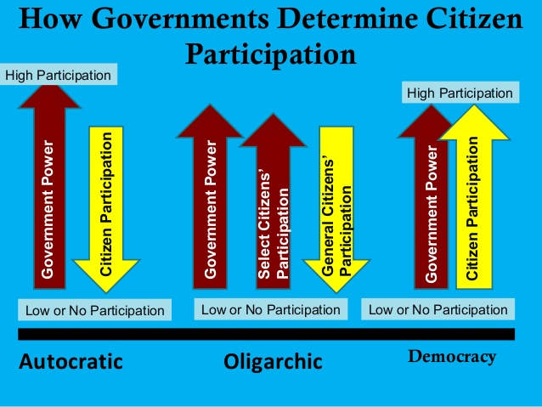
Citizen Participation

Slide 29
