Slide 1
Davis Bacon Wage Req’ts DO NOT APPLY to ARP/CSLFRF
But may apply if other federal grant funds also used for same project
But for certain projects, LGs must document wage and labor standards
6.15. Are eligible water, sewer, and broadband infrastructure projects, eligible capital expenditures under the public health and negative economic impacts eligible use category, and eligible projects under the revenue loss eligible use category subject to the Davis-Bacon Act?
The Davis-Bacon Act requirements (prevailing wage rates) do not apply to projects funded solely with award funds from the SLFRF program, except for SLFRF-funded construction projects undertaken by the District of Columbia. . . . Recipients may be otherwise subject to the requirements of the Davis-Bacon Act when SLFRF award funds are used on a construction project in conjunction with funds from another federal program that requires enforcement of the Davis-Bacon Act. Additionally, corollary state prevailing-wage-in-construction laws (commonly known as “baby Davis-Bacon Acts”) may apply to projects. Please refer to FAQ #4.8 concerning projects funded with both SLFRF funds and other sources of funding.
Treasury has indicated in its final rule that it is important that capital expenditure projects and necessary investments in water, sewer, or broadband infrastructure be carried out in ways that produce high-quality results, avert disruptive and costly delays, and promote efficiency. Treasury encourages recipients to ensure that capital expenditure projects and water, sewer, and broadband projects use strong labor standards, including project labor agreements and community benefits agreements that offer wages at or above the prevailing rate and include local hire provisions, not only to promote effective and efficient delivery of high-quality projects, but also to support the economic recovery through strong employment opportunities for workers. Using these practices in projects may help to ensure a reliable supply of skilled labor that would minimize disruptions, such as those associated with labor disputes or workplace injuries. Treasury has also indicated in its reporting guidance that recipients will need to provide documentation of wages and labor standards for capital expenditure projects and infrastructure projects over $10 million, and that that these requirements can be met with certifications that the project is in compliance with the Davis-Bacon Act (or related state laws, commonly known as “baby Davis-Bacon Acts”) and subject to a project labor agreement.

Slide 2
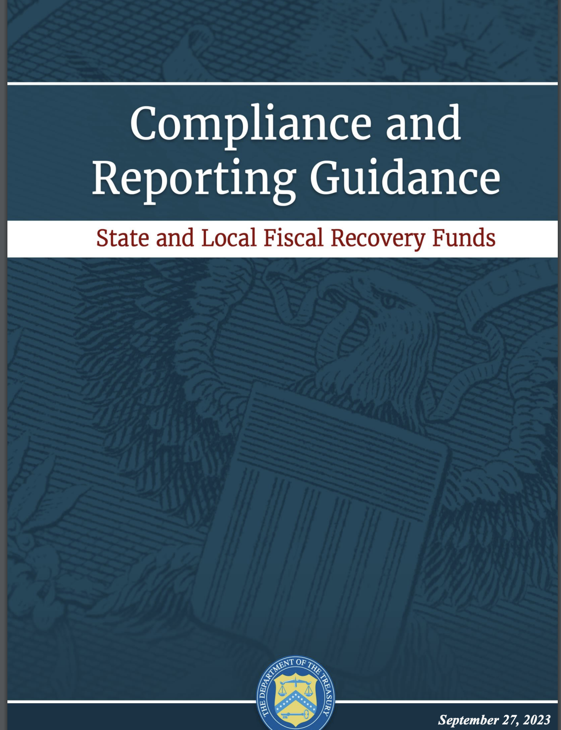
Required Wage Data for Water, Sewer, Stormwater, Broadband Projects (EC 5) over $10 million (based on expected total cost):
Document compliance with Davis-Bacon (or baby Davis-Bacon) prevailing wages for all laborers and mechanics employed by contractors and subcontractors
-Or-
Complete a project employment and local impact report detailing:
The number of employees of contractors and sub-contractors working on the project;
The number of employees on the project hired directly and hired through a third party;
The wages and benefits of workers on the project by classification; and
Whether those wages are at rates less than those prevailing.
Recipients must maintain sufficient records to substantiate this information upon request.
1
2

Slide 3
As of October 23, 2023, new regulations for Davis-Bacon wage calculations
Required Wage Data for Water, Sewer, Stormwater, Broadband Projects (EC 5) over $10 million (based on expected total cost):
Document compliance with Davis-Bacon (or baby Davis-Bacon) prevailing wages for all laborers and mechanics employed by contractors and subcontractors
-Or-
Complete a project employment and local impact report detailing:
The number of employees of contractors and sub-contractors working on the project;
The number of employees on the project hired directly and hired through a third party;
The wages and benefits of workers on the project by classification; and
Whether those wages are at rates less than those prevailing.
Recipients must maintain sufficient records to substantiate this information upon request.
1
2

