Slide 1


Slide 2
Federal Compliance Requirements
Award Terms | Prohibited Expenditures | Uniform Guidance (UG)
All funds obligated by December 31, 2024 & fully expended by December 31, 2026 Reporting requirements Project & Expenditure reports (quarterly or yearly, depending on size) -- Document data elements for certain EC’s Performance Plan reports (for largest units only) Civil rights compliance / nondiscrimination policy Compliance with all applicable Uniform Guidance provisions Records retention policy with retention for at least 5 years after award term ends Special audit requirements Other federal laws | NO: Pension fund contributions NO: Borrowing money NO: Financial reserves / rainy day fund NO: Settlement/judgement/consent decree NO: Undermines or discourages compliance with CDC guidelines NO: Violates conflict of interest provisions NO: Violates state law or other federal laws and regulations, including applicable Uniform Guidance | General Financial Management Internal Controls Eligible Projects Determination & Documentation Policy Cost Principles/Allowable Costs Policy Procurement, Suspension, & Debarment Policy Subaward Policy Program Income Policy Property Management Policy
Applies to ALL projects
Applies ONLY TO SOME projects and DOES NOT apply to Revenue Replacement
What local government agreed to as condition of receiving funds. Applies to ALL categories.
The Final Rule prohibits certain expenditures no matter what. Applies to ALL categories
Set of federal compliance regulations that apply to federal awards.

Slide 3
Did You Use non-Revenue Replacement ARP/CSLFRF to…..
Purchase real property (or any interest in real property)?
Renovate, expand, repair, maintain, improve real property?
Purchase equipment?
Purchase supplies?
Acquire intangible property (such as trademarks, licenses, copyrights, patents and patent applications, lease agreements)?
Triggers Uniform Guidance Property Management Requirements
May Trigger Uniform Relocation Assistance and Real Property Acquisitions Act of 1970 (applies to revenue replacement too)
May Trigger Extra Documentation/Justification Requirements (based on Expenditure Categories)

Slide 4
Property Management
Definitions of Property
2 CFR 200.1
Computing devices: machines used to acquire, store, analyze, process, and publish data and other information electronically, including accessories (or “peripherals”) for printing, transmitting and receiving, or storing electronic information. See also the definitions of supplies and information technology systems in this section.
Equipment: tangible personal property (including information technology systems) having a useful life of more than one year and a per-unit acquisition cost which equals or exceeds the lesser of the capitalization level established by the [county/City/Town/Village] for financial statement purposes, or $5,000. See also the definitions of capital assets, computing devices, general purpose equipment, information technology systems, special purpose equipment, and supplies in this section.
Information technology systems: computing devices, ancillary equipment, software, firmware, and similar procedures, services (including support services), and related resources. See also the definitions of computing devices and equipment in this section.
Intangible property: property having no physical existence, such as trademarks, copyrights, patents and patent applications and property, such as loans, notes and other debt instruments, lease agreements, stock and other instruments of property ownership (whether the property is tangible or intangible).
Personal property: property other than real property. It may be tangible, having physical existence, or intangible.
Property: real property or personal property.
Real property: land, including land improvements, structures and appurtenances thereto, but excludes moveable machinery and equipment.
Supplies: all tangible personal property other than those described in the definition of equipment in this section. A computing device is a supply if the acquisition cost is less than the lesser of the capitalization level established by the local government for financial statement purposes or $5,000, regardless of the length of its useful life. See also the definitions of computing devices and equipment in this section.

Slide 5

Property Management
Title vests in recipient (local government); May NOT be encumbered during award term
01
Real property: land, including land improvements, structures and appurtenances thereto, but excludes moveable machinery and equipment.
Must be used for ARP/CSLFRF-eligible purpose
Equipment: tangible personal property (including information technology systems) having a useful life of more than one year and a per-unit acquisition cost which equals or exceeds the lesser of the capitalization level established by the [county/City/Town/Village] for financial statement purposes, or $5,000.
02
Must be insured in same way as other local government property
Supplies: all tangible personal property other than those described in the definition of equipment in this section. A computing device is a supply if the acquisition cost is less than the lesser of the capitalization level established by the local government for financial statement purposes or $5,000, regardless of the length of its useful life.
03

Slide 6
Equipment
Equipment Tracking Database
Description of Equipment
Serial number, model number, other ID number
FAIN for ARP/CSLFRF: SLFRP0002
Statement that title vests in local government
Acquisition date & cost
Info that would permit the calculation of federal share % (if other funds also contributed to cost)
Location and condition of equipment (and date last inventoried/inspected)
Disposition data (if applicable), including date, sales price, and method used to calculate fair market value, and federal share
01
Maintain sufficient property records.
02
Inventory. Physical inventory must be taken and reconciled with records at least every 2 years. Document continued use for ARP/CSLFRF purposes.
03
Establish control systems and maintenance procedures. Adopt and implement procedures to safeguard against loss, damage, or theft. Establish maintenance procedures to keep equipment in good working order.

Slide 7
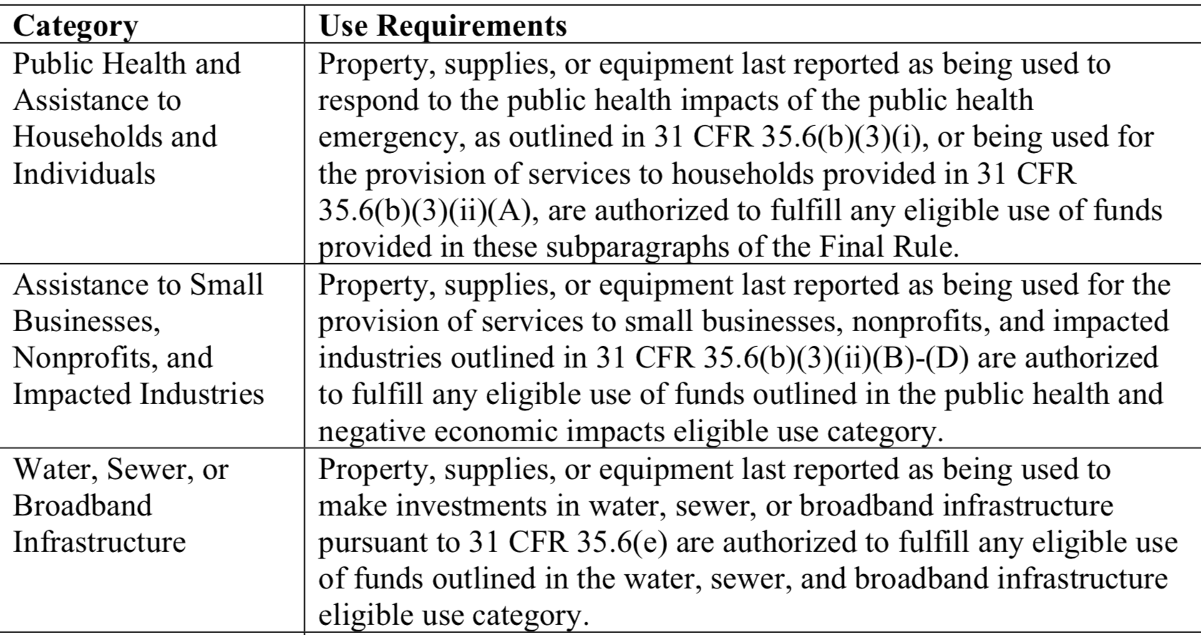
Use of Property
Now – December 31, 2026
After December 31, 2026
“T]he property, supplies, or equipment must be used consistent with the purpose for which it was purchased or improved or for any other eligible purpose in the same category as the purpose reported to Treasury as of the final reporting period, as set forth in the table below.”
A local government “may use property, supplies, or equipment purchased or improved with [ARP/CSLFRF] funds for a purpose other than the purpose for which it was purchased or improved if such other purpose is also consistent with the eligible use requirements.”
Local governments are responsible for being able to substantiate their determinations on whether the use of an asset is authorized and maintain a record of that determination.
Local governments are not required to seek or obtain the approval of Treasury prior to changing the use within the parameters of the authorized purpose.

Slide 8
What if Sell Property or Change Use of Property Outside ARP/CSLFRF Parameters?
During Award Term
If a local government changes the use of an asset to an ineligible use or sells/transfers the asset prior to the end of the period of performance, then the local government must follow the disposition procedures in the Uniform Guidance. See 2 CFR 200.311, 200.313, 200.314, and 200.315.
After Award Term
If an asset’s use shifts outside the parameters of the eligible purpose according to the table after the grant term ends, then the local government (and any subrecipient) must follow the disposition procedures in the Uniform Guidance. See 2 CFR 200.311, 200.313, 200.314, and 200.315.
Real Property |  |  | Equipment |  |  | Supplies
Retain title and compensate US Treasury the “federal share” | Sell the property and compensate US Treasury the “federal share” | Transfer title to US Treasury or to a third party designated/ approved by US Treasury | If FMV of $5K or less, local government may retain, no compensation to US Treasury | If FMV over $5K must request disposition instructions from US Treasury. If US Treasury does not provide instructions within 120 days, may sell or use for different purpose, but must repay US Treasury “federal share” | Transfer title to US Treasury or to a third party designated/ approved by US Treasury | If there is a residual inventory of unused supplies exceeding $5,000 in total aggregate value upon termination or completion of the project and the supplies are not needed for any other Federal award, the local government must retain the supplies for use on other activities or sell them, but must, in either case, repay US Treasury “federal share”
Must get specific instructions from US Treasury on which option to take.

Slide 9

Reports & Closeout
A local government (and its subrecipients) must account for all existing property at the closeout of award.
If at closeout FMV of real property, equipment, or supplies is greater than $5,000, must continue to track and report. (SF 428: Tangible Personal Property Reports)
Treasury likely will provide further guidance on closeout procedures

Slide 10
Uniform Relocation Assistance & Real Property Acquisition for Federal and Federally-Assisted Programs
Implementing Regulations
The purpose of this part is to promulgate rules to implement the Uniform Relocation Assistance and Real Property Acquisition Policies Act of 1970, as amended (42 U.S.C. 4601 et seq.) (Uniform Act), in accordance with the following objectives:
(a) To ensure that owners of real property to be acquired for Federal and federally-assisted projects are treated fairly and consistently, to encourage and expedite acquisition by agreements with such owners, to minimize litigation and relieve congestion in the courts, and to promote public confidence in Federal and federally-assisted land acquisition programs;
(b) To ensure that persons displaced as a direct result of Federal or federally-assisted projects are treated fairly, consistently, and equitably so that such displaced persons will not suffer disproportionate injuries as a result of projects designed for the benefit of the public as a whole; and
(c) To ensure that Agencies implement these regulations in a manner that is efficient and cost effective.

Slide 11
Capital Outlay for Address COVID and
Negative Economic Impact Category
If a project has total expected capital expenditures of | and the use is enumerated in (b)(3), then | and the use is not enumerated in (b)(3), then
Less than $1 million | No Written Justification required | No Written Justification required
Greater than or equal to $1 million, but less than $10 million | Written Justification required but recipients are not required to submit as part of regular reporting to Treasury | Written Justification required and recipients must submit as part of regular reporting to Treasury
$10 million or more | Written Justification required and recipients must submit as part of regular reporting to Treasury
Written justification must include the following elements:
Describe the harm or need to be addressed;
Explain why a capital expenditure is appropriate; and
Compare the proposed capital expenditure to at least two alternative capital expenditures and demonstrate why the proposed capital expenditure is superior.

Slide 12
ARPA-Flex
MITIGATION ACTIVITIES WITH CAPITAL EXPENDITURES EXCEEDING $1 MILLION
For mitigation activities with total expected capital expenditures of $1 million or greater, recipients must complete and meet the substantive requirements of a Written Justification for the capital expenditures in their project.
A Written Justification includes:
Description of emergency relief to be provided and potential impact to be addressed: Recipients must provide a description of the specific mitigation activities to be provided, and why the emergency relief is needed to lessen or avert the potential impacts of the natural disaster that is threatened to occur in the future. When appropriate, recipients may provide quantitative information on the extent and type of assistance needed, such as the number of individuals or entities that may be affected. Recipients must use the documented evidence of historical patterns or predictions of natural disasters that would reasonably demonstrate the likelihood of future occurrence of a natural disaster in their communities, along with considerations of efficacy, cost, cost effectiveness, and time to delivery, to support their determinations that mitigation activities would be related and reasonably proportional.
Explanation of why a capital expenditure is appropriate: Recipients must provide an assessment demonstrating why a mitigation activity capital expenditure is appropriate to address the specified potential impact identified. The assessment must include an explanation of why existing equipment and facilities, or policy changes or additional funding to pertinent programs or services, would be inadequate to addressing the potential impact of the threat of a natural disaster and why policy changes or additional funding to pertinent programs or services would be insufficient without the corresponding capital expenditures.
Comparison of the proposed capital expenditure against alternative capital expenditures: Recipients must provide an objective comparison of the proposed mitigation capital expenditure against at least two alternative capital expenditures and demonstrate why their proposed capital expenditure is superior to alternative capital expenditures that could be made. Specifically, recipients must assess the proposed capital expenditure against at least two alternative types or sizes of capital expenditures that are potentially effective and reasonably feasible. Where relevant, recipients must compare the proposal against the alternative of improving existing capital assets already owned or leasing other capital assets. Recipients must use quantitative data when available, although they are encouraged to supplement with qualitative information and narrative description. Recipients that complete analyses with minimal or no quantitative data must provide an explanation for doing so.
Emergency Relief from Natural Disasters (Mitigation Activities)
Surface Transportation Projects
Title I Projects
1
2
3

Slide 13

Special Reporting Requirements
Check Compliance and Reporting Guide for EC-specific reporting requirements!

