Slide 1
Local Government Fundamentals
NC Local Government Finance 101
Kara Millonzi
Bradshaw Distinguished Professor of Public Law and Government
October 2023

Slide 2

Local Government Finance Is…..
Oversight
Contracting
Fiscal Control
Budgeting
The resources that enable local governments to function, and the authority to match those resources with particular activities.
The set of laws, regulations, rules, policies, and processes that govern collecting, managing, accounting, contracting, obligating, disbursing, reporting, and auditing of public funds.
Fund
Accounting
Expenditure
Authority
Revenues

Slide 3
Can We Do It?
How Do We Manage It?
How Can We Pay For It?
Who Ensures Compliance?
Is It Budgeted?

Slide 4
Which of the following are lawful?
Yes
County contract with nonprofit fire department to fund purchase of fire truck that will be owned by fire department that provides services in county.
City contract with boys and girls club (nonprofit) to fund a new van to transport city students from school to boys and girls club facility for after school program
City contract with nonprofit museum to provide funding for operating expenses and capital maintenance on nonprofit’s building.
County expenditure to improve city owned street.
City assesses sales and use tax on sales transactions in the city.
City donation to community organization that runs an annual community music festival.
County commissioner may direct appropriation to local rotary club if part of commissioner’s discretionary funds.
Expenditure Authority
No
Yes
No
No
No
No

Slide 5
A local government and public authority must have statutory authority to undertake any activity!
Expenditure Authority

Slide 6


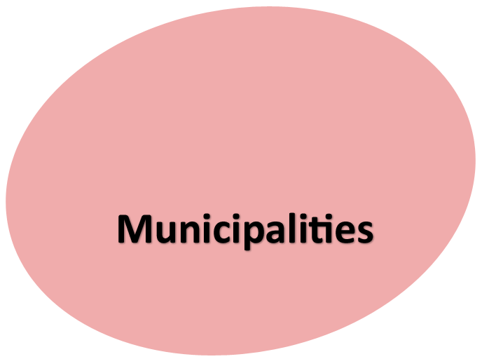
Elections
Courts Public Health Mental Health
Social Services
Medical
Examiner
Juvenile Detention
Sheriff
Register of Deeds
Soil and Water Conservation
Cooperative Extension
Community Colleges
County Home
Jails
EMS
Schools
Libraries
Emergency Mgmt.
Property Assessment
MAJOR COUNTY & MUNICIPAL FUNCTIONS
Solid Waste
Public Transportation
Airports
Parks & Recreation
Sewer
Animal Control
EMS
Building Code Enforcement
Hospitals
Airports
Ambulance
Schools
Water
Land Regulation
Tax/Fee Collection
Parking
Public
Housing
Fire/Rescue
Community & Economic Dev.
Regulatory
Powers
Streets/
Sidewalks/Street Lighting
Stormwater / Watershed
Downtown Development / Redevelopment
Cemeteries
Cable/Broadband
Police
Electric
Natural Gas

Slide 7
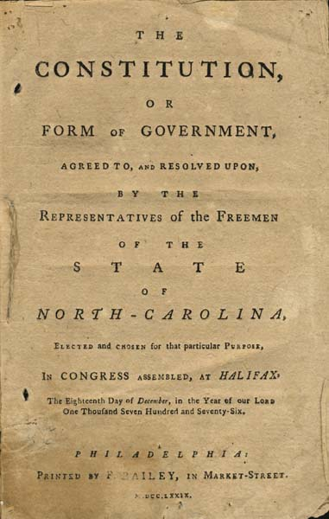
Public Purpose
“The power of taxation shall be exercised . . . for public purposes only . . .” N.C. Const. Art. V, Sect. 2(1)
You must have statutory authority to expend funds for any purpose
Public funds must be spent for benefit of citizens of your LG
Public funds must be spent for citizens generally and not solely to benefit private individual / entity
Exclusive Privileges & Emoluments
“No person or set of persons is entitled to exclusive or separate emoluments* or privileges from the community but in consideration of public services.”
N.C. Const. Art. I, Sect. 32
You may not provide direct benefit to private entities or individuals without receiving public benefit in return

Slide 8
Is there a statute, charter provision, or local act that specifically authorizes activity?
Does the general welfare benefit outweigh direct benefit to any particular individual or entity?
If a public enterprise is involved, does the activity benefit the public enterprise system?
Does the activity provide a general benefit to the LG’s citizens or a subset of the LG’s citizens?
Is the activity intended to promote the general welfare of LG’s citizens?
Can We Do It?

Slide 9
Funding for Nonprofits & Community Organizations
vs.
Partnership
Support
A local government generally
DOES NOT have statutory authority to support a nonprofit’s, community organization’s, or other private entity’s general operating or capital expenditures (but there are exceptions)
A local government MAY enter a partnership (contractual agreement) with any private entity to fund an activity, service, project, etc. that the local government has statutory authority to engage in.
See G.S. 160A-20.1 & G.S. 153A-449
Unless an exception applies, should treat nonprofit / other private entity as a ”service provider”

Slide 10

Revenues
Must have statutory authority to generate a particular revenue and authority to expend it for a particular purpose.
Largest source of general fund revenue. Restricted to purposes listed in G.S. 160A-209 or G.S. 153A-149.
There are several options to borrow money for capital projects, including GO Bonds, Revenue Bonds, Installment Financings, Project Development Financings, Special Obligation Bonds
Property Taxes
All counties levy 2%. Some counties levy up to .75% more. Must share a portion of proceeds with most municipalities. Generally unrestricted, but a portion of county amount is earmarked for school capital. And a portion of the additional .75% is earmarked for public transportation.
Borrowing Money
Sales Taxes
The state shares several state tax and fee proceeds on utilities (electric, telecommunication, cable franchise, etc.) and provides funding to municipalities for road maintenance.
State-shared Revenues
Other Local Taxes
There are a handful of other local taxes (animal, beer & wine, rental, occupancy, disposal, etc.). Generally unrestricted, except for occupancy taxes.
Allow a local government to generate revenue from a subset of property owners to fund specific projects & services that benefit their properties.
Assessments & Taxing Districts
General & Regulatory Fees
There is some fee authority for government services, such as recreation. Generally unrestricted revenue. There is also authority to charge to cover costs of regulatory activities. This is restricted revenue.
Public Enterprise Fees
There is broad fee authority to charge for public enterprise (utility) services. Some revenue is restricted; some is unrestricted.

Slide 11
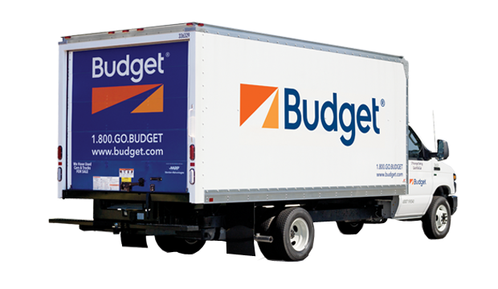
Budgeting Vehicles
Annual Budget Ordinance
Capital Project Ordinance
Grant Project Ordinance
Multi-year
Single Fiscal Year
Multi-year
For capital projects only
Mainly operating expenses
Anything funded with a grant (operations and/or capital)
Often involves debt financing
Traditional revenue sources
Allows for easier compliance with grant regulations

Slide 12
Accounting & Budgeting Funds
General Fund
Enterprise Funds
Special Revenue Funds
Other Funds
A Fund is a “fiscal and accounting entity with a self-balancing set of accounts recording cash and other resources, together with all related liabilities and residual equities or balances, and changes therein, for the purpose of carrying on specific activities or attaining certain objectives in accordance with special regulations, restrictions, or limitations.”

Slide 13
Annual Budget Ordinance
Estimated Net Revenues
Appropriations
Appropriated Fund Balance
The annual budget is effective from July 1 through June 30 (fiscal year). It must be balanced when adopted and as amended throughout the fiscal year.

Slide 14
Estimated Net Revenues
Appropriations
Appropriated Fund Balance
Estimates of revenues that will come into the local government during the fiscal year
By Major Source
Cash reserves from prior years
“Appropriated fund balance in any fund shall not exceed the sum of cash and investments minus the sum of liabilities, encumbrances, and deferred revenues arising from cash receipts, as those figures stand at the close of the fiscal year next preceding the budget year.”
Authorization to spend revenues
By Department, Function, or Project

Slide 15





Budget Requirements
G.S. 159-13 specifies certain substantive budget requirements and limitations.
Must budget amounts due on outstanding loans (debt service)
Must budget amounts due on multi-year contracts
May budget contingency appropriations up to 5% in each fund
May not budget revenues that have not legally earned
Must levy property taxes

Slide 16
Budget Timeline
Budget Retreats / Pre-planning / Citizen Input
Department Heads Submit Budget Requests to Budget Officer
(By April 30)
Budget Officer Submits Proposed Budget to Board (By June 1)
Clerk Publishes Notice of Public Hearing and Makes Copy Available for Inspection
Board Holds Public Hearing
Board Adopts Budget Ordinance (at least 10 days after proposed budget submitted)
Budget Ordinance Effective July 1
Budget Ordinance Expires June 30
Many local governments are engaged in budget discussions / management year-round, but most active budget processes start in January.

Slide 17
Local Government Appropriations
FY 2018-19
Appropriations = Authorization for Expenditures
Education
Other
Utilities
Public Safety
Debt Service
General Gov’t
General Gov’t
Human Services
Public Safety
Debt Service
Other

Slide 18

What Makes NC Gov’t Unique?
State has primary responsibility for funding education and highways
Counties have primary responsibility for human services at the local level
Counties have authority to provide most urban-type services
Counties and cities have extensive authority to regulate and direct urban development
Counties and cities have broad authority to enter interlocal agreements and form regional partnerships
Heavy reliance on general-purpose local governments (counties and cities) to perform most local functions (e.g. schools do not have taxing authority)

Slide 19




Budgeting
Cash Management & Investments
Obligating & Disbursing Public Funds
Accounting & Financial Reporting
Auditing & Local Government Commission
The Local Government Budget and Fiscal Control Act, G.S. 159, Art. 3, governs budgeting and financial management

Slide 20
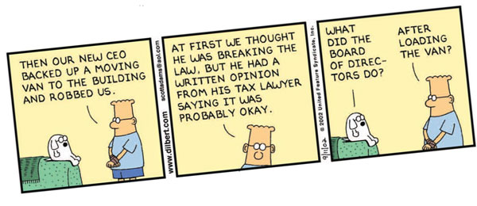
Preaudit Processes
G.S. 159-28 provides a statutory review process to ensure budgetary authority and sufficient remaining funds before incurring a legal obligation and disbursing public funds

Slide 21
Preaudit Process Triggered When:
Obligation
1
A local unit enters into contract or agreement (or places an order) for goods or services that are accounted for in the budget ordinance (or project ordinance); AND
the local unit is obligated to pay money by the terms of the contract/ agreement/ order; AND
if the budget authority is the annual budget ordinance, the local unit anticipates paying at least some of the money in the current fiscal year (fiscal year in which the contract/agreement/order entered into).
This criteria does not apply if budget authority is a capital project ordinance or grant project ordinance.
2
No preaudit is needed if no money is expected to be paid out during the budget term.
3

Slide 22
Preaudit Process
Deputy finance office must be designated by governing board
Finance Officer (or Deputy)
Before an obligation is incurred, finance officer (or deputy finance officer) must:
Appropriation
Check to see if there is an appropriation in budget ordinance or project ordinance for amount due this fiscal year
Unencumbered Monies
Check to see if sufficient funds remain in the appropriation to cover amount that will come due this fiscal year
Certificate
Affix preaudit certificate to any “writing” that evidences contract/agreement/order. The certificate must be signed by the finance officer or deputy finance officer
Encumber
Subtract amount that is expected to be paid out during budget period from total appropriation
There are some exceptions to the certificate requirement

Slide 23

If No Preaudit…..
Contract/agreement/order is VOID and cannot be enforced
Any individual or officer who enters contract/agreement/order or causes funds to be disbursed without following statutory processes may be held personally liable for amounts committed or disbursed
Any employee or official who approves any claim or bill knowing it to be fraudulent, erroneous, or otherwise invalid, or make any written statement, give any certificate, issue any report, or utter any other document required by this Chapter, knowing that any portion of it is false, or shall willfully fail or refuse to perform any duty imposed upon him by this Chapter, he is guilty of a Class 3 misdemeanor.

Slide 24
External Accountability & Oversight
There are separate but overlapping mechanisms to ensure local government compliance with financial and other statutory requirements.
Annual Audit
Local Government Commission
(LGC)
State Auditor
State Bureau of Investigation (SBI)
New Legislative Commission
01
02
03
04

Slide 25
Annual Audit
Audit category is based on total funds expended, not the receipt of funds.
LGC may force LG to select auditor from approved list if LG had investigative audit with findings by the State Auditor within last 3 years. The auditor will report to the LGC and governing board.
Financial Audit: All local governments must undergo an annual financial audit (G.S. 159-34)
Yellow Book Audit: Expend $100,000 or more in combined federal or state dollars
Federal Single Audit: Expend $750,000 or more in federal dollars during the non-federal entity’s fiscal year
Alternative Compliance Engagement (for ARP/CSLFRF ONLY):
For local governments receiving $0-$10 million in ARP/CSLFRF
If only reason triggering Single Audit is ARP/CSLFRF, then can do this as alternative to Single Audit
Must follow federal procurement process to select auditor

Slide 26
What is Compliance?
Adopt
Adopt the policies
Incorporate
Incorporate procedures
Follow
Follow the procedures
Document
Document everything
Retain
Retain the documentation
Assign
Assign responsibilities
Policies, processes, and procedures to ensure that grant funds are managed and spent appropriately and that assets acquired / constructed / repaired / etc. with federal grant funds are managed appropriately.

Slide 27
Governing Board Action on Audit
If a county is notified by its independent auditor that the unit’s audited financial statements include one or more
  significant deficiencies,
  material weaknesses,
  other findings, or
  financial performance indicators of concern
the board of commissioners must develop a “Response to the Auditor's Findings, Recommendations, and Fiscal Matters" signed by a majority of the commissioners and submitted to the LGC within 60 days of the auditor's presentation.
Low fund balance
Uncollected tax levy
Late audit submission
Transfers from enterprise fund to general fund
Operating net income loss in enterprise fund
Quick ratio below 1 in enterprise fund
Budget violations
Other statutory violations

Slide 28
Local Government Commission (LGC)
Prevent
Regulate
Manage
Support
State oversight of local government finances
Enacts financial management rules
Audit approval and review
Debt approval
Resource for local governments
Additional interventions for struggling local governments

Slide 29
Joint Legislative Commission on
Governmental Operations
To “undertake the ongoing examination, evaluation, and investigation of State agencies, public authorities, units of local government, and non-State entities receiving public funds, and of their actual effectiveness in implementing public policy or providing public services….”
Request documents
Inspect buildings & facilities
Interview public officials and employees
Local governments
Public authorities
Private entities that contract with local governments or public authorities to undertake programs and/or provide services and receive public funds
CONFIDENTIALAL

