Slide 1
The ARPA Journey….
September 30, 2026:
Expenditure deadline for CDBG and Surface Transportation Projects
April 2027: Final Closeout
April 10, 2023: Premium Pay Authority Ends
December 31, 2026: Expenditure deadline for all other funds
END
March 3, 2021: ARPA Effective Date
07
START
December 31, 2024: All funds must be obligated
January 27, 2020:
Pandemic Begins
06
05
You are here
03
02
04
Make sure local government is on track to expend all ARPA funds by December 31, 2026, and continues to comply with all regulations
01

Slide 2
P&E Report

Slide 5
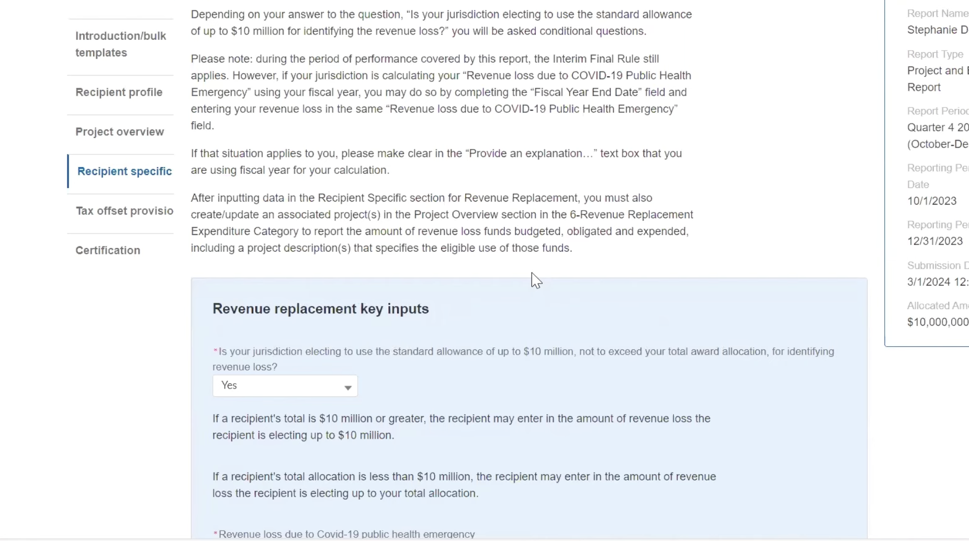

Slide 6
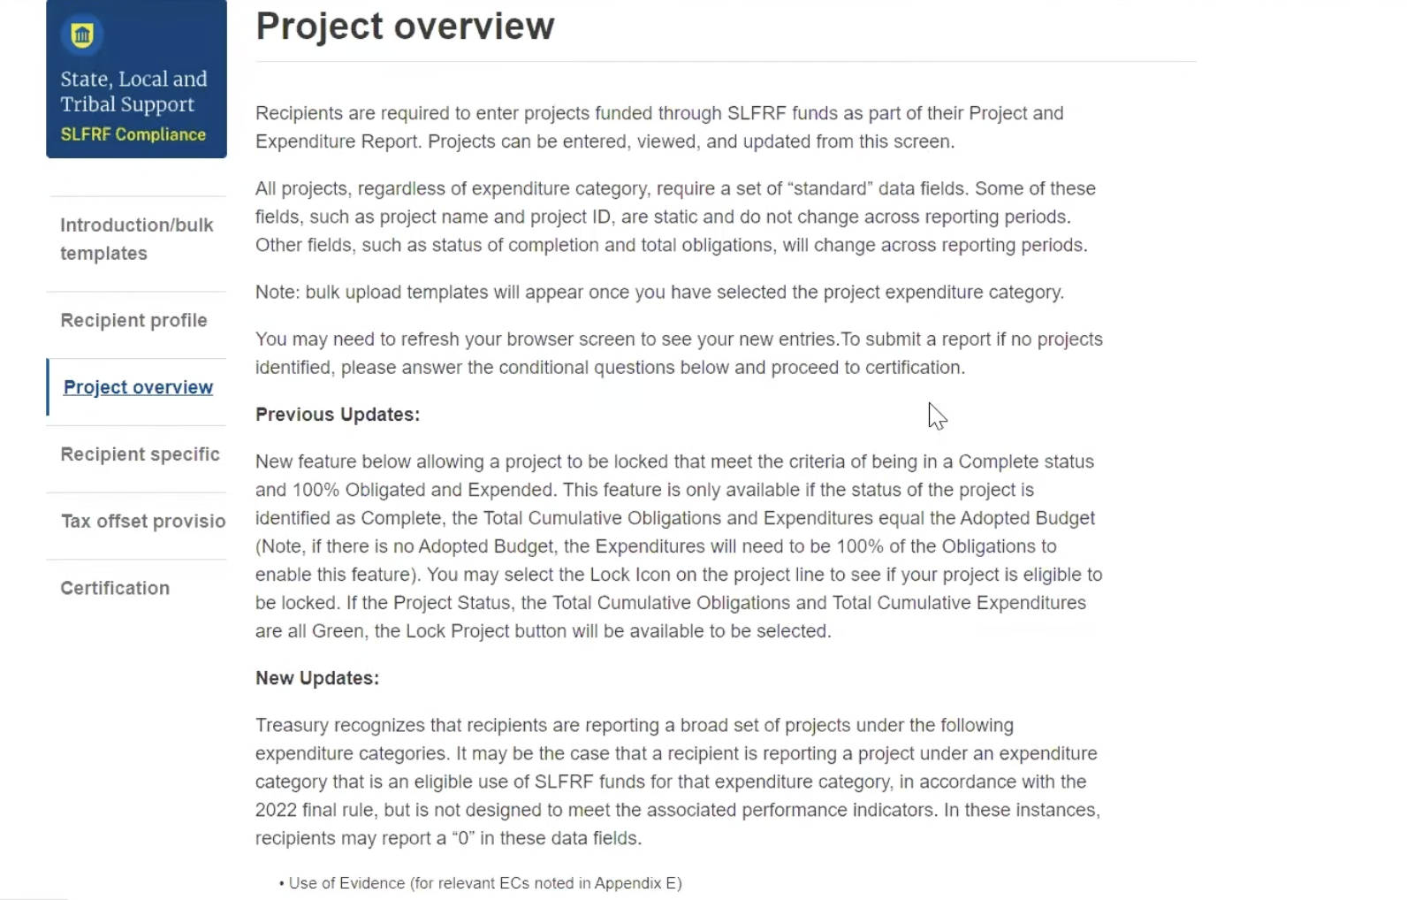

Slide 7
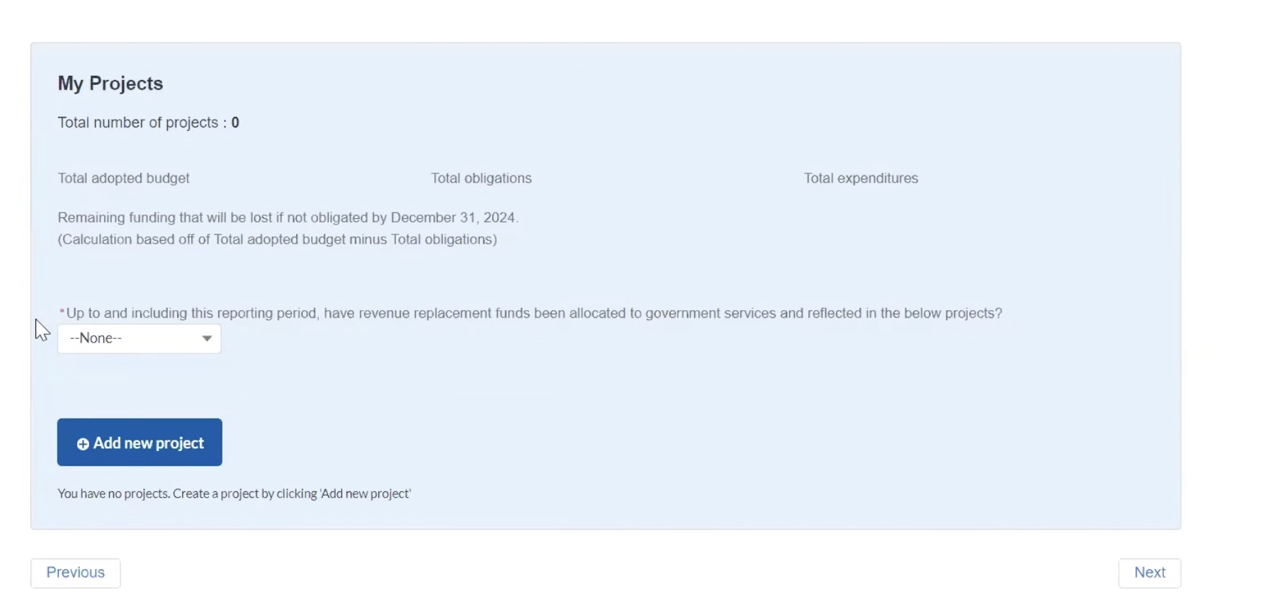

Slide 8
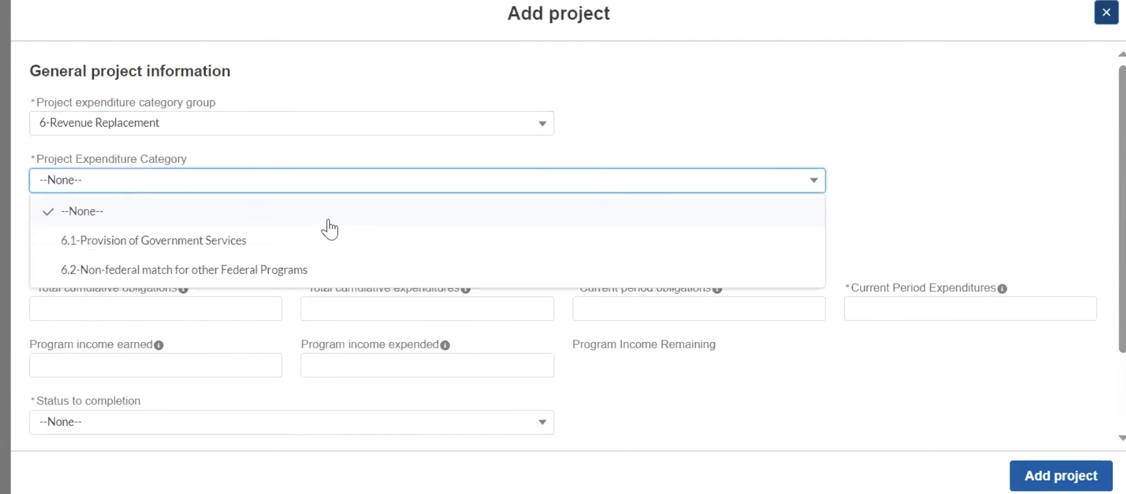

Slide 9
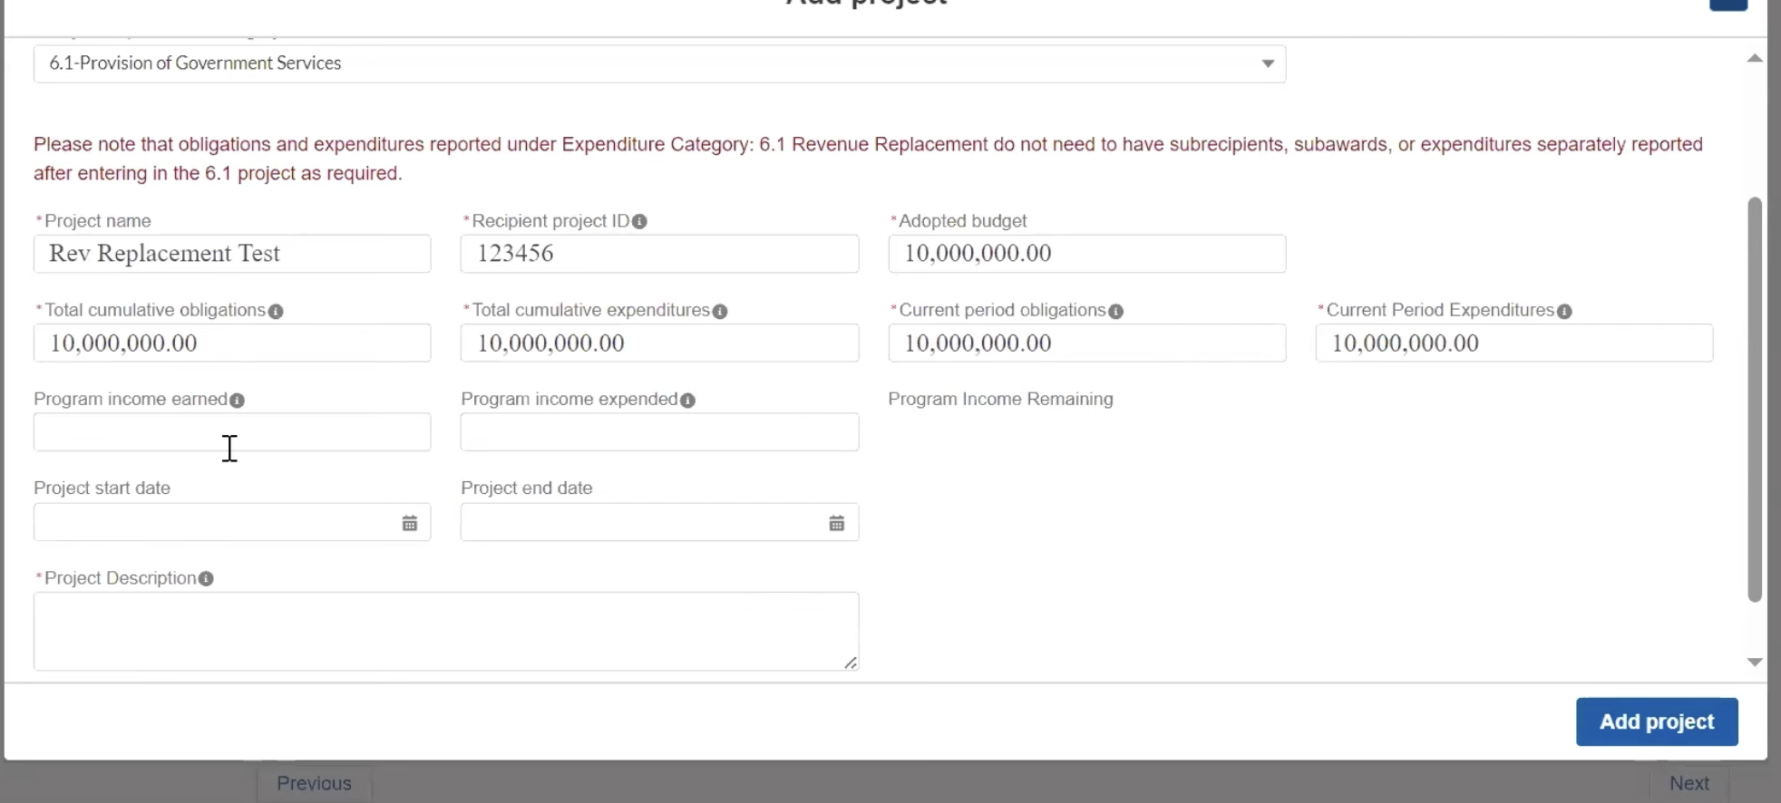

Slide 10
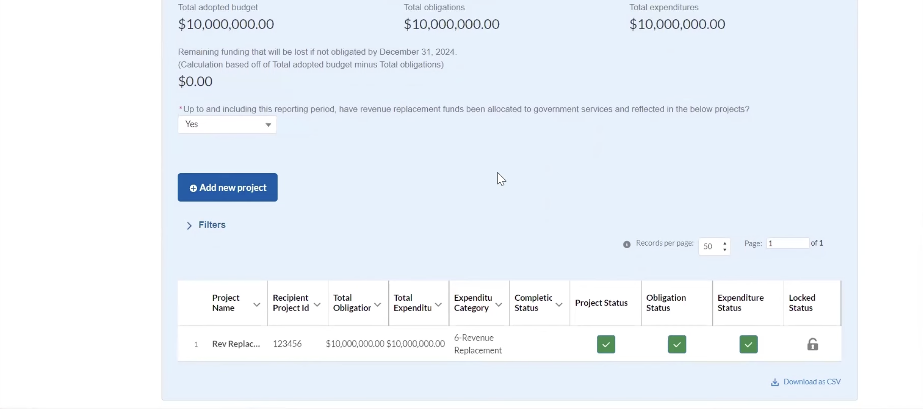

Slide 11
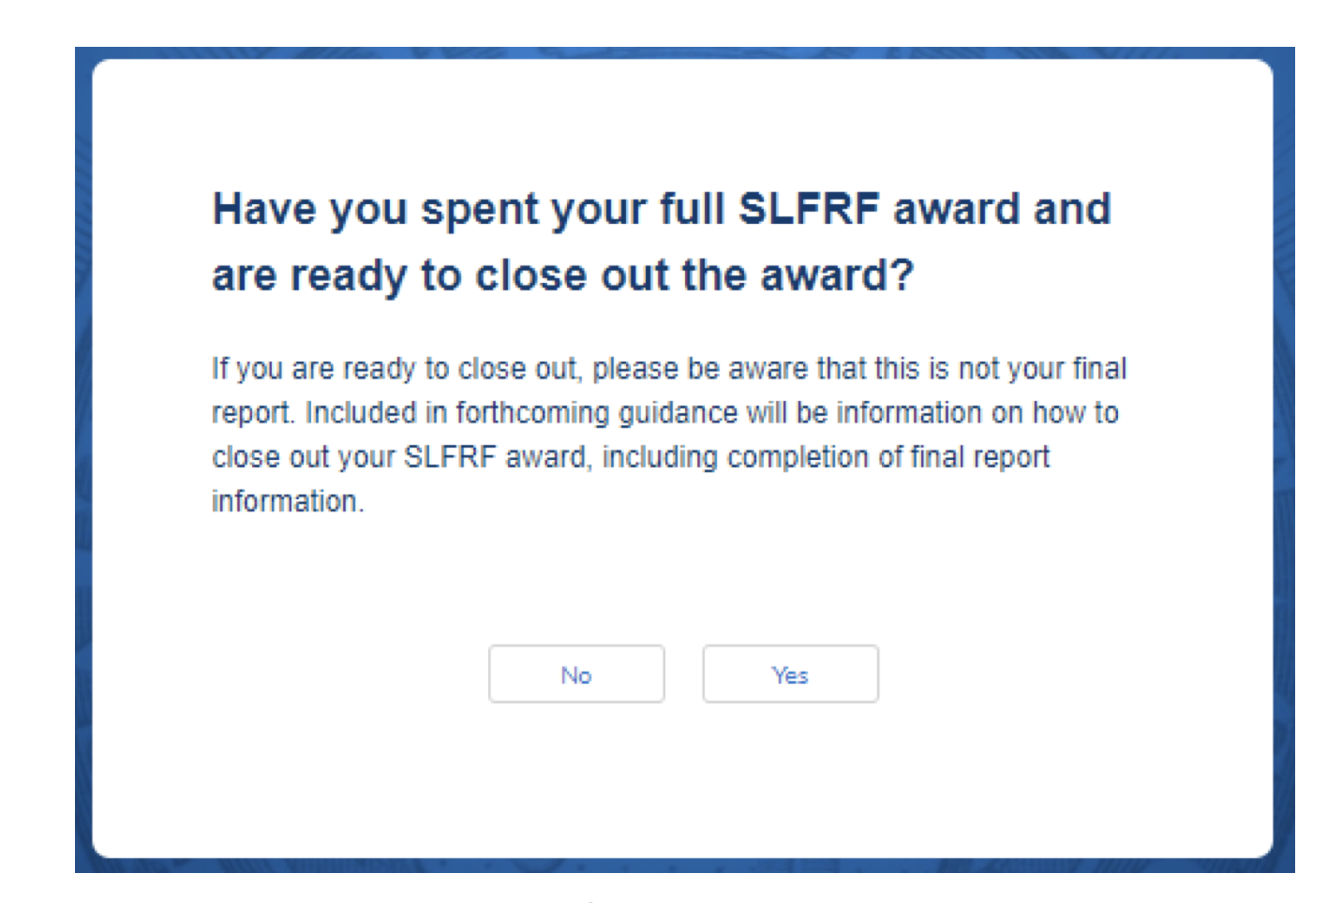

Slide 12
ARP/CSLFRF Spending Categories
ADDRESS COVID PUBLIC HEALTH & NEGATIVE ECONOMIC IMPACT
Support public health expenditures, by funding COVID-19 mitigation efforts, medical expenses, behavioral healthcare, and certain public health and safety staff;
Address negative economic impacts caused by the public health emergency, including economic harms to workers, households, small businesses, impacted industries, and the public sector;
Support disproportionately impacted communities
REPLACE LOST REVENUE
Replace lost public sector revenue, using this funding to provide government services to the extent of the reduction in revenue experienced due to the pandemic;
$10 million standard allowance OR formula approach
PREMIUM PAY (only through April 10, 2023)
Provide premium pay for essential workers, offering additional support to those who have borne and will bear the greatest health risks because of their service in critical infrastructure sectors;
Target low-and moderate- income employees or employees who face(d) added risks during pandemic
INFRASTRUCTURE INVESTMENTS
Invest in water, sewer, and broadband infrastructure, making necessary investments to improve access to clean drinking water, support vital wastewater and stormwater infrastructure, and to expand access to broadband internet.
ARP/CSLFRF FLEX
Disaster response/mitigation
Certain CDBG (Title I) projects
Certain Surface Transportation Projects
Know Your Category!

Slide 13
Federal Compliance Requirements
Award Terms | Prohibited Expenditures | Uniform Guidance (UG)
All funds obligated by December 31, 2024 & fully expended by December 31, 2026 Reporting requirements Project & Expenditure reports (quarterly or yearly, depending on size) -- Document data elements for certain EC’s Performance Plan reports (for largest units only) Civil rights compliance / nondiscrimination policy Compliance with all applicable Uniform Guidance provisions Records retention policy with retention for at least 5 years after award term ends Special audit requirements Other federal laws | NO: Pension fund contributions NO: Borrowing money NO: Financial reserves / rainy day fund NO: Settlement/judgement/consent decree NO: Undermines or discourages compliance with CDC guidelines NO: Violates conflict of interest provisions NO: Violates state law or other federal laws and regulations, including applicable Uniform Guidance | General Financial Management Internal Controls Eligible Projects Determination & Documentation Policy Cost Principles/Allowable Costs Policy Procurement, Suspension, & Debarment Policy Subaward Policy Program Income Policy Property Management Policy
Applies to ALL projects
Applies ONLY TO SOME projects and DOES NOT apply to Revenue Replacement
What local government agreed to as condition of receiving funds. Applies to ALL categories.
The Final Rule prohibits certain expenditures no matter what. Applies to ALL categories
Set of federal compliance regulations that apply to federal awards.

Slide 14
Local Governments Fall Into 1 of 3 Categories
$0-$10 Million ARP/CSLFRF Allocation | $0-$10 Million ARP/CSLFRF Allocation + State ARP/CSLFRF Funds (competitive grant or direct State Budget appropriation) | Over $10 Million ARP/CSLFRF Allocation
Spend all ARP/CSLFRF funds in Revenue Replacement Category More limited compliance and reporting requirements | Spend all city’s own ARP/CSLFRF funds in Revenue Replacement Category with more limited compliance and reporting May have more substantial compliance requirements for State funds (even if part of same project as local funds) and concerns about obligation and expenditure deadlines. Work closely with State Agency administering funds. $800million of DEQ ARPA funds recently converted to state funds | May spend at least $10 million in Revenue Replacement Category Likely must spend some funds in at least one of the other categories More substantial compliance and reporting requirements & higher risk of audit findings Bigger concerns about obligation & expenditure deadlines ARPA Flex coming “soon” (adding eligible expenditures on certain transportation, CDBG, and disaster recovery projects)

Slide 15

ARP/CSLFRF Process
DOCUMENT! DOCUMENT!
Expend & Disburse
FIGURE OUT PROJECT SPECIFICS
Track & Document Req’d Data
NAIL DOWN AUTHORITY
Cost Estimates & Timing
Eligible Use & Allowable Cost Review & Documentation
OBLIGATE
Identify ALL Compliance Req’ts
Adopt Grant Project Ordinance
Follow Req’d Processes
Adopt ALL Policies
ARP/CSLFRF Category & EC?
Identify Potential Project(s)
SLFRF COMPLIANCE GUIDE
SLFRF FAQS
State Law Authority?
SLFRF TERMS & CONDITIONS
SLFRF COMPLIANCE SUPPLEMENT
SLFRF OVERVIEW

Slide 16
ARP/CSLFRF Obligation & Expenditure Deadlines
OBLIGATION DEADLINE
”ADJUSTMENTS”
EXPENDITURE DEADLINE I
EXPENDITURE DEADLINE II
Generally, ARP/CSLFRF funds must be obligated by this date
For some costs, the obligation will be considered to have happened by December 31, 2024, even if the legal obligation happens later
ARP/CSLFRF funds must be fully expended for Title I and Surface Transportation projects.
All other ARP/CSLFRF funds must be fully expended
December 31, 2024
September 30, 2026
December 31, 2026
Treasury has enacted an obligation IFR and subsequent FAQs that expands what qualifies as an obligation and allows for some (limited) flexibility to move monies around after obligation deadline.

Slide 17
What did it mean to Obligate?
An obligation was satisfied by December 31, 2024 if:
  LG executes legal contract or subaward committing the local government to pay money to another (including hiring at-will employee) by December 31, 2024
  LG documents total # of eligible positions funded with ARP/CSLFRF and filled on December 31, 2024, for grant-eligible projects or activities that extend beyond this date
  LG documents reasonable and justifiable estimate of mandatory grant compliance costs (including close-out costs and subrecipient monitoring costs) that will be incurred between January 1, 2025 and December 31, 2026. Original estimates due July 2024 but may be adjusted January 2025.
  LG makes budget appropriation plus internal contract between board or manager and department head that serves as binding commitment to spend money for a particular ARP/CSLFRF-eligible purpose by December 31, 2024
  LG executes legal contract committing LG to pay money to another entity by December 31, 2024. Expenditure would have been ARP/CSLFRF-eligible, but LG planned to use local monies to fund.
Traditional Obligation
Position
Obligation
Mandated Future Compliance Costs
Internal
Obligation
Other ARP/CSLFRF Eligible Obligation

Slide 18



Position Obligation
EMPLOYEE IN OBLIGATED POSITION GETS PROMOTION
Local government may continue to count obligated position even if position is reclassified and even if higher compensation cost
LOCK IN OBLIGATED POSITIONS
Count positions that are currently filled and paid for with ARP/CSLFRF funds
December 31, 2026
December 31, 2024
EMPLOYEE OBLIGATED POSITION QUITS/IS FIRED
Local government may replace employee and use ARP/CSLFRF funds to pay for new person in position, even if at higher compensation cost (as long as still meets allowable cost item regulations)
LAST DAY FOR PAYROLL EXPENDITURE FOR OBLIGATED POSITIONS

Slide 19
Mandated Future Compliance Costs
A local government may enter into a new contract/agreement for costs related to “a requirement under federal law or regulation or a provision of the [ARP/CSLFRF] award terms of conditions to which the [local government] becomes subject as a result of receiving or expending the [ARP/CSLFRF] funds.” This includes close out costs, pursuant to 2 CFR 200.344. It also includes subrecipient monitoring costs.
Single audit costs attributable to ARP/CSLFRF grant
Costs to perform reporting, documentation, other internal controls, & subrecipient monitoring
Mandated grant close-out costs
Complying with environmental laws
Complying with civil rights laws
Complying with property management requirements
Other similar costs mandated as part of administration of ARP/CSLFRF grant
A local government must:
estimate that amount of ARP/CSLFRF funds it will use to cover these expenditures;
document a reasonable justification for the estimate and how it was made; and
report the estimate to Treasury in the July 2024 P&E Report (may update in Jan. 2025 P&E report)
At award closeout the local government must report on the final amount expended for these costs. If a local government’s estimate exceeds what it ultimately expends, it may use left over funds on another ARP/CSLFRF-eligible obligated project / expense.
If using indirect cost recovery, may continue to charge indirect rate on MDTC through expenditure deadline

Slide 20
Internal Obligation
May treat a budget appropriation + internal contract as an obligation if the agreement:
  Imposes conditions on the use of funds by the department;
  Governs the provision of funds to carry out an eligible use of ARP/CSLFRF funds; or
  Governs procurement of goods or services by the department.
The agreement must:
  set forth specific requirements, such as scope of work and project deliverables;
  Be signed by both the governing board designee and the department head/staff member that will carry out agreement; and
  NOT include language that disclaims any binding effect or state that it does not create rights or obligations.
Example 1:
City council appropriates ARP/CSLFRF funds for a public safety-related project to the law enforcement department. City council and police chief enter into a agreement, whereby police chief commits to spending funds for specific ARP/CLSFRF-eligible public safety project and to comply with all applicable regulations, documentation, record-keeping, and other requirements.
Example 2:
County commissioners appropriates ARP/CSLFRF funds to the social services department to cover operational costs of a grant-eligible lease assistance program for low-income senior citizens. The county manager, as budget officer, enters into a contract with the social services director, whereby the director agrees to perform and complete in a satisfactory and proper manner the scope of work specified in accordance with all the ARP/CSLFRF award terms and conditions.

Slide 21
Other ARP/CSLFRF-Eligible Project Obligation
z
Obligate Non-ARP/ CSLFRF Revenues by December 31, 2024
ARP/
CSLFRF project falls through or comes in under budget
Substitute ARP/ CSLFRF funds for project
ARP/
CSLFRF
Eligible* Project
Budget Non-ARP/ CSLFRF Revenues
SUBSTITUTE
z
*To be ARP/CSLFRF eligible likely requires compliance with all applicable federal regulations, including federal procurement, allowable cost, and property management
Obligation: Execute Legal Contracts

Slide 22
Adjustment Period
January 1, 2025 – December 31, 2026
Certain new legal obligations allowed
But must provide estimate & justification to Treasury in advance
Substituting new hires or other staff into an Obligated Position, even if nature of position changes
New contracts executed related to Mandated Future Compliance Costs (including for personnel)
New contracts executed to carry out Internal Obligation (including for personnel)
Substitute ARP/CSLFRF funds for local funds on ARP/CSLFRF-eligible project that was obligated by December 31, 2024
Change Orders or Contract Contingencies that were expressly allowed in original contract executed by December 31, 2024
  May use ARP/CSLFRF to fund increase in costs
Amendments to contracts executed by December 31, 2024, if amended contract is of substantially the same scope and for substantially the same purpose as original contract
  May use ARP/CSLFRF to fund increase in costs
*Substituting Contractors or Subawards for certain purposes, if new contract or subaward is of substantially the same scope and for substantially the same purpose as original executed by December 31, 2024
  May use ARP/CSLFRF to fund new contract or subaward, even if it imposes higher costs

Slide 23
*Substituting Contractors or Subrecipients
A local government may “replace” a contract or subaward after December 31, 2024 if any of the following occur:
Substitute contract or subaward must be for substantially the same purpose as original
May use ARP/CSLFRF to fund any increase costs necessary to accomplish the substitution
The local government terminates a contract or subaward because of the contractor or subrecipient’s default, because the contractor or subrecipient goes out of business, or because the recipient otherwise determines that the contractor or subrecipient will not be able to perform under the contract or carry out the subaward; or
2. The local government and contractor or subrecipient mutually agree to terminate the contract or subaward for convenience (As part of required federal contract terms, all contracts greater than $10,000 must include provisions for termination for cause and convenience by the contractor.); or
3. The local government terminates the contract or subaward for convenience if the contract or subaward was not properly awarded (such as if the contractor was not eligible to receive the contract), there is clear evidence that the contract or subaward was improper, the local government documents its determination that the contract or subaward was not properly awarded, and the original contract or subaward was entered into by the recipient in good faith.
Must follow all UG and state law processes to select new contractor/subrecipient

Slide 24
What Funds for What Purpose?
Cost Type After Obligation Deadline | Source(s) of ARP/CSLFRF Revenue That Can Be Used to Cover Costs
1. New Staff in Obligated Position | ARP/CSLFRF funds that LG no longer needs for other obligated projects Estimated Mandated Future Compliance Costs not needed Program Income
2. Mandated Future Compliance Costs | ARP/CSLFRF funds in the amount estimated in July 2024 (and revised in Jan. 2025) ARP/CLSFRF funds that LG no longer needs for other obligated projects Program Income
3. Change Orders and Contingencies | ARP/CSLFRF funds in the amount estimated in January 2025 ARP/CSLFRF funds that LG no longer needs for other obligated projects Program Income
4. Contract Amendments | ARP/CSLFRF funds in the amount estimated in January 2025 ARP/CSLFRF funds that LG no longer needs for other obligated projects Program Income
5. Replacement Contractors or Subrecipients | ARP/CSLFRF funds in the amount estimated in January 2025 ARP/CSLFRF funds that LG no longer needs for other obligated projects Program Income

Slide 25
What Funds for What Purpose?
Cost Type After Obligation Deadline | Source(s) of ARP/CSLFRF Revenue That Can Be Used to Cover Costs
6. Substitute Project | ARP/CSLFRF funds that LG no longer needs for another obligated project Program Income
7. Internal Obligation | Amount of ARP/CSLFRF funds obligated by budget appropriation and internal agreement executed before December 31, 2024

Slide 26
Obligation Deadline Does Not Apply to Subrecipients
Applies to
local governments receiving subawards from State ARP/CSLFRF funds, but still must comply with state agency deadlines
A local government must execute its subaward by the December 31, 2024 deadline
But a subrecipient does not have to incur its obligations by this deadline.
A subrecipient must still expend all funds by December 31, 2026 (or September 30, 2026 for Title I and Surface Transportation projects)

