Slide 1
Communicating with Your Customers
May 22, 2025
Alicea Easthope-Frazer
Senior Project Director
Notes:
The goal of customer engagement is to help them understand the reality of the situation. They will likely see an increase in their water/wastewater bill, but it will mean longer-term sustainability of the system.

Slide 2

Be Transparent

Slide 3
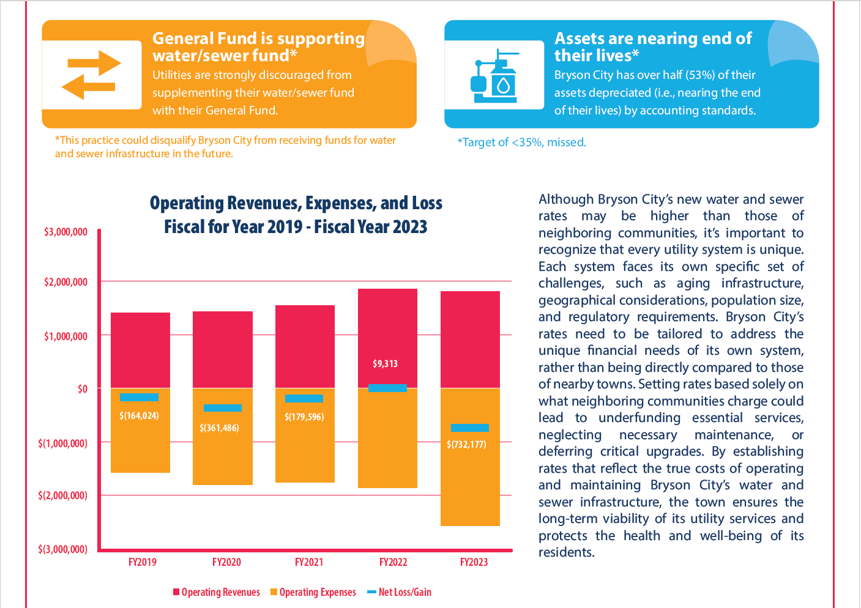
Why rates change
Be transparent
Explain the need (e.g., infrastructure upgrades, inflation, legal compliance)
Saving for the future
  Creating (or bulking up) an asset management plan
  Building up reserve funds for leaks, wear and tear
  Having funds stored away in case a major crisis happens (Like a water main break!)

Slide 4
Cost breakdown
Be transparent
Use visuals to show where customer money goes (e.g., maintenance, upgrades, personnel).

Slide 5

Long-term benefits
Be transparent
Highlight how changes improve service reliability and sustainability.
Are you meeting your utility's goals?
Are you meeting water quality standards?
Do you have sufficient capacity to meet current and future needs?
Image by Memed_Nurrohmad on Pixabay
Notes:
If your system has significant changes that need to be made to meet water quality standards, or if you have capacity issues, this can be something that you can appeal to your board about. If the basic goals and mission of your utility are not being met, your board may be more inclined to approve reasonable rate increases. Your board will be more likely to play it safe than to take a risk and potentially run into bigger issues down the road

Slide 6
Provide Advanced Notice

Slide 7

Early communication
Provide advanced notice
Announce changes well in advance with reminders.
Plan ahead to decide on the frequency and method of communication.
  Be okay with shifting if needed.

Slide 8
Phased implementation
Provide advanced notice
Spread rate increases over time to ease the impact.
 | Current | FY26 | FY27 | FY28 | Total Change
Base | $47.62 | $50.00 (5% increase) | $53.50 (7% increase) | $57.78 (8% increase) | 21%, spread over 3 years instead of at once
Volumetric | $2.88/kgal | $3.00 (4% increase) | $3.18 (6% increase) | $3.34 (5% increase) | 16%, spread over 3 years instead of at once

Slide 9
Demonstrate Accountability

Slide 10
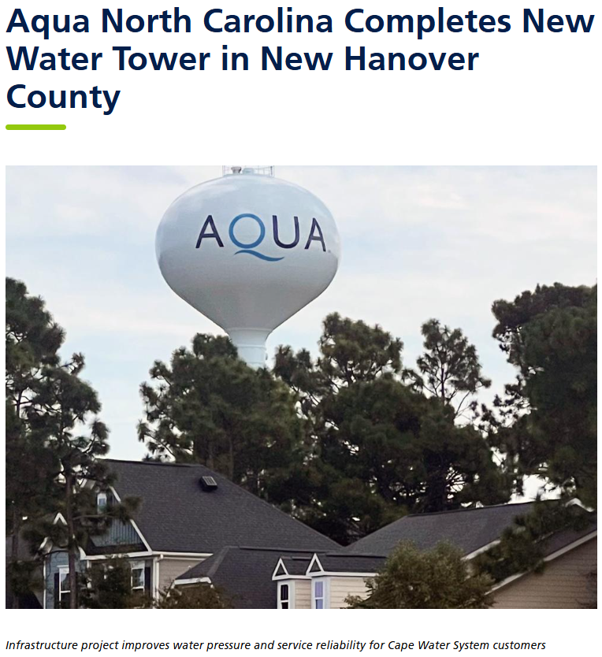
Show achievements
Demonstrate accountability
Highlight past projects funded by rate increases.
https://www.aquawater.com/news/aqua-north-carolina-completes-new-water-tower-new-hanover-county

Slide 11
Pitch what you’re providing
Demonstrate accountability
Customers often take water quality for granted
Showing that additional revenues are required to maintain or improve water quality gives more context to rate increases
Additional service charge dollars are coming right back in the form of higher water service quality
Improved aesthetic water quality?

Slide 12
Efficiency efforts
Demonstrate accountability
Show what steps you’re taking to reduce costs and improve operations.
Are there efficiencies that the increase will sustain?
  May save your system money in the long run

Slide 13
Offer Customer Support

Slide 14
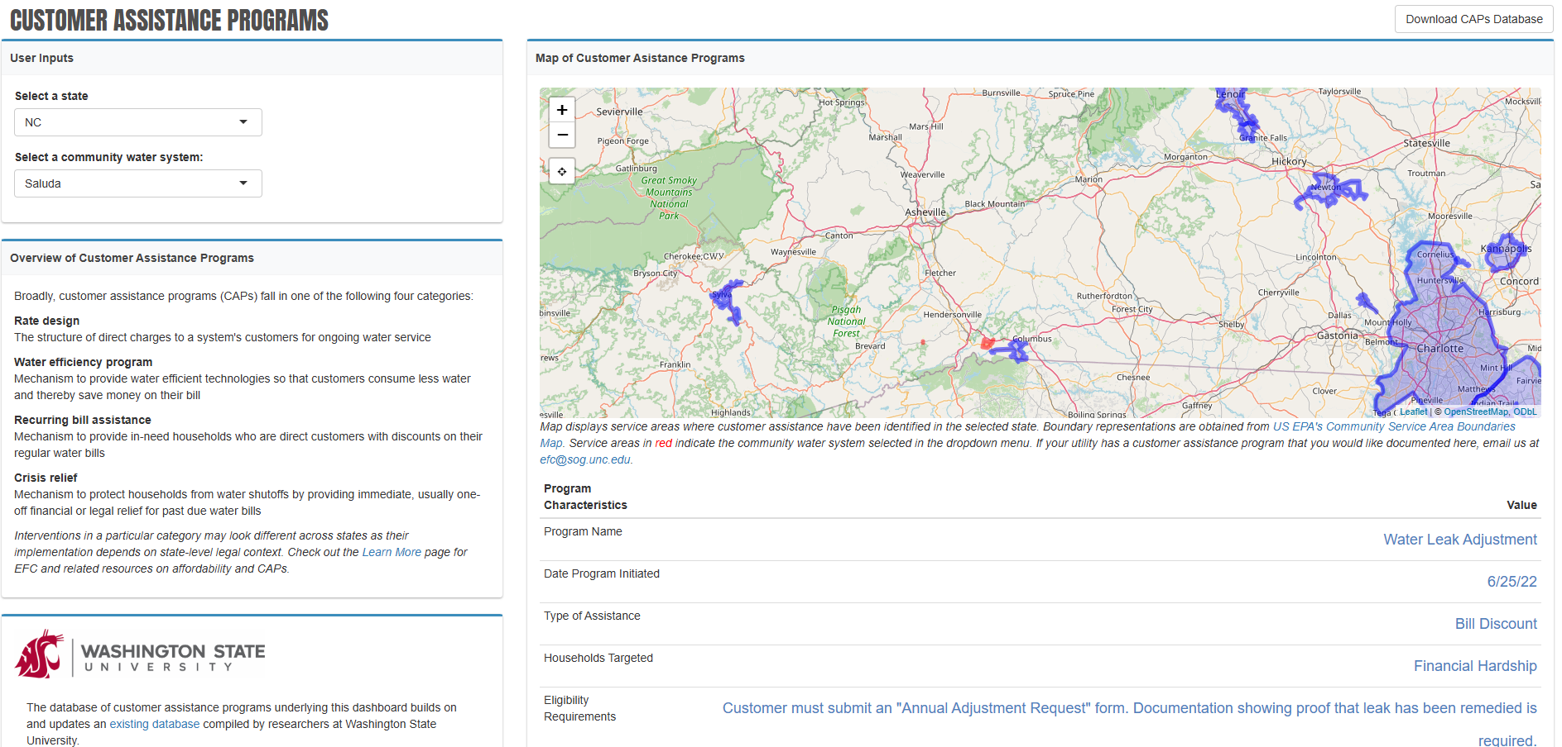
Affordability programs
Offer customer support
Provide subsidies for low-income households. Connect with other government or community resources.

Slide 15
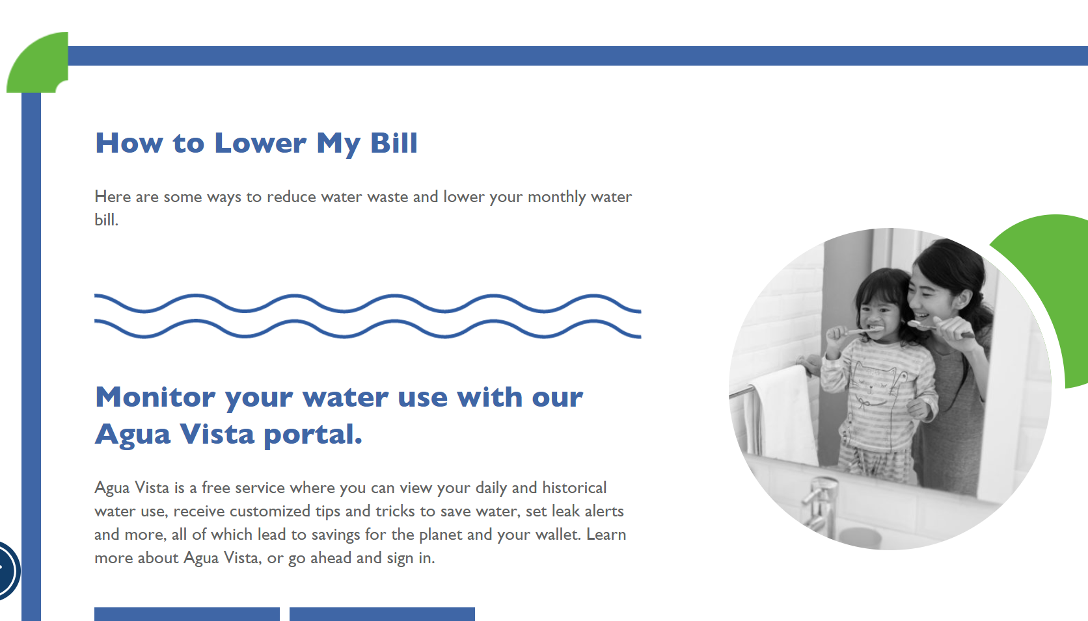
Water-saving tips
Offer customer support
Share resources to help customers reduce their bills.
https://www.owasa.org/save-water-save-money/

Slide 16
Use Multiple Channels

Slide 17
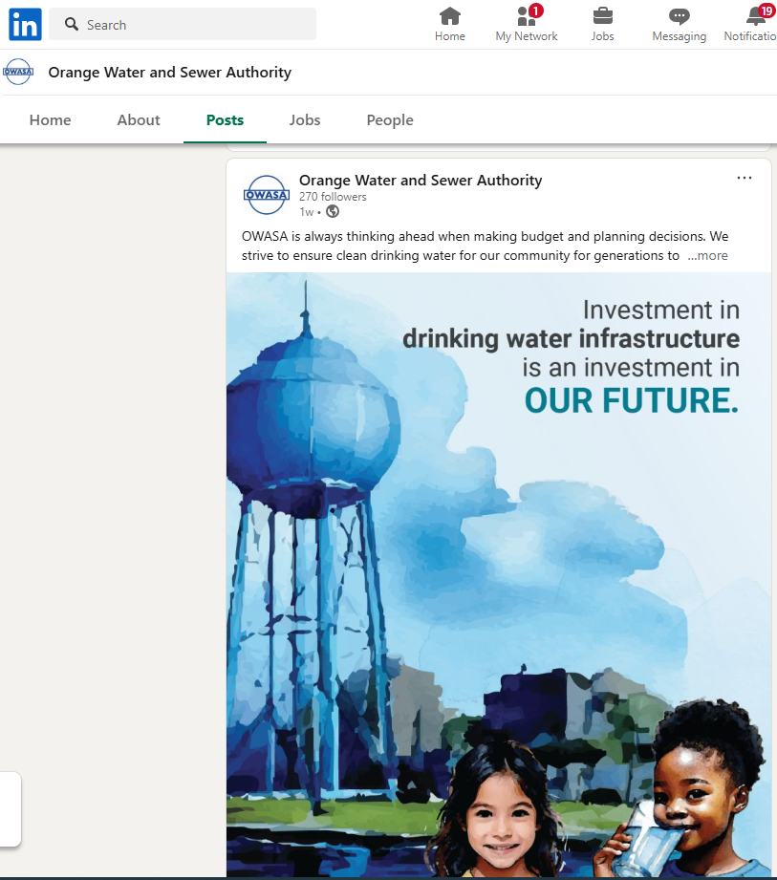
Digital
Use multiple channels
Websites, social media, email updates
Downloadable Key Performance Indicators
https://www.linkedin.com/company/owasa/posts/?feedView=all

Slide 18
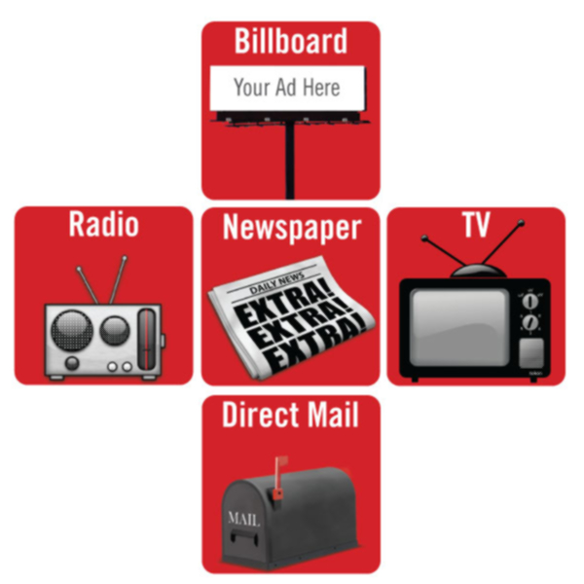
Traditional
Use multiple channels
Mailed notices, newspaper ads, community boards
Newsletters, flyers, door hangers
Council meetings
Staff on site at projects, as relevant
Public Service Announcements
Radio spots
Image source: https://avilaralph27.wordpress.com/2018/12/05/12/

Slide 19
Consider Language

Slide 20
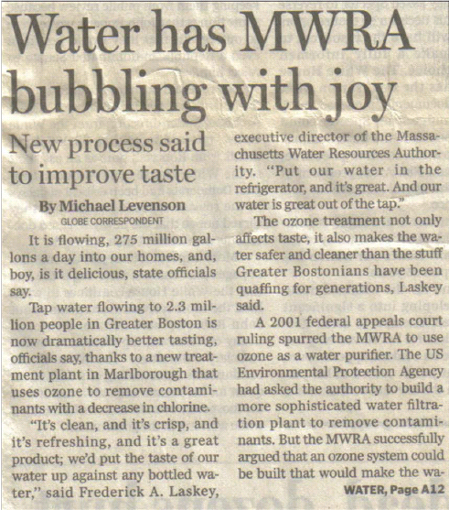
Appeal based on what’s good
Consider language
“It’s clean, and it’s crisp, and it’s refreshing, and it’s a great product…”
Notes:
One approach—focus on what is good about water system. This is often overlooked. Boston-area utility. People don’t talk about water in this way. We joke about not drinking tap water in some town. This is a good way for support.
To add on to that point, your customers want to have safe water, but we know that safe water and aesthetically pleasing water are not always the same thing. As a utility, your top priority is safe water, and while having additional capacity for aesthetics is nice, it is not a requirement. If this is something you will have capacity to do, this could be an effective way to engage with stakeholders and drum up support
Additionally, if you are trying to add something to your system that will make it more efficient (like radio-read meters), you may be able to justify these increases by noting that you will not need another substantial increase for a long time. Similarly, you may be able to justify implementing a small, yearly rate increase by laying it out in your city code, informing customers, and making it small enough that it does not make a huge difference in their overall bill. Appeal based on minimal future increases and by being proactive now.

Slide 21

Warn of consequences
Consider language
Notes:
#3—Scare the crap out of people. But there are real consequences. Can you afford the crisis from inaction?
This is a great method if you are trying to build an asset management plan or if you want to keep some additional capital for a "rainy day". You will inevitably run into problems like ageing infrastructure, breaks, leaks, (a pandemic where people cannot pay for their bills), and pressure issues, among other things. These are normal events that happen for all utilities, and not having the capital to tackle those head-on when they happen could mean major losses in the long run (or additional costs from loans)

Slide 22
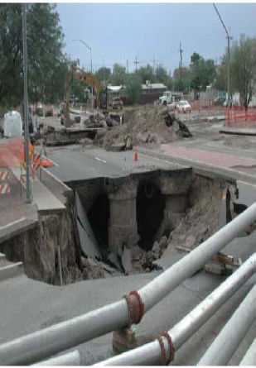
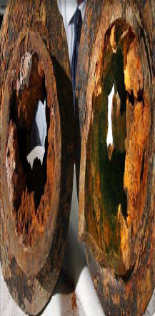
Provide visuals
Consider language
Photo Source: http://www.wuc.on.ca/information/distribution.our_watermains.cfm
Notes:
One of the big problems we have is asset is behind trees or walls or underground. This makes it real and tangible and obvious. This is not unusual for cast iron pipes in older systems. At funding fair, we had a small town mayor there who did not know much about technical details. But a lay person can understand this, so the mayor brought in a rusty pipe to the funders.
We have seen multiple utilities use this angle to get buy-in for necessary rate increases. Appealing to problems that are present in your utility and actually SHOWING your board / council the kinds of problems you are facing could make the situation more real and tangible for them. Seeing rusty, clogged pipes and other infrastructure issues can make these issues feel more real and give context to the water quality that your utility can produce under current and future financial conditions

Slide 23
Communications After Major Disruption

Slide 24
Contact Us!
Alicea Easthope-Frazer
Senior Project Director
aliceaef@sog.unc.edu

