Slide 1
Funding Overview
May 22, 2025
Alicea Easthope-Frazer
Senior Project Director

Slide 2
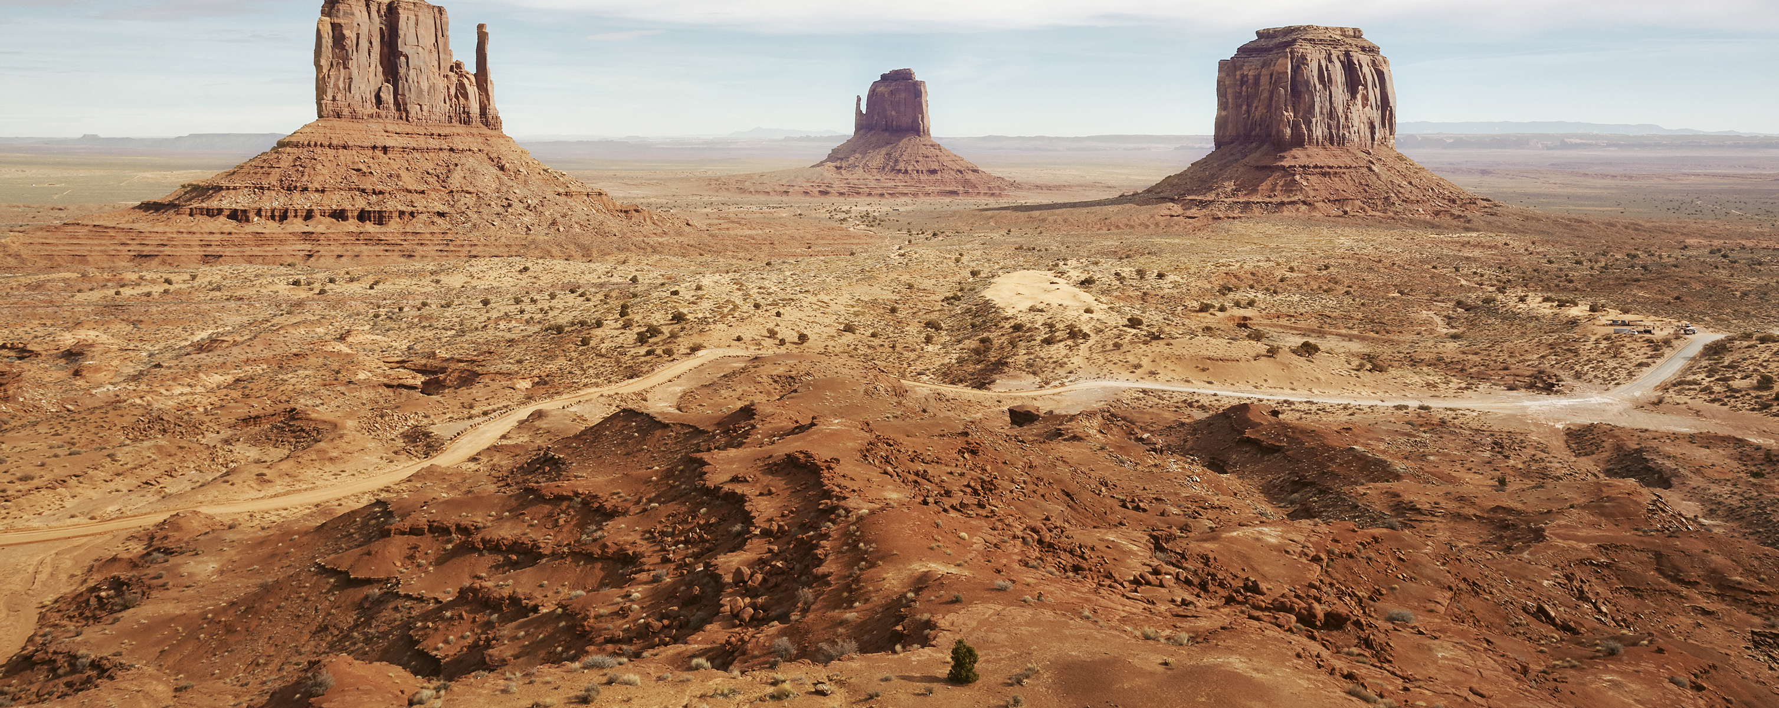
Navigating the funding landscape

Slide 3
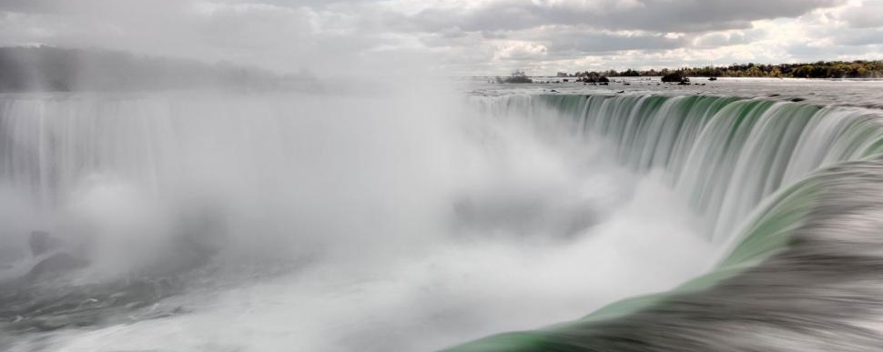
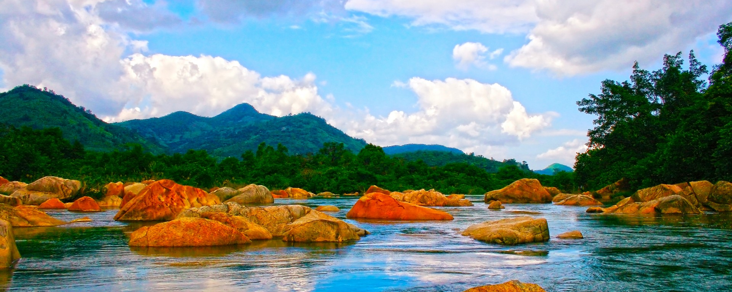
Navigating the funding landscape
Pexels, CC license, https://freerangestock.com/photos/129628/niagara-falls.html

Slide 4

Navigating the funding landscape
MFA Boston, https://www.mfa.org/exhibition/dali-disruption-and-devotion

Slide 5
Navigating the funding landscape
Funding is confusing, complex, and constantly changing
Know the basics, check the details
Stay inquisitive, investigative, innovative
MFA Boston, https://www.mfa.org/exhibition/dali-disruption-and-devotion

Slide 6

Why is it so hard to access infrastructure funding?
Navigating the funding landscape

Slide 7
Why is it so hard to access infrastructure funding?
Navigating the funding landscape
Complex application processes
Reluctance to take on loans/no debt service capacity
Lack of staff time, capacity, expertise (or support from engineers)
Out of audit compliance
Project doesn’t qualify
Matching funds/closing fees required
Requires additional analysis ($$, professional expertise, etc.)

Slide 8

Sources of Funding

Slide 9
What funding sources are you familiar with?
Funding sources

Slide 10
Funding overview
Sources of funding
Federal, recurring
  State revolving fund (SRF)
    State specific amounts, set-asides, etc.
  Community development block grant (CDBG)
  United States Department of Agriculture (USDA) Rural Development
  Federal Emergency Management Agency (FEMA)
  Others – EPA, USACE, EDA, DOE, etc. etc. etc.
Federal, onetime
  Coronavirus Aid, Relief, and Economic Security Act (CARES)
  American Rescue Plan Act (ARPA or ARP)
State
  State reserves & specific programs
  Direct appropriations/ earmarks
Non-profits
  Golden LEAF
  NC Rural Center
  Appalachian Regional Commission
  Other regional sources
  Others?
Private market– loan
“Self funding”
  Bonds?
  Reserves
  Rate increases

Slide 11
Funding overview
Sources of funding
Federal, recurring
  State revolving fund (SRF)
    State specific amounts, set-asides, etc.
  Community development block grant (CDBG)
  United States Department of Agriculture (USDA) Rural Development
  Federal Emergency Management Agency (FEMA)
  Others – EPA, USACE, EDA, DOE, etc. etc. etc.
Federal, onetime
  Coronavirus Aid, Relief, and Economic Security Act (CARES)
  American Rescue Plan Act (ARPA or ARP)
State
  State reserves & specific programs
  Direct appropriations/ earmarks
Non-profits
  Golden LEAF
  NC Rural Center
  Appalachian Regional Commission
  Other regional sources
  Others?
Private market– loan
“Self funding”
  Bonds?
  Reserves
  Rate increases

Slide 12
State Revolving Fund

Slide 13
Background
State revolving fund
Drinking Water & Clean Water (wastewater) operate separately and under different policies
  Sometimes housed under separate state agencies
  Established in 1987 (CW) and 1996 (DW)
Offers low-interest (~2-3%) loans for water-related infrastructure projects
“Revolving”
  EPA capitalizes the loans to the states
  States provide 20% match and make determinations on how to distribute funds
  Funds are paid back by recipients (towns, authorities, Counties, etc.) with interest so that funds can be redistributed in the future
EPA details $$ to each state in the annual allotment from Congress

Slide 14
Types of Projects
State revolving fund
Clean Water:
  Wastewater treatment
  Wastewater collection
  Reclaimed water
  Stormwater BMPs
  Stream restoration
  Energy efficiency at treatment works or collection systems
Drinking Water:
  Source
  Treatment
  Storage
  Transmission & distribution systems

Slide 15
Key Requirements
State revolving fund
Clean Water:
  Loan maximum is $35M.
  Construction must start within 24 months of Letter of Intent to Fund.
  Closing fee of 2% (which cannot be financed).
  Local Government Commission (LGC) must approve all loans.
Drinking Water:
  Loan maximum of $25M.
  Construction must start within 24 months of Letter of Intent to Fund.
  Closing fee of 2% (which cannot be financed).
  Local Government Commission (LGC) must approve all loans.

Slide 16
Intended Use Plans
State revolving fund
Dense documents provided by the states to the EPA to detail how they’re going to use the previous year’s grant
Project Priority List (PPL)
Scoring methods
Financing terms for loan (length, maximum amount, interest rate, principal forgiveness)
Project requirements (Davis Bacon, BABA, etc.)
Set aside details
Open for feedback prior to finalization

Slide 17
Timing & Links
State revolving fund
Spring and Fall submission, date varies every year but roughly falls at the end of April and the end of September
CW SRF: https://www.deq.nc.gov/about/divisions/water-infrastructure/i-need-funding/clean-water-state-revolving-fund
DW SRF: http://deq.nc.gov/about/divisions/water-infrastructure/i-need-funding/drinking-water-state-revolving-fund

Slide 18
Emerging contaminants (PFAS, lead service line)
State revolving fund
Emerging contaminants
  Construction projects or planning projects addressing any PFAS in drinking water and wastewater systems. Treatment of landfill leachate with PFAS is also eligible for funding.
  LGUs or non-profit water/wastewater corporation, DW – investor-owned
  100% principal forgiveness
Lead service line
  Replace lead service lines and lead connectors between the main water line and the point of the premise plumbing, usually outdoors up to the building inlet
  LGUs, non-profit water/wastewater corporation, investor-owned water utilities
  Low-interest loans; principal forgiveness will be offered for those that are eligible, subject to availability.
5 cycles per year (next is June 2, 2025)

Slide 19
Special SRF (SA-HMW)

Slide 20
Hurricane Helene SRF
Special SRF (SA-HMW)
American Relief Act, 2025 (PL 118-158) includes Supplemental Appropriations for the State Revolving Funds (SRF) for drinking water facilities and wastewater treatment works impacted by Hurricane Helene (SA-HMW)
The SRF Helene funds will be used for infrastructure projects for drinking water, wastewater, and decentralized wastewater treatment systems that reduce flood risk and vulnerability and/or enhance resiliency to rapid hydrologic change or natural disasters.

Slide 21
SA-HMW – Types of Projects
Special SRF (SA-HMW)
This program can fund SRF-eligible projects that serve one or more of the following purposes:
Reduce flood risk and vulnerability at treatment works
Enhance resiliency to rapid hydrologic change or natural disasters at treatment works
Examples (not inclusive)
  Projects that prevent interruption of collection/distribution system operation in the event of a flood or natural disaster
  Projects that prevent floodwaters from entering treatment works or well house
  Projects that make connections from homes served by decentralized wastewater treatment systems to centralized wastewater treatment systems

Slide 22
SA-HMW – Eligibility
Special SRF (SA-HMW)
Any local government unit (LGU) or non-profit water/wastewater corporations affected by Hurricane Helene (LGUs include counties, cities, towns, sanitary districts, water and sewer authorities, etc.)
Investor-owned drinking water corporations affected by Hurricane Helene may also apply for the DWSRF SA-HMW funds.

Slide 23
SA-HMW – Amounts & Terms
Special SRF (SA-HMW)
North Carolina’s allotment is $409 million for DWSRF projects and $253 million for CWSRF projects, including administrative costs.
There is also approximately $22 million for the CWSRF program to improve the resilience of decentralized wastewater treatment systems.
Terms: no interest loans, with principal forgiveness applied to a portion of the loan, 20- to 30-year loan terms (based on anticipated life of infrastructure)
IUP expected any day

Slide 24
Community Development Block Grant

Slide 25
Background
CDBG
Funded through Housing and Urban Development (HUD)
Goal: build stronger and more resilient communities
More discretion from the community on how to accomplish goals
One piece – Rural Infrastructure Program (includes water/wastewater)

Slide 26
Rural Infrastructure
CDBG
Assist with public infrastructure projects that will lead to the direct creation of new, full-time, private-sector jobs.
Projects
  Construction, upgrade, or repair of public drinking water or wastewater treatment plants
  Construction, upgrade, extension, of repair of public water or sewer lines
Eligible applicants are units of local government located in Tier 1 or Tier 2 counties, or within a rural census tract in a Tier 3 county.
The program requires a cash match of 5% of the grant request amount.

Slide 27
USDA Rural Development

Slide 28
Background
USDA
Emergency Community Water Assistance Grants
SEARCH grants: pays for predevelopment feasibility studies & design
Revolving fund: small, short loans requiring 20% match
Water and Waste Disposal Loans and Grants: terms up to 40-years
https://www.rd.usda.gov/nc

Slide 29
Emergency Community Water Assistance Grants
USDA
This program helps eligible communities prepare, or recover from, an emergency that threatens the availability of safe, reliable drinking water.
Rurally located public bodies (<10k), Nonprofit organizations, Federally recognized tribes
Show major decline in quantity or quality of water occurred within two years of the date of the application. Grants are also awarded when a significant decline in quality and quantity of water is imminent.
Transmission line cap: $150k, water source: $1M

Slide 30
SEARCH - Special Evaluation Assistance for Rural Communities and Households Grants
USDA
This program helps very small, financially distressed rural communities with predevelopment feasibility studies, design and technical assistance on proposed water and waste disposal projects.
Rurally located public bodies (<2,500), Nonprofit organizations, Federally recognized tribes
Low-income (MHI below the poverty line or <80% of the statewide non-metropolitan MHI based on latest Census data)
Predevelopment planning costs, including: Feasibility studies, Preliminary design and engineering analysis, Technical assistance

Slide 31
Water and Waste Disposal Loans and Grants
USDA
Funding for clean and reliable drinking water systems, sanitary sewage disposal, sanitary solid waste disposal, and storm water drainage to households and businesses in eligible rural areas.
Rurally located public bodies (<10k), Nonprofit organizations, Federally recognized tribes
Long-term, low-interest loans (40-year term, interest rate based on need and MHI)
If funds are available, a grant may be combined with a loan if necessary to keep user costs reasonable
Funds may be used to finance the acquisition, construction, or improvement

Slide 32
Overview of Programs
USDA
https://www.rd.usda.gov/programs-services/all-programs/nc?field_program_section_target_id=6982&keywords=

Slide 33
Other State Opportunities

Slide 34
Asset Inventory and Assessment Grants
Other state opportunities
Grants, limited to $150,000 from the Wastewater Reserve or the Drinking Water Reserve, over a period of three years
https://www.deq.nc.gov/about/divisions/water-infrastructure/i-need-funding/asset-inventory-and-assessment-grants

Slide 35
Merger/Regionalization Feasibility Grants
Other state opportunities
Studies to evaluate the potential consolidation or two or more systems into one system into one system and the potential physical interconnection with another system for regional wastewater treatment or regional water supply.
Grants, limited to $50,000 from the Wastewater Reserve or the Drinking Water Reserve, over a period of three years
https://www.deq.nc.gov/about/divisions/water-infrastructure/i-need-funding/mergerregionalization-feasibility-grants

Slide 36
Earmarks/Appropriations
Other state opportunities
Direct appropriations that fund a specific recipient
Can be an opportunity to fund things that normally are challenging to fund via competitive processes
Can be for larger amounts of money and not a loan
Can be funded without as much direction or potential oversight
Often political, able to be withdrawal, often requires lots of lobbying

Slide 37
Funding is complicated, where do we start?
Consider your existing knowledge, conditions, debt
Consider projects based on greatest need and eligibility
Seek out support for how to best approach options

Slide 38
Contact Us!
Alicea Easthope-Frazer
Senior Project Director
aliceaef@sog.unc.edu

