Slide 1
Setting the Right Rates for Your Water and Wastewater System
May 22, 2025
Alicea Easthope-Frazer
Senior Project Director

Slide 2
Agenda
Setting the right rates
Revenue Requirements
Types of Rate Structures
Causes of Revenue Variation
Customer Affordability
Billing Correctly
Designing Blocks
Rate-Setting Objectives
Process for Raising Rates
Pricing for Full-Cost Recovery
Questions

Slide 3
Session Objectives
Setting the right rates
Understand common types of rate setting objectives
Learn how to match rate structure elements with rate setting objectives
Be able to use different approaches to calculate base charges and volumetric charges
Evaluate the impact of different pricing structures on different customers
Identify factors that can impact your pricing assumptions

Slide 4

Need for Rate Review
Setting the right rates
3%
5%
9%
24%
36%
21%
Increased level of financial sufficiency
Not all O&M
O&M but no owed debt
O&M + some (but not all) debt service
O&M + all debt service
O&M, debt, additional revenue but not enough for all the utility's reserve
O&M, debt, + all needed reserves, including for short-term future capital needs
Source: UNC-EFC: Results of the 2024 North Carolina
Water and Wastewater Utility Management Survey
Notes:
In 2024, most utilities were bringing in enough revenue from their rates and other revenue generators to sufficiently sustain themselves, yet only a fifth reported being able to sustain themselves while also putting away additional capital for future needs and prevent future rate increases. This means 79% of utilities will likely need to consider a rate increase in the near future to meet, sustain, or fund current and future goals.

Slide 5

Revenue Requirement
Setting the Right rates
Notes:
This is the “science” part of the rate making process
Sets the bar for how much you need to operate a financially sustainable utility

Slide 6
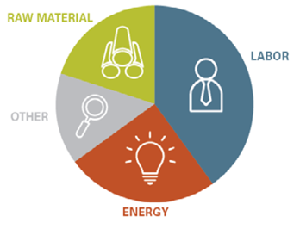
Three Types of Costs
Revenue requirement
Operating Costs—what you need to run the system day in and day out (O&M), etc.)
  Look at trends from previous years and challenge your operators to look for cost savings
  Look to the future
  Don’t forget indirect costs of running the system
    shared management costs, shared facility costs, etc.
Notes:
There are 3 types of costs, which are the components of your revenue requirement
First, are operating and maintenance expenses
Look at trends from previous years and challenge your operators to look for cost savings
Pay attention to the largest buckets of expenses that might move the needle for cost control
Look to the future
Don’t forget indirect costs of running the system (shared management costs, shared facility costs, etc.)
Include salaries, energy costs, things that are variable as well as fixed

Slide 7
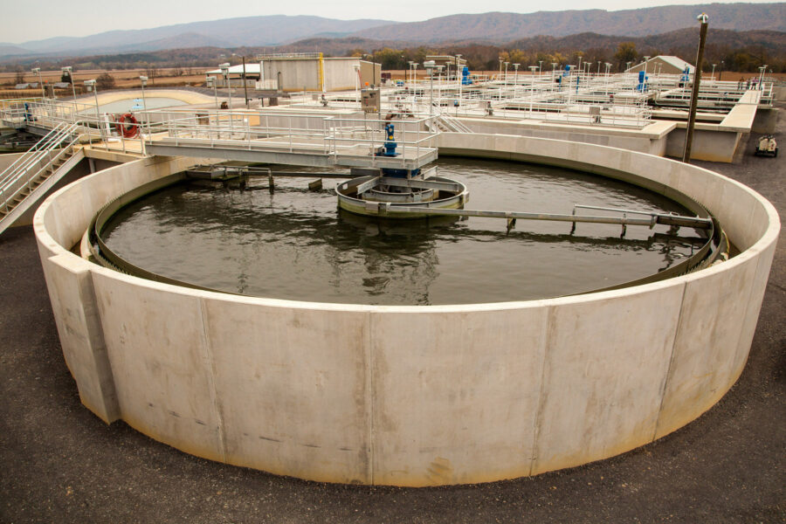
Three Types of Costs
Revenue requirement
Operating Costs—what you need to run the system day in and day out (O&M), etc.)
Capital Costs—rehabilitation and replacement of existing infrastructure and new infrastructure
  Asset management and capital improvement plans are key
  Be flexible in your spending but do not manage to failure

Slide 8
Three Types of Costs
Revenue requirement
Operating Costs—what you need to run the system day in and day out (O&M), etc.)
Capital Costs—rehabilitation and replacement of existing infrastructure and new infrastructure
Debt Service—what you owe on loans and bonds
  Principal and Interest
Notes:
Debt service – prep for debt service by thinking about cost recovery from debt

Slide 9
Many Types of Reserve Funds
Revenue requirement
Capital Reserve Fund—Infrastructure rehabilitation and replacement
Repair Fund—Known, ongoing maintenance issues
Emergency Fund—Unknown, unanticipated maintenance issues
Rainy Day Fund—Unexpected revenue shortfalls

Slide 10
Flows of Funds
Revenue requirement
System
Income
Operating
Costs
Reserve
Funds
Capital Reserve
Repair
Current Capital Projects
Debt
Emergency
Debt
Service
Rainy Day
10
Revenues
Costs
SAVINGS
Notes:
Note: there are a lot of pots of money, moving around for different purposes under different conditions; and so its understandable for it to be confusing

Slide 11
Consequences of not understanding
Revenue requirement
Financially unsustainable
Collect too much
Collect too little
Send the wrong message to your customers

Slide 12
Budgeting for the full cost
Revenue requirement
Operations & maintenance expenditures
Taxes and accounting costs
Contracts
Long-term debt (principal and interest)
Contingencies for emergencies
Reserves for capital improvement
Indirect costs (fleet, buildings, shared expenditures, etc.)
Retirement
Notes:
These will guide your other decisions.
Include salaries, energy costs, things that are variable things that are fixed. Could include related activities – source water protection for drinking water?

Slide 13
Budgeting for the full cost
Revenue requirement
Knowing all about the costs informs how much is needed in revenues
Operations & maintenance expenditures
Taxes and accounting costs
Contracts
Long-term debt (principal and interest)
Contingencies for emergencies
Reserves for capital improvement
Indirect costs (fleet, buildings, shared expenditures, etc.)
Retirement
Notes:
These will guide your other decisions.
Include salaries, energy costs, things that are variable things that are fixed. Could include related activities – source water protection for drinking water?

Slide 14
Causes of Revenue Variation
Setting the Right rates

Slide 15

Your revenues last year were…
Causes of Revenue Variation
Significantly higher than expected
Slightly higher than expected
Close to as planned
Slightly lower than planned
Significantly lower than planned

Slide 16

Rate Changes
Causes of Revenue Variation
As rates go up, usage goes down
As a rule of thumb, typically usage goes down 3-4% for every 10% increase in rates

Slide 17
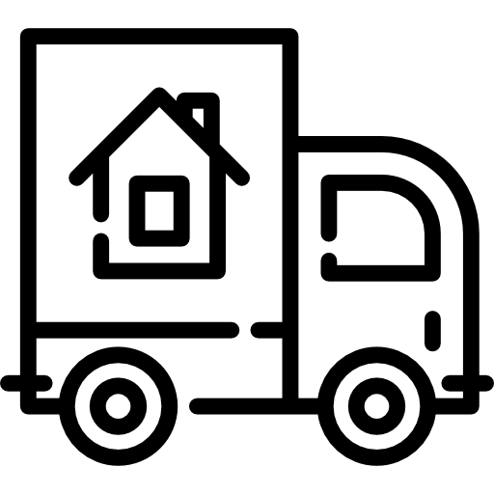
Population Changes
Causes of Revenue Variation
Customers could be coming into your system or leaving your system

Slide 18

Loss of a Big Customer
Causes of Revenue Variation
Some customers use significantly more water than others.
Losing or gaining a single big user can have a disproportionate impact on your budget

Slide 19
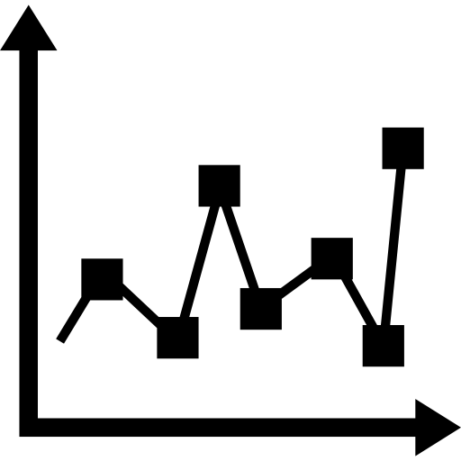
Economic Conditions
Causes of Revenue Variation
Economic downturns can cause customers to cut back on water use.
Conversely, periods of economic growth can lead to higher water consumption

Slide 20

Changes in Collection Rates
Causes of Revenue Variation
Even if the number of customers doesn’t change, how often they are paying you may be changing

Slide 21


Weather/Climate
Causes of Revenue Variation
Rainy conditions or dry/drought conditions can impact how much water customers use for outside irrigation
Rainy conditions can impact how much additional water is entering your wastewater system

Slide 22

Water Use Restrictions
Causes of Revenue Variation
Whether due to water supply shortages or drought conditions, restricting water use will obviously impact revenues

Slide 23


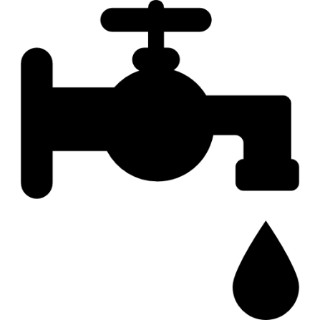

Technology
Causes of Revenue Variation
Fixtures use less water today than in the past, and overall per capita water demand is decreasing across the country

Slide 24
Budgeting / Projecting
Causes of Revenue Variation
Source: Orange Water and Sewer Authority, North Carolina
Notes:
Budgeting need to predict the future.
There are people who do projections.
Look at this – easy projection. Straight line. Easy for budgeting. And population continued to grow. But … we saw …

Slide 25
Budgeting / Projecting
Causes of Revenue Variation
Conservation Pricing Changes in 2002 and 2007
Reclaimed Water Use Begins
Source: Orange Water and Sewer Authority, North Carolina
Notes:
… this. Use went down. Combination of people using less (more efficient) and a few events and big projects. University reclaim water use. In some towns , it’s loss of an industry. Drought. Predictions – need to keep finger on the pulse of the community, AND be ready for the bad scenarios.

Slide 26
Billing Correctly
Setting the Right rates

Slide 27
Water
Billing correctly
Volume From Own Sources
Treatment and Storage
Water Exported
Authorized Consumption
Billed
Authorized Consumption
Water Exported
Revenue
Water
Supplied To Your System
Billed Metered
Billed Unmetered
Unbilled
Authorized Consumption
Unbilled Metered
Non-Revenue
Water
Unbilled Unmetered
Water Losses
Apparent Losses
Unauthorized
Consumption
Customer Metering Error
Systematic Data Handling Errors
Imported
Water
Real Losses
Mains Leaks
Service Leaks
Tank Overflows

Slide 28
Wastewater
Billing correctly
Revenue
Water
Inflow and Infiltration
Consider
Is the wastewater treatment of all your customers the same? Do you have any industrial wastewater users whose waste is more costly to treat?
Billed water
Non-Revenue
Water
Revenue
Wastewater
Irrigation Use
Notes:
Billed water turns into billed wastewater, but you lose some to irrigation, and gain some through I&I
Inflow and infiltration (operating expense) – stormwater events, high groundwater table, old/broken infrastructure,
Are all of your water customers being billed for wastewater and vice versa? (some may tap into one and not the other)
Pretreatment requirements for industrial users? Surcharge for industrial users if producing waste above a certain standard?

Slide 29
Rate Setting Objectives
Setting the Right rates

Slide 30


Best Rate Setting Practices
Rate setting objectives
Simple
Based on expenses
Cover full costs
Fair, affordable & equitable
Super-complicated
Frozen in time
Based on political desires
Based upon neighbors
Notes:
Rates and setting them should be simple to understand, implement, and change when necessary. Complex tier structures can be challenging, so try to keep them straight-forward so that utility staff and rate-payers and decision-makers all understand the process for setting and implementing rates.
Rates should be based on expenses to cover full costs of operations and should be fair, affordable, and equitable for all rate-payers.
Rates should not be frozen in time. Rates have to increase as costs increase in order to cover the cost of operating a utility. They should not be based on political desires or ambitions but rather on what is needed for the utility and the community. It is okay to consider what other similar communities’ rates are; however, it is important to understand that each utility is unique in its community and its needs. Use your own community’s information to make wise decisions about rates and setting them.

Slide 31
Rates that are right can:
Rate setting objectives
Provide adequate funds to support:
  public health
  environmental protection
Support local and state policies and priorities
Communicate in a certain way with customers
Allocate costs in an intentional and fair way

Slide 32
Path towards financial sustainability
Rate setting objectives
Get to know your assets and financial condition
Establish your priorities and goals
Identify your “true”, “full”, or “fuller” costs
Get to know your customers (usage, characteristics)
Consider future scenarios and changes
Establish rates (rate structure and prices)
Repeat as often as necessary…..

Slide 33
Rates that aren’t right can:
Rate setting objectives
Provide inadequate funds to support:
  public health
  environmental protection
Contradict local and state policies and priorities
Communicate in a certain undesirable way with customers
Allocate costs unfairly

Slide 34
Utility Objectives
Rate setting objectives
Full cost recovery / revenue stability
Encouraging conservation
Maintaining affordability
Fostering business-friendly practices
Building reserves
Bring in enough revenue to cover the full cost of running the utility:
  O&M
  Capital needs
  Debt service
Notes:
Budgets, again can be used to communicate water system objectives

Slide 35
Utility Objectives
Rate setting objectives
Full cost recovery / revenue stability
Encouraging conservation
Maintaining affordability
Fostering business-friendly practices
Building reserves
Use pricing to encourage customers to reduce their water consumption
Why do this? What challenges does this create?
Notes:
Budgets, again can be used to communicate water system objectives

Slide 36
Utility Objectives
Rate setting objectives
Full cost recovery / revenue stability
Encouraging conservation
Maintaining affordability
Fostering business-friendly practices
Building reserves
Ensure that all customers in your water system can afford enough water to live on
Why do this? What challenges does this create?
Notes:
Budgets, again can be used to communicate water system objectives

Slide 37
Utility Objectives
Rate setting objectives
Full cost recovery / revenue stability
Encouraging conservation
Maintaining affordability
Fostering business-friendly practices
Building reserves
Use pricing to encourage businesses and agriculture to locate to your community or stay in your community
Why do this? What challenges does this create?
Notes:
Budgets, again can be used to communicate water system objectives

Slide 38
Utility Objectives
Rate setting objectives
Full cost recovery / revenue stability
Encouraging conservation
Maintaining affordability
Fostering business-friendly practices
Building reserves
Use pricing to build up capital reserves and pay for future capital needs or emergencies
Why do this? What challenges does this create?
Notes:
Budgets, again can be used to communicate water system objectives

Slide 39
What is your # 1 objective?
Rate setting objectives
Full cost recovery
Encouraging conservation
Business friendly
Affordability
Building reserves
Something else

Slide 40
Pricing for Full-Cost Recovery
Setting the Right rates

Slide 41
Number 1 Goal
Pricing for full-cost recovery
Full cost recovery / revenue stability
Encouraging conservation
Maintaining affordability
Fostering business-friendly practices
Building reserves
Goal: charges for water/sewer cover the entire cost of running the system today and into the future
Many ways to calculate
Rate setting philosophy
Notes:
Budgets, again can be used to communicate water system objectives

Slide 42
Rate Setting Philosophies
Pricing for full-cost recovery
Payment for access vs. payment for volume of product received
Fixed charges for fixed costs and variable charges for variable costs
Some mix of the above ideas

Slide 43

Pricing for full-cost recovery
Image Credit
Notes:
Iterative, not a science, challenging, no silver bullet – different based on your utility, risk tolerance, fixed cost, your priorities

Slide 44
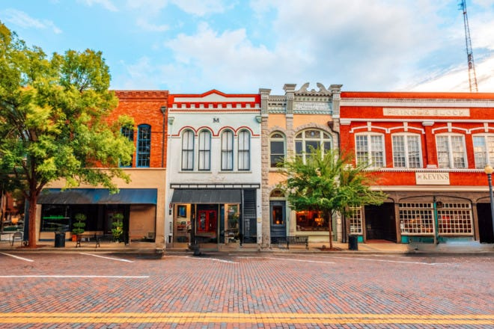
Pricing for full-cost recovery
Greetings from
IRVINDALE
Image Credit
Notes:
Iterative, not a science, challenging, no silver bullet – different based on your utility, risk tolerance, fixed cost, your priorities

Slide 45


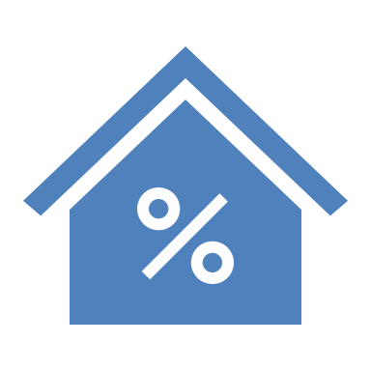
Irvindale
Pricing for full-cost recovery
Small town with a water and wastewater system
Population: 1,100
Service Connections: 450
MHI: $24,432

Slide 46
All Revenues
Pricing for full-cost recovery

Slide 47
Rate Revenue
Pricing for full-cost recovery
Total Revenues:
$382,932.87
Revenues from Rates:
$344,445.00

Slide 48
Types of Rate Structures
Setting the Right rates

Slide 49



Payment for Access
Types of rate structures
In its pure form, everyone in the water system pays the same amount for access to the system, regardless of how much water they use

Slide 50
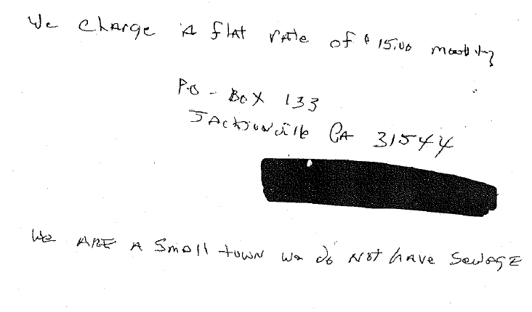
Payment for Access
Types of rate structures
Jacksonville, GA

Slide 51
Payment for Access
Types of rate structures
Data needs:
Total revenue requirement
Number of accounts
Jacksonville, GA

Slide 52
Payment for Access – Calculation
Types of rate structures
$344,445
$765.43
$63.79
450

Slide 53
Payment for Access – Which objective(s)?
Types of rate structures
Full cost recovery / revenue stability
Encouraging conservation
Maintaining affordability
Fostering business-friendly practices
Building reserves
Notes:
Full cost recovery
Might be business-friendly, if businesses are water users

Slide 54
Payment for Volume of Product Received
Types of rate structures
In its pure form, everyone in the water system pays for the volume of water received and only for the volume of water received

Slide 55
Payment for Volume of Product Received
Types of rate structures
Troutman, NC

Slide 56
Payment for Volume of Product Received
Types of rate structures
Data needs:
Total revenue needed from rates
Total gallons sold
Troutman, NC

Slide 57
Payment for Volume – Calculation
Types of rate structures
$344,445
$10.48
32,877,590

Slide 58
Payment for Volume – Which objective(s)?
Types of rate structures
Full cost recovery / revenue stability
Encouraging conservation
Maintaining affordability
Fostering business-friendly practices
Building reserves
Notes:
Encouraging conservation while full cost recovery? Some measure of affordability I would imagine since disadvantaged users tend to be lower users.
Volumetric – connection with customer, customers are more likely to look at this, use less

Slide 59
Base Charge for Fixed Costs; Volumetric Charge for Variable Costs
Types of rate structures
In its pure form:
  Fixed costs covered by the base charge
  Variable costs covered by the volumetric rate

Slide 60

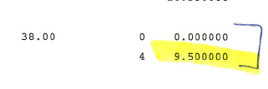
Base Charge for Fixed Costs; Volumetric Charge for Variable Costs
Types of rate structures
Readsboro, VT

Slide 61
Base Charge for Fixed Costs; Volumetric Charge for Variable Costs
Types of rate structures
Readsboro, VT

Slide 62
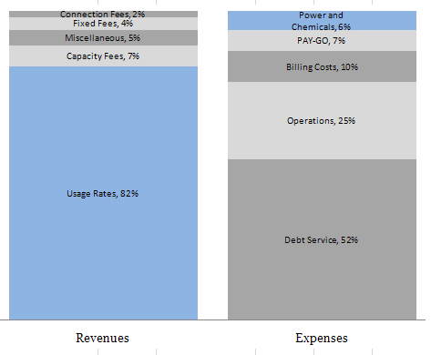
Fixed vs. Variable Revenues and Expenses
Types of rate structures
Revenue and Expenses for Charlotte-Mecklenburg Utilities in a Given Year
Revenues change with the amount of water used
Most expenses stay constant
Source: CMU Director Doug Bean’s presentation to the Charlotte City Council on December 1, 2008.
Notes:
And why is it important to try to match these up? well because naturally expenses and revenues work pretty differently, and have different factors impacting their variation. In this budget, we can see that revenues are highly dependent on amount of water sold, so highly variable (big blue bar on the left); but costs (grey bars on the right) are almost entirely fixed. So, if this utility has a down month in revenues -- say it rains a lot, and people arent watering their lawns -- they could struggle to cover all of their fixed costs
Another characteristic of public enterprises. The things that are blue are directly proportional to the services being provided. Blue – variable. As you provide more services, blue goes up. As services go down, blue goes down. So if there’s a drought and Charlotte has to provide 20% less, revenues go down, but will costs go down proportionally? No.
In NC, we are selling less water.
“But the bill keeps going up!”
EXACTLY. Because of this. We are selling less. Revenues going down a lot, but costs don’t. So you need to raise the rates and the bills go up as a consequence.
One of the key lessons that all utility managers should remember is that water and wastewater utilities are very capital-intensive. The vast majority of the expenses for a utility are tied to capital and administrative costs, and not tied to how much water is treated and distributed. Variable costs increase in the short run as more water is treated and distributed, such as the cost for energy and chemicals. Fixed costs are the other costs that the utility incurs, and do not vary in the short run based on volume of water produced. For most utilities, such as this example from Charlotte-Mecklenburg Utilities, the vast majority of costs are fixed costs, while the majority of revenues come from usage rates. Thus, if customers reduce their consumption significantly (e.g.: during mandatory watering restriction periods), revenues will reduce significantly while the overall costs will not change much. This is the reason why utilities frequently have insufficient revenues during mandatory restriction periods, and require a significant rate increase the next year.
There are ways the utility can design its rate structures to buffer against this effect, mainly through charging higher non-variable base charges, but these methods require a balance between setting revenue stability-oriented rate structures and conservation-oriented rate structures that reward customers financially for reducing consumption.

Slide 63
Fixed vs. Variable Revenues and Expenses
Types of rate structures
Revenues decrease when you sell less – often resulting in higher bills to continue to cover costs
Revenue and Expenses for Charlotte-Mecklenburg Utilities in a Given Year
Revenues change with the amount of water used
Most expenses stay constant
Rate structures can be designed to better cover fixed costs including administrative and capital needs
Source: CMU Director Doug Bean’s presentation to the Charlotte City Council on December 1, 2008.
Notes:
Another characteristic of public enterprises. The things that are blue are directly proportional to the services being provided. Blue – variable. As you provide more services, blue goes up. As services go down, blue goes down. So if there’s a drought and Charlotte has to provide 20% less, revenues go down, but will costs go down proportionally? No.
In NC, we are selling less water.
“But the bill keeps going up!”
EXACTLY. Because of this. We are selling less. Revenues going down a lot, but costs don’t. So you need to raise the rates and the bills go up as a consequence.
One of the key lessons that all utility managers should remember is that water and wastewater utilities are very capital-intensive. The vast majority of the expenses for a utility are tied to capital and administrative costs, and not tied to how much water is treated and distributed. Variable costs increase in the short run as more water is treated and distributed, such as the cost for energy and chemicals. Fixed costs are the other costs that the utility incurs, and do not vary in the short run based on volume of water produced. For most utilities, such as this example from Charlotte-Mecklenburg Utilities, the vast majority of costs are fixed costs, while the majority of revenues come from usage rates. Thus, if customers reduce their consumption significantly (e.g.: during mandatory watering restriction periods), revenues will reduce significantly while the overall costs will not change much. This is the reason why utilities frequently have insufficient revenues during mandatory restriction periods, and require a significant rate increase the next year.
There are ways the utility can design its rate structures to buffer against this effect, mainly through charging higher non-variable base charges, but these methods require a balance between setting revenue stability-oriented rate structures and conservation-oriented rate structures that reward customers financially for reducing consumption.

Slide 64
Base Charge for Fixed Costs; Volumetric Charge for Variable Costs
Types of rate structures
More information needed for this calculation
  Total revenue needed to cover fixed costs
  Total accounts
  Total revenue needed to cover variable costs
  Total gallons sold

Slide 65
Base Charge for Fixed Costs; Volumetric Charge for Variable Costs – Calculation
Types of rate structures
Revenues from Rates:
$344,445
W/S Utilities
Chemicals & Salt
Purchase Water Bill
Everything else
$292,045
$52,400
Fixed Cost
Variable Cost

Slide 66
Base Charge for Fixed Costs; Volumetric Charge for Variable Costs – Calculation
Types of rate structures
$292,045
$648.99
$54.08
450
$52,400
$1.59
32,877,590

Slide 67
Base for Fixed and Volume for Variable – Which objective(s)?
Types of rate structures
Full cost recovery / revenue stability
Encouraging conservation
Maintaining affordability
Fostering business-friendly practices
Building reserves
Notes:
Objective will depend on customers – what does the bill look like for this method? (We’ll look at this.)
Likely less emphasis on conservation – volumetric is so low
Likely less on affordability - $50 is expensive for some, before even paying for water

Slide 68
Common Approached to Setting Base Charges
Types of rate structures
All fixed costs
Debt costs
Customer service costs
Capped at a “reasonable” amount

Slide 69
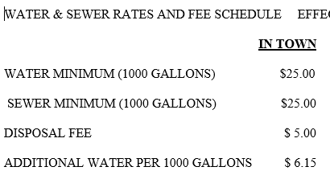
Alternative – Select Base Charge, Balance Volumetric
Types of rate structures
Pick a base charge ($25) and see what the volumetric charge would need to be
Denton, NC

Slide 70
Alternative – Select Base Charge, Balance Volumetric
Types of rate structures
What information do we need to make this calculation?
  Total Accounts
  Total Revenue Needed
  Total Gallons
  Desired Base Charge

Slide 71
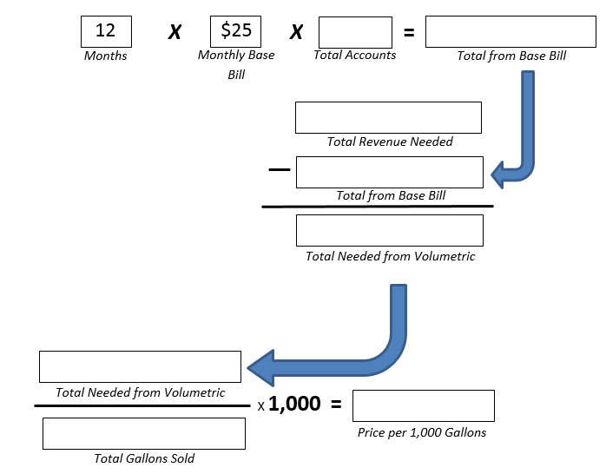
Alternative – Select Base Charge, Balance Volumetric
Types of rate structures
450
$135,000
$344,445
$135,000
$209,445
$209,445
$6.37
32,877,590

Slide 72
Base for Fixed and Volume for Variable – Which objective(s)?
Types of rate structures
Full cost recovery / revenue stability
Encouraging conservation
Maintaining affordability
Fostering business-friendly practices
Building reserves
Notes:
Objective will depend on customers – what does the bill look like for this method? (We’ll look at this.)
Likely less emphasis on conservation – volumetric is so low
Likely less on affordability - $50 is expensive for some, before even paying for water

Slide 73
What structure does your utility have?
Types of rate structures
Ansonville – decreasing block
Payment for Access
Payment for Volume of Product Received
Base charge for fixed costs, Volumetric charge for variable costs
Selected base charge, balance with volumetric
Booonville – flat volumetric
Hot Springs – flat volumetric
Lansing – flat volumetric
Maysville – increasing block

Slide 74
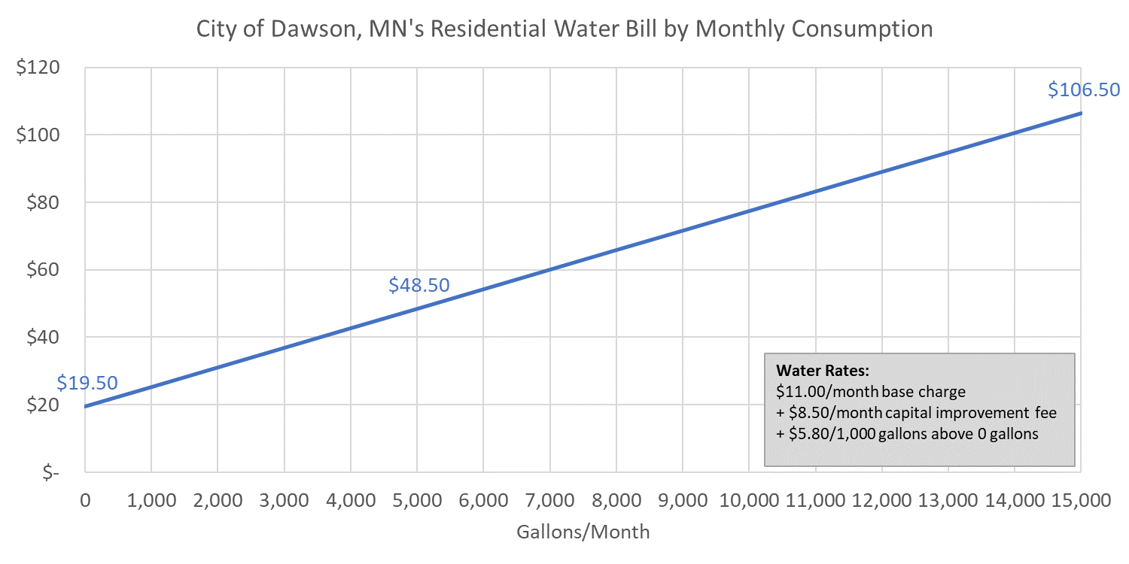
Example of a Rate Structure – Cost Recovery
Types of rate structures
Dawson, MN

Slide 75
Example of a Rate Structure – Conservation
Types of rate structures
Dawson, MN

Slide 76
Example of a Rate Structure – Building Reserves
Types of rate structures
Dawson, MN

Slide 77
Example of a Rate Structure – Business-Friendly
Types of rate structures
Dawson, MN

Slide 78
Example of a Rate Structure – Affordability
Types of rate structures
Dawson, MN

Slide 79
Customer Affordability
Setting the Right rates

Slide 80
Get to Know Your Customers
Customer affordability
Residential vs. non-residential
Incomes and economic status of customers
Use of water (irrigation, industrial production, tourism)
Seasonality patterns
Economic future of large users
Population and usage trends

Slide 81
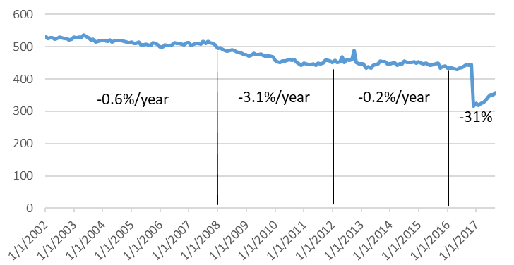
Example: Population Decline
Customer affordability

Slide 82





How do rate structures impact customers?
Customer affordability
1,000 gallons/month | 4,000 gallons/month
12,000 gallons/month | 34,000 gallons/month

Slide 83
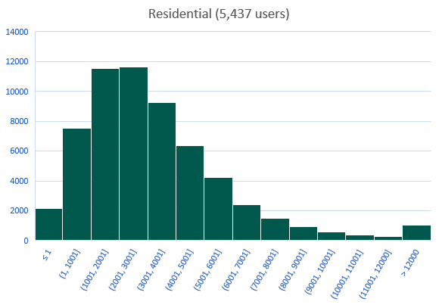
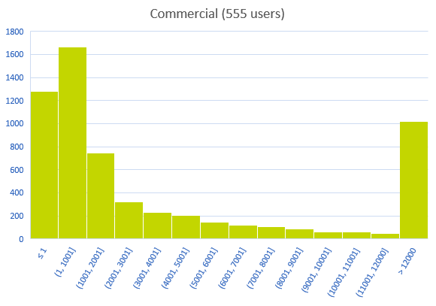
Customer Usage Can Vary
Customer affordability

Slide 84
Irvindale – Rate Options
Customer affordability
$63.79 base
$10.49 per 1,000 gallons
$54.08 base
$1.59 per 1,000 gallons
$25.00 base
$6.37 per 1,000 gallons
Payment for access
Payment for volume
Fixed vs. Variable
Pick a base charge

Slide 85
Irvindale – Rate Options
Customer affordability
 | 1,000 gallons/month | 4,000 gallons/month | 12,000 gallons/month | 34,000 gallons/month
Payment for Access (fixed monthly bill)
Payment for Volume Received
Base Charge for Fixed Costs; Volumetric for Variable Costs
$25 Base Charge; Volumetric for Balance
$63.79
$63.79
$63.79
$63.79
$10.48
$41.92
$125.76
$356.32
$55.67
$60.44
$73.16
$108.14
$31.37
$50.48
$101.44
$241.58
Notes:
All achieve full cost recovery – but the impact on the customer varies substantially

Slide 86
How to support customers
Customer affordability
Get to know your customers
Choose your rate structure appropriately
Consider Customer Assistance Programs (CAPs)

Slide 87
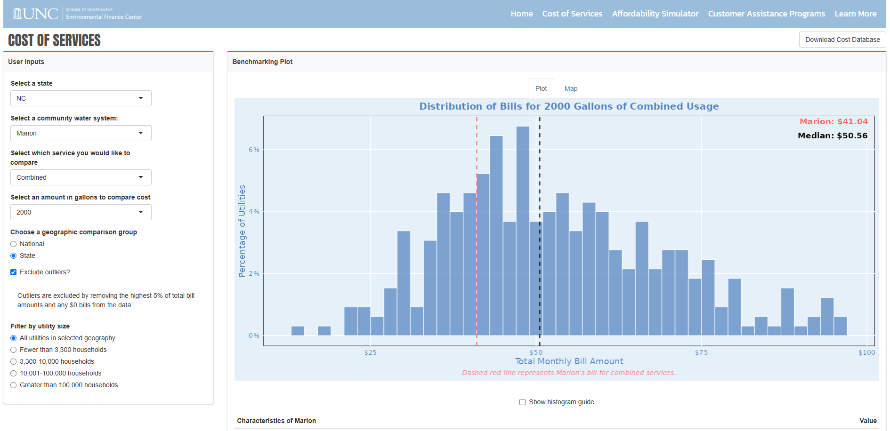
Affordability Dashboard – Cost of Services
Customer affordability
Notes:
Our Affordability Tool helps utilities determine how rate increases will affect customers across different income buckets. The bottom three buckets (up to $25,000 per year), are highlighted in red to show income levels that are affected the most. This extrapolated information is supplemented by six socioeconomic metrics for the chosen census-designated place (MHI, % households below poverty level, % unemployed, % on social security, % of households on SNAP benefits, and % on supplemental income). This information helps contextualize the population served by the utility in the CDP and determine who rate increases will impact the most.

Slide 88
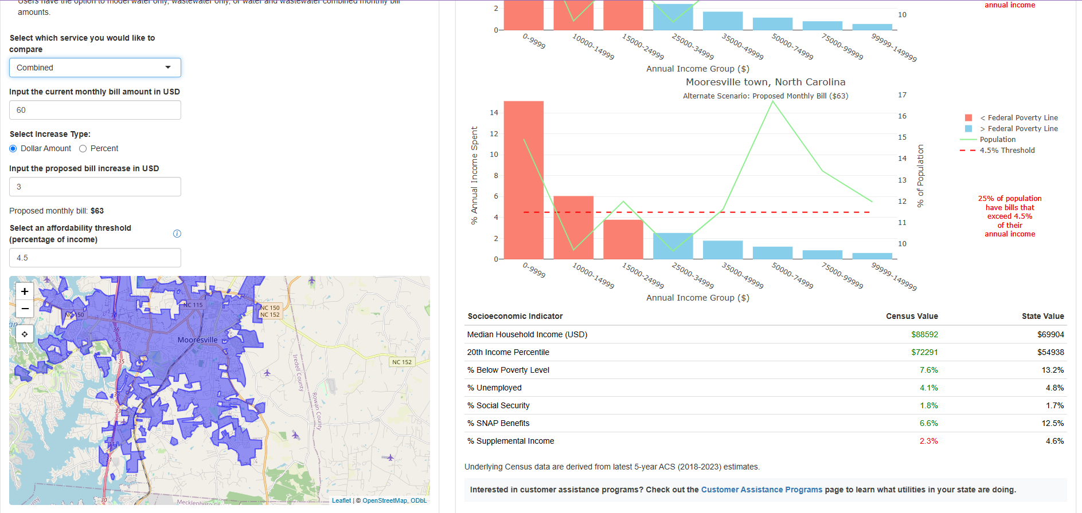
Affordability Dashboard – Affordability
Customer affordability

Slide 89
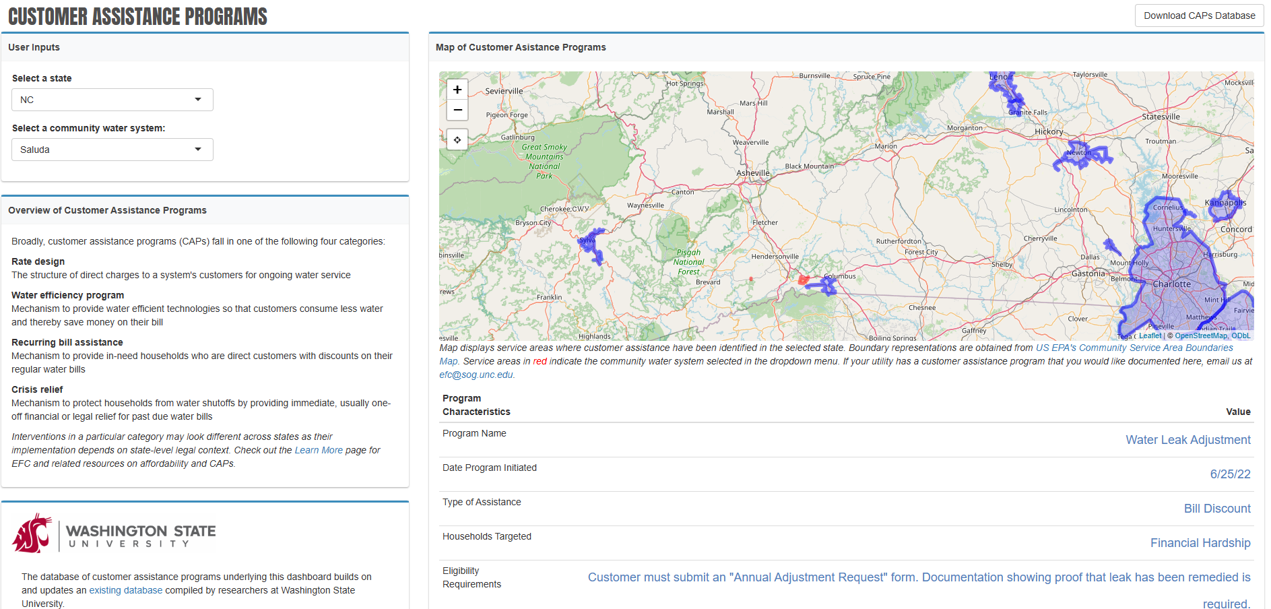
Affordability Dashboard – CAPs
Customer affordability

Slide 90
Designing Blocks
Setting the Right rates

Slide 91
Rate design elements
Customer affordability
Customer classes/distinction
Billing period
Base charge vs. volumetric
Consumption allowance (included in base charge)
# of blocks, sizes and rate differential
Temporal adjustments
Frequency of rate changes

Slide 92
Rate design elements
Customer affordability
For block rate structure designs, decide on:
  The correct number of blocks
  Where the blocks should end/start
Remember your larger users
Keep in mind your base charge and consumption allowance
Set significant rate differentials between blocks
Meter reading must be punctual, and meters must be reliable
Notes:
In addition to rate structure designs with base and volumetric charges, as we reviewed, there are many other options, including block rate structures, such as the increasing block tariff.
Increasing block rate structures alone are not sufficient to encourage conservation. The design of block rate structures is critical to set the appropriate price signals to the customers, not unduly overburden certain segments of the service population, and to provide sufficient revenue stability for the utility.
If a utility will use a block rate structure (increasing, decreasing, targeted, uniform at one block, or budget-based), they should consider these questions and use data-driven analyses to make decisions when possible.
Decide on: the correct number of blocks and where they should start and end:
For a utility to target residential consumption with increasing block rates, it should use at least 2 blocks within the normal range of residential use, from 0 through 15,000 gallons/month. Increasing block rate structures for residential use should at least start the second block just over the average residential usage level.
It does not do any good to start the second block at a usage level that only a very small number of customers use.
In determining the number and size of blocks, it is very useful to analyze data from billing records and the number of bills sent out each month for different usage levels.
Remember your larger users: If the utility only uses one rate structure for all of its customers, the block sizes at much higher levels of use should be carefully considered from the commercial and industrial customers’ perspective.
Keep in mind your base charge and consumption allowance
Set significant rate differentials between blocks
The punctuality and accuracy of meter reading is important since delays may lead to customer jumps between blocks

Slide 93


Shift to Reflect Usage
Designing blocks

Slide 94
Affordability? Consider Allowance
Designing blocks

Slide 95
Customer Classes
Designing blocks
Alternative | Targets
One rate structure for all | All are equal
Separate rate structure for residential, irrigation, commercial, industrial, governmental, or wholesale customers | Specific type of customer
One rate structure, but with different base charges based on meter size | Non-residential or multi-family housing
One rate structure for all, but with blocks that implicitly only target non-residential use | Non-residential
Negotiated rate structure with individual high-use customers (typically an industrial customer) | Only one customer
Different rates for customers outside municipal limits/service area boundaries | “Outside” customers
Notes:
Utilities have several options in deciding how to charge different sets of customers.
However, utilities can only legally charge different rates for customers based on cost-related factors, such as usage. Hence, it is possible to set a rate structure for residential customers and a separate rate structure for commercial or industrial customers, since the non-residential customers use a lot more water and the marginal cost of providing them with additional units of water is very low.
Utilities cannot charge lower or higher rates to customers based on non-cost related factors, and thus providing discounted rates to senior citizens or low-income customers purely on that basis is illegal. Customer assistance programs must utilize money from the general fund.
One advantage to creating different rate classes of customers as shown here is that it provides the utility with greater flexibility in targeting different objectives for different types of customers. For example, a utility could charge increasing block rate structures for residential customers to encourage conservation but also charge uniform rates for non-residential customers to avoid overburdening them with excessively high rates.
Before adding new rate structure classes, utility managers should first assess the ability of their billing software to handle the complexity of this switch, and also the staff’s ability to make the conversion and continuously monitor, assess and correct the inevitable increase in billing errors.

Slide 96
Process for Raising Rates
Setting the Right rates

Slide 97
When was the last time you raised your rates?
Rate setting objectives
Full cost recovery
Encouraging conservation
Business friendly
Affordability
Building reserves
Something else

Slide 98
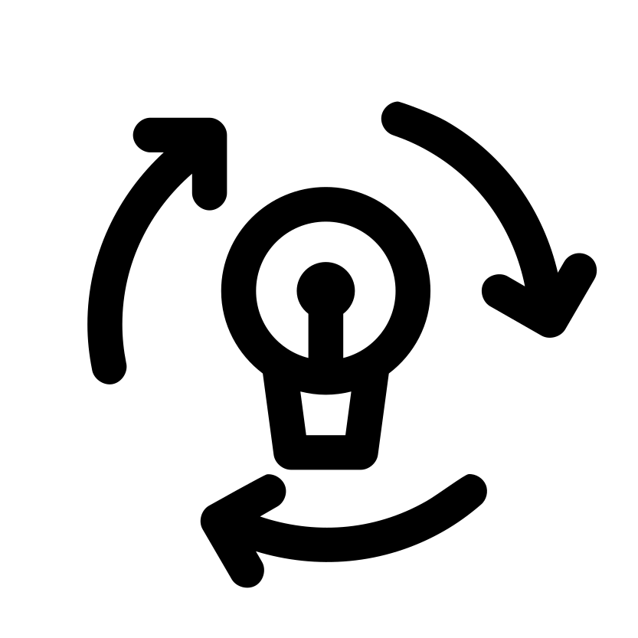
When should you revisit your rates?
Process for raising rates
We recommend revisiting your rates every year to make sure that your utility's revenues can sustain its operations (and then some)
  Some utilities find that small, yearly increases ensure that revenues from rates are sustainable
  Other utilities find that implementing rate increases less frequently allows them to make more targeted increases and rate updates
Image by Joe Pictos found on The Noun Project
Notes:
Checking your rates every year keeps your utility accountable for your finances by giving you an opportunity to make changes to your largest revenue generator. Yearly increases are a great way to make sure that you are accounting for inflation, and it may help your customers become accustomed to minor increases in their rates. Larger, less frequent increases may give you more room to decide where you want to target your increases, but be mindful that customers may have become used to current rates and may push back. Setting the rights rates for your utility can significantly reduce the amount you need to increase your rates by, if you need to increase them at all

Slide 99
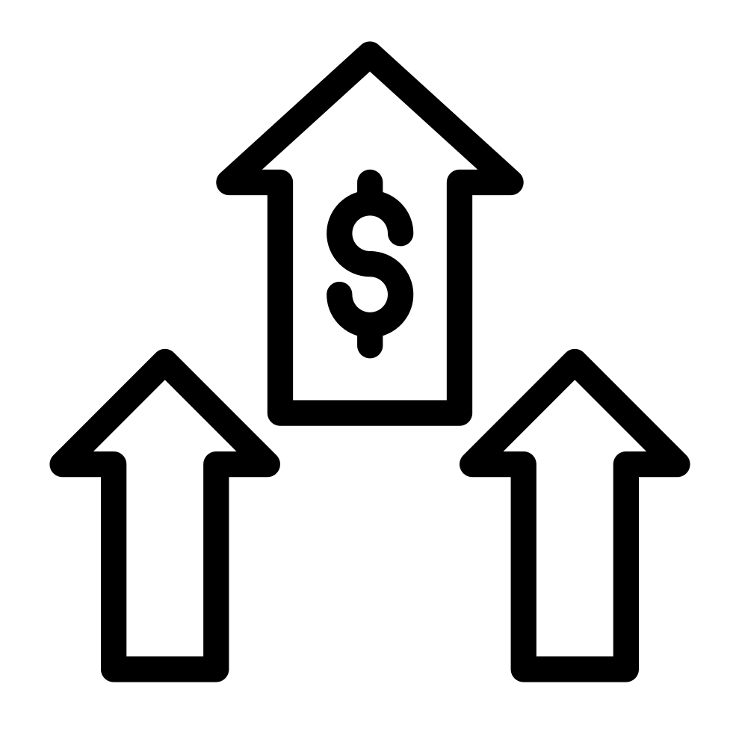
When should you increase your rates?
Process for raising rates
While it is ultimately up to the utility to determine when to increase rates, the EFC recommends updating rates at least every four years
  This accounts for inflation, changes in customer base, asset management, debt service, and several other financial factors
Image by Vectorstall found on The Noun Project
Notes:
Your utility now is not the same utility that it was four years ago (especially after the pandemic). You may have observed increases in prices of equipment, chemicals, and purchased water. Your salaries for employees may have increased. You may need to replace additional infrastructure, and let's not forget inflation! With rates being your largest revenue generator, this is where you will have the most flexibility into generating the revenue that you need to financially sustain your utility. If you haven't updated your rates in the last four years, you may want to check your rates to make sure that you are generating the revenue you need from your rates

Slide 100

When should you increase your rates?
Process for raising rates
Be wary of sudden, drastic rate increases
These may overwhelm your customer base and significantly impact what customers are able (or willing) to pay
Additionally, consumption will drop as rates increase
  Larger increases = noticeable drop in consumption
Image by Pixabay found on stockvault (CC0)
Notes:
Like we have talked about, consumption often drops with drastic increases because customers are often unable or unwilling to pay significantly more for water usage. The utility may also receive significant pushback for large increases, therefore, rate increases should be considered in addition to affordability

Slide 101
Key Considerations
Process for raising rates
Rate increases are necessary to sustain healthy utility finances and fund future projects
Rate increases can be difficult on customers, especially sudden, large increases
Rate increases look different for every utility, but the most efficient will balance required revenues and customer considerations
Notes:
The bottom line is this: utilities need regular rate increases to sustain healthy finances, but rate increases can have a dramatic impact on customers. Sudden, large increases should be avoided because they can significantly impact who can afford water services, but they also won't fix your utility overnight. They may create more problems than they are worth between backlash, affordability concerns, and dips in consumption. The best and most efficient rate increases will balance required revenues (including things like debt service and depreciation) while also considering what your customers can afford. The conception of a "fair price" depends on the needs of your utility and what its customers can afford to pay

Slide 102
Rates are complicated – what should I do?
Make multiple forecasts based on different assumptions
Ideally, be conservative
Don’t forget price elasticity!
Use tools to stress test projections
Give decision makers options to consider

Slide 103
Contact Us!
Alicea Easthope-Frazer
Senior Project Director
aliceaef@sog.unc.edu

