Slide 1
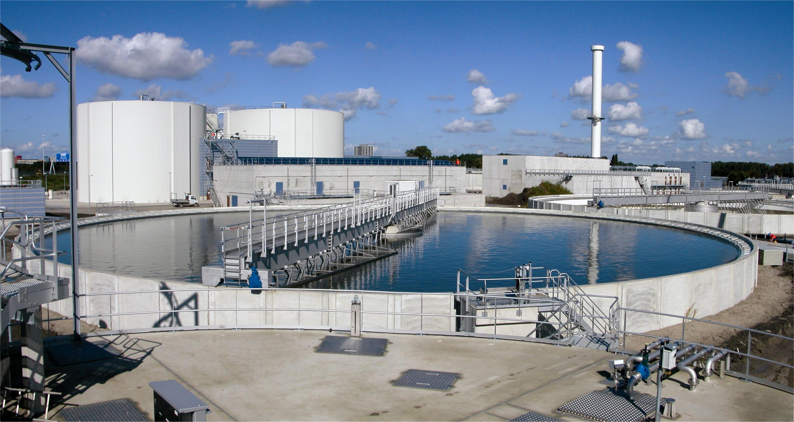
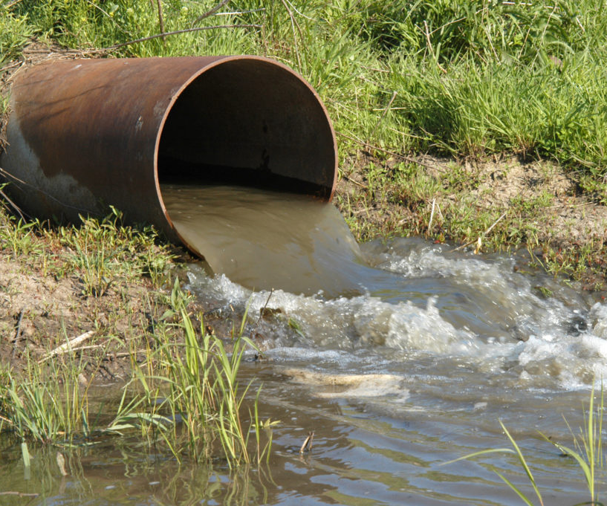
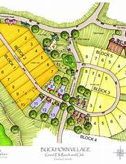
SDFs and Growth Management
Kara A Millonzi
UNC Chapel Hill School of Government
2025

Slide 2
System Development Fees
G.S. 162A-201(9): “A charge or assessment for service, including service provided pursuant to a wholesale arrangement between a water and sewer authority organized under Article 1 of Chapter 162A of the General Statutes and a local governmental unit, imposed with respect to new development to fund costs of capital improvements necessitated by and attributable to such new development, to recoup costs of existing facilities which serve such new development, to recoup costs incurred by a local government unit to purchase capacity in, or reserve capacity supplied by, capital improvements or facilities owned by another local government unit, or a combination of those costs, as provided in this Article.”
For Service
New development
Capital improvements necessitated by and attributable to
Recoup costs of existing facilities which serve new development
Reserve capacity

Slide 3
Narrow Construction
162A‐215. Narrow construction.
Notwithstanding G.S. 153A‐4 and G.S. 160A‐4, in any judicial action interpreting this Article, all powers conferred by this Article shall be narrowly construed to ensure that system development fees do not unduly burden new development.
Narrow
Wide

Slide 4
Who Can Assess & For What?
Local Government Unit
Counties
Sanitary Districts
County Water and Sewer Districts
Metropolitan Water Districts
Metropolitan Sewerage Districts
Metropolitan Water and Sewerage Districts
Joint Agencies (City/County Utility Commission)
Fayetteville PWC / Greenville Utilities Commission
Water and Sewer Authorities
Municipalities

Slide 5
Water &/or Sewer Service
G.S. 162A-201(9): “A charge or assessment for service, including service provided pursuant to a wholesale arrangement between a water and sewer authority organized under Article 1 of Chapter 162A of the General Statutes and a local governmental unit,…….[or] to recoup costs incurred by a local government unit to purchase capacity in, or reserve capacity supplied by, capital improvements or facilities owned by another local government unit.”
G.S. 162A-201(7): Service. – Water or sewer service, or water and sewer service, provided by a local governmental unit, including water or sewer service provided pursuant to a wholesale arrangement between a water and sewer authority organized under Article 1 of Chapter 162A of the General Statutes and a local governmental unit.

Slide 6
Bulk Purchase /
Treatment Agreements
Wholesale ”purchaser” likely may not assess SDFs to recoup costs of agreement.
Wholesale
Unless…..
If agreement between Water & Sewer Authority (G.S. 162A, Art. 1) and any other local government utility, “purchaser” may assess SDF based on cost of purchase agreement
Notes:
Source File:
https://unsplash.com/photos/_uuRwSS1hxQ

Slide 7
Operations & Maintenance Agreements
Agreement should specify in writing who is “providing” the water & sewer service
There may be flexibility for either owner or operator to assess (if operator also is a local government unit), as long as no double charging for same costs
O&M
Notes:
Source File:
https://unsplash.com/photos/_uuRwSS1hxQ

Slide 8
Reserved Capacity Agreements
G.S. 162A-205(10): Local government that pays for reserved capacity may assess its own SDFs to recoup the costs from new development (must use combined cost methodology to make this work)
Capacity
Notes:
Source File:
https://unsplash.com/photos/_uuRwSS1hxQ

Slide 9
Who Can Be Assessed?
G.S. 162A-201(9): “A charge or assessment for service, …. imposed with respect to new development….”

Slide 10
What is “New Development?"
Any of the following occurring after the date a local government begins the written analysis process required by G.S. 162A‐205, no more than one year prior to the adoption of a system development fee, which increases the capacity necessary to serve that development:
1
Subdivision of Land
2
Construction, reconstruction, redevelopment, conversion, structural alteration, relocation, or enlargement of any structure which increases the number of service units
3
Any use or extension of the use of land which increases the number of service units
LG Begins SDF Analysis
LG Adopts SDFs
Retroactive period (<=1 year)

Slide 11
What is “New Development?"
“Uses the gallons per day per service unit that the local governmental unit applies to its water or sewer system engineering or planning purposes for water or sewer, as appropriate, in calculating the system development fee."
1
Subdivision of Land
2
Construction, reconstruction, redevelopment, conversion, structural alteration, relocation, or enlargement of any structure which increases the number of service units
3
Any use or extension of the use of land which increases the number of service units

Slide 12
What is “New Development?"
Does it require larger meter to trigger or can there be some other measure of increase in service units?
What if SDFs did not exist at subdivision stage – can you rely on triggers 2 or 3 to assess?
1
Subdivision of Land
2
Construction, reconstruction, redevelopment, conversion, structural alteration, relocation, or enlargement of any structure which increases the number of service units
3
Any use or extension of the use of land which increases the number of service units

Slide 13
When is Service Committed & For How Long?
Local government utility must specify in water / sewer ordinance at what point in the process service is legally committed and capacity is reserved.
1
Negotiations about new development?
2
Plat recorded?
The ordinance also should address when service is no longer committed such that reserved capacity is freed up for another parcel
3
Building permit pulled?
STEP 2
4
Individual development unit connected?
5
Other?

Slide 14
No Capacity-Type Fees for Existing Development?
General User Fee: County “may establish, revise and collect rates, fees or other charges and penalties for the use of or the services furnished or to be furnished by…. [the water and/or sewer utility system]”
System Development Fee: “A charge or assessment for service [imposed on] new development to fund costs of [water and sewer] capital improvements necessitated by and attributable to such new development, to recoup costs of existing [water and sewer] facilities which serve such new development, or a combination of those costs….”
Existing development. – Land subdivisions, structures, and land uses in existence at the start of the written analysis process required by G.S. 162A‐205, no more than one year prior to the adoption of a system development fee.
Greensboro also “occasionally” charged capacity use fees for “existing development” after 1 July 2018, which totaled $14,865.70.
***
Greensboro argues charging fees for existing development is outside the scope of the Act because it requires only that fees for new development conform to the Act's requirements.
Developers argue the existing development fees were not allowed because Greensboro was simultaneously charging both the original capacity use fees (for existing development( and fees adopted under the System Development Fee Act (for new development) in violation of Kidd, 271 N.C. App. at 395, 845 S.E.2d at 799 (“The [Act] grants local government utilities specific authority to assess one type of upfront charge—a system development fee—as long as that fee is calculated in accordance with the [Act's] ‘written analysis’ process.”). Because Greensboro was charging multiple types of upfront charges, we conclude the fees collected for existing development starting 1 July 2018 were ultra vires, illegal, and must be refunded.
True Homes, LLC v City of Greensboro, 898 SE2d 52 (2024)
Unclear if holding prohibits local government from proceeding under trigger 2. or 3. if extending new service to existing development.

Slide 15
Adopting, Collecting, & Expending Proceeds

Slide 16
1
Professional Analysis
2
Public Input
3
Professional Analysis Reconsidered
4
Public Hearing
5
Adopt Resolution or Ordinance
Notice of System Development Fee Schedule
6
7
Periodic Updates ( at least every 5 years)
SDF Analysis
Done by engineering or finance professional with sufficient training/experience
Detailed Analysis
Select 1 of 3 Methodologies
Service Unit Rate
Revenue Credits
Construction/Contribution Credits
Equivalency or Conversion Table
Planning Horizon of 5-20 years
SDF fees may not exceed maximum calculated in analysis

Slide 17
Professional Analysis: Accounting Methods
Cost-Based Approaches
Cash Flow Method: Projects future system costs and adjusts for inflation, interest rates, and revenue sources.
Asset Valuation Method: Uses current system asset values, adjusted for depreciation, replacement cost, or historical cost.
Net Present Value (NPV) Analysis: Evaluates long-term system costs and discounts future expenses to present-day dollars.
Key Accounting Principles Applied
Proportionality: Fees must reflect the actual cost of service.
Revenue Neutrality: Fees must fund only capital costs, not ongoing operations.
Cost Recovery: Ensures new users contribute a fair share toward system expansion.

Slide 18
Professional Analysis: Engineering Methods
Capacity & Demand Analysis
Equivalent Residential Unit (ERU): Defines water and sewer demand based on a typical single-family home (e.g., required Gallons Per Day (GPD) by statute).
Peak Flow vs. Average Flow: Determines if the system needs upgrades based on maximum daily demand.
Hydraulic Modeling: Uses software to analyze system capacity and identify necessary expansions.

Slide 19
Methodologies
Buy In
Incremental Cost
1
2
Based on generally accepted method of valuing the actual or replacement costs of the capital improvement for which the buy-in fee is being collected less depreciation, debt credits, grants, and other generally accepted valuation adjustments.
Based on the value or cost to expand the existing system’s capacity to continue to serve the “new development” that paid the SDF
Combo
3
Based on a combo of buy-in and incremental cost

Slide 20
Revenue Credits
Construction Credits
A Construction or Contributions Credit applies when a developer builds oversized infrastructure that benefits areas beyond their own development.
If a developer constructs or pays for larger water or sewer facilities (e.g., an oversized pump station, large transmission mains) that serve other future developments, they receive a credit.
Limits on the Construction Credit
No credit is given for standard on-site improvements (e.g., pipes within the development).
No credit is given for connections to existing facilities, only for oversized infrastructure that serves external areas.
A Revenue Credit prevents double-charging new customers for system improvements already funded by existing revenue sources. It does this by reducing the projected cost of capital improvements in one of two ways:
Option 1: Outstanding Debt Deduction
If the local government has issued bonds or taken loans for system improvements, the remaining debt principal is deducted from the total capital improvement cost.
This prevents new development from paying for infrastructure that existing ratepayers are still funding through debt payments.
Option 2: Present Value of Future Revenue Deduction
If the system is expected to generate future revenue from user rates, fees, or other income, the present value of that revenue is deducted from capital costs.
This ensures that new development does not overpay for infrastructure that will also generate revenue over time.
Minimum Credit Requirement
The law mandates that the credit must be at least 25% of the total projected capital improvement cost.

Slide 21
Service Unit
Service unit. – A unit of measure, typically an equivalent residential unit, calculated in accordance with generally accepted engineering or planning standards
SDF Rate Analysis Must: “Use[] the gallons per day per service unit that the local governmental unit applies to its water or sewer system engineering or planning purposes for water or sewer, as appropriate, in calculating the system development fee.”
Check Your Existing SDF Schedule!!!!

Slide 22
Service Unit
Effective October 10, 2023, the Section 18 Session Law 2023-137 established a wastewater design flow rate of 75 gallons per day per bedroom (GPD/BR) for wastewater systems serving two or more dwelling units.
Does a LG need to change its SDFs now to reflect this change or can it wait until its next 5-year analysis?

Slide 23
Example SDF Fee Schedule
System Development Fees (SDF) Calculation Basis:
Method Used: Combined Cost Method (Buy-In + Incremental Cost)
Planning Horizon: 10 years
Capital Improvement Cost: $20 million
Existing Debt Deduction: $5 million
Future Revenue Credit: $2 million (present value
of future user revenue)
Total Adjusted Cost: $13 million
Projected Growth Demand: 2.5 million GPD
Base Fee per GPD: $5.20 per GPD
Customer Type | GPD Assumption | Fee per Unit
Single-Family Home (Detached) | 250 GPD | $1,300
Apartment (per unit) | 150 GPD | $780
Small Retail (per 1,000 sq. ft.) | 100 GPD | $520
Restaurant (per seat) | 20 GPD | $104
Office (per 1,000 sq. ft.) | 75 GPD | $390
Hotel (per room) | 120 GPD | $624
Industrial (per 1,000 sq. ft.) | 50 GPD | $260

Slide 24
Timing of Assessment & Collection
Trigger / Fee Assessed | Fee Collected
Subdivision of land | Must collect the SDFs either at the time of the application for a building permit or when water or wastewater service is committed by the local government utility, whichever occurs later.
Construction, reconstruction, redevelopment, conversion, structural alteration, relocation, or enlargement of any structure which increases the number of service units. | Must collect SDFs either When property owner applies for connection of individual unit of development; or When local unit commits to provide water/wastewater service whichever occurs sooner
Any use or extension of the use of land which increases the number of service units | Must collect SDFs either When property owner applies for connection of individual unit of development; or When local unit commits to provide water/wastewater service whichever occurs sooner

Slide 25
When is Service Committed & For How Long?
Local government utility must specify in water / sewer ordinance at what point in the process service is legally committed and capacity is reserved.
1
Negotiations about new development?
2
Plat recorded?
The ordinance also should address when service is no longer committed such that reserved capacity is freed up for another parcel
3
Building permit pulled?
STEP 2
4
Individual development unit connected?
5
Other?

Slide 26
SL 2021-76
Expending Proceeds
Incremental Cost Method
Costs of constructing capital improvements,
Professional fees to prepare SDF analysis
If no capital improvements planned for 5 years, or costs already provided for, may be used on debt for existing capacity
Reserved capacity charges
Capital improvement. – A planned facility or expansion of capacity of an existing facility other than a capital rehabilitation project necessitated by and attributable to new development.
Capital rehabilitation project. – Any repair, maintenance, modernization, upgrade, update, replacement, or correction of deficiencies of a facility, including any expansion or other undertaking to increase the preexisting level of service for existing development.
Combined Cost Method
Previously completed capital improvements for which capacity exists (debt service)
Capital rehabilitation projects
All SDF proceeds must be assigned to a specific capital project in the county’s Capital Reserve Fund
(G.S. 159-18)
Buy-in Method
Previously completed capital improvements for which capacity exists (debt service)
Capital rehabilitation projects

Slide 27
Expending SDF Proceeds
Buy-in Method
Combined / Hybrid Method
Incremental / Marginal Cost Method
Reimburse share of costs previously completed capital improvements for which capacity exists and for capital rehabilitation projects
Everything here
Costs of constructing capital improvements limited to any of the following: Construction contract prices.; Surveying and engineering fees; Land acquisition cost; Principal and interest on bonds, notes, or other obligations issued by or on behalf of the local governmental unit to finance any of these costs.
Professional fees incurred by the local governmental unit for preparation of the
SDF fee analysis
If no capital improvements are planned for construction within 5 years or the
foregoing costs are otherwise paid or provided for, then principal and interest on bonds, notes, or other obligations issued by or on behalf of a local governmental unit to finance the construction or acquisition of existing capital improvements.
Contract fees for reserved capacity
Everything here

Slide 28
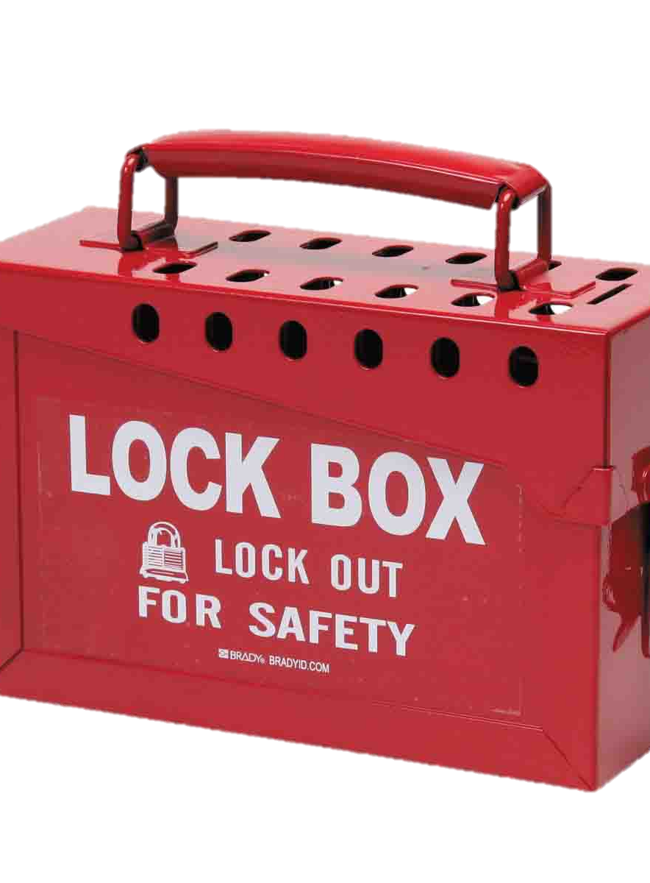
Capital Reserve Fund (CRF)
Adopt Ordinance or Resolution
Specify projects to be funded with proceeds
Amend CRF each year to appropriate new proceeds
Must move $ to budget or project ordinance before spending
EXCEPTION: If and to the extent that revenues derived from system development fees are pledged to secure revenue bonds or notes issued by a local government unit under the provisions of Article 5 of Chapter 159 of the General Statutes, such revenues may be deposited in such funds, accounts or subaccounts, and applied in such manner, as set forth in the bond order, resolution, trust agreement or similar instrument authorizing and securing such bonds or notes until all such revenue bonds or notes are no longer outstanding.

Slide 29
Establishing an CRF
Board adopts Resolution or Ordinance that states:
The purposes for which the fund is being created.
A board may accumulate moneys for multiple capital projects within a single capital reserve fund, but it must list each project separately.
The approximate periods of time during which the moneys will be accumulated for each purpose.
A board must provide a rough estimate of when moneys will be expended from the capital reserve fund for each capital project.
The approximate amounts to be accumulated for each purpose.
A board must provide a rough estimate of the total amounts it intends to save for each capital project.
After initial appropriation, to add new money to capital reserve fund, board must make the appropriation specifically to the CRF.
The sources from which moneys for each purpose will be derived.
A board must indicate the revenue sources it intends to allocate to the capital reserve fund to finance each project (e.g. property tax proceeds, utility fees, local sales and use tax proceeds, grant proceeds, etc.).

Slide 30
CAPITAL RESERVE FUND RESOLUTION
WHEREAS, there is a need in the Town of Bluesky to provide funds for future capital projects related to its combined water and wastewater system, and to make debt service payments on existing debt related to past capital projects for its water and wastewater system, and WHEREAS, NCGS 159-18 authorizes the creation of a capital reserve fund, and WHEREAS, NCGS 162A, Art. 8 requires that all system development fee proceeds be accounted for in a capital reserve fund,
NOW, THEREFORE, BE IT RESOLVED BY THE GOVERNING BOARD THAT
Section 1. The Governing Board hereby creates a Capital Reserve Fund for the purpose of funding the following capital projects related to the town’s water and wastewater system:
Water Treatment Plant Upgrade. The existing plant on Fuller Avenue is designed to serve a population equivalent (PE) of 10,000, but is currently operating above its capacity at 11,200 PE, calling for an upgrade to meet current and projected future requirements. The estimated cost of the project is $1.2 million The town expects to complete the project in FY 2024, and intends to appropriate approximately $300,000 of system development fee revenues to the CRF for this purpose. The town anticipates receiving a zero-interest loan from the state to fund the remainder of the cost. It will use future system development fee collections to make debt service payments on the loan.
The 2022-2023 appropriation from the budget ordinance to the CRF of SDF proceeds for this purpose is $100,000.
Construction of new elevated water storage tanks. Estimated to be 0.650 million gallons, this new tank is planned for the distribution system near North Ponds Park, at a cost of $2.2 million. Construction of the tank is expected in FY 2026. The town anticipates funding approximately 40 percent of the cost of the tank with system development fee proceeds. The remaining cost will be funded through existing fund balance in the water fund.
The 2022-2023 appropriation from the budget ordinance to the CRF is $550,000, comprised of $150,000 in SDF proceeds from the water and sewer enterprise fund, and $400,000 in water and sewer enterprise fund balance.
Regional Pump Station and Force Main: One regional pump station project and one force main replacement project are already under design, to be complete by FY 2023.The estimated cost is $900,000. The town anticipates funding 100 percent of the cost with SDF proceeds.
The 2022-2023 appropriation from the budget ordinance to the CRF is $156,000 in SDF proceeds.
Expansion of the Town of Bluesky Wastewater Treatment Plant: Capacity expansion by 1.4 MGD is estimated to cost $30 million. The project will occur in phases, with an expected completion date of 2030. Within the town’s 10-year CIP planning period (FY 2018-19 through FY 2028-29), approximately $20 million or 67% of the total cost, is anticipated to be expended. The town expects to issue revenue bonds to fund this project, to be repaid from both SDF proceeds and general wastewater user fees.
The 2022-2023 appropriation from the budget ordinance to the CRF is $75,000 in SDF proceeds.
Section 2. This CRF shall remain effective until all the above-listed projects, and any projects added in the future, are completed. The CRF may be amended by the governing board as needed to add additional appropriations, modify or eliminate existing capital projects, and/or add new capital projects.
Section 3. This Resolution shall become effective and binding upon its adoption.

Slide 31
Other Options

Slide 32
System Develop-ment Fees
Contractual Charges
Connection / Tap Fees
User Fees
Availability Fees
Regulatory Fees
Special Assess-ments
EXEMPTION FROM SDF:
“Reimbursement to the local governmental unit for its expenses in constructing or providing for water or sewer utility capital improvements adjacent or ancillary to the development if the owner or developer has agreed to be financially responsible for such expenses; however, [must provide a credit to developer for value of costs in excess of the development's proportionate share of connecting facilities required to be oversized for use of others outside of the development.]”
Assessed to cover costs of inspections, plan reviews, etc.
Assessed on property owner at time of connection to cover costs of connection
Assessed on “new development” to cover past or future capital costs necessary to serve/continue to serve “new development”
Reimbursement charges for capital projects that benefit assessed
properties
Assessed pursuant to a contract with developer or property owner to extend water/sewer lines to property or do system changes / expansions to serve property
Assessed on water/sewer utility customers—typically has fixed and variable component
Assessed on certain properties when water/sewer available but property owners choose not to connect
Rate Setting

Slide 33
System Develop-ment Fees
Contractual Charges
Connection / Tap Fees
User Fees
Availability Fees
Regulatory Fees
Special Assess-ments
Town of Spring Hope v. Bissette, 305 N.C. 248 (1982)
General user fee statute (prior to 2017 amendments) was broad enough to authorize the town to increase its periodic water and sewer rates to finance the construction, operation, and maintenance of an upgraded water treatment plant. The new plant was required to maintain the town’s permit to discharge treated water. The fee at issue was assessed on all current customers of the water and sewer system. The court held that the fee was assessed for a service that the customer currently received. In so holding, the court noted the generally recognized authority for a local government utility to charge fees to cover both operating and capital costs. And it cited favorably to the court of appeals’ determination that:
The great weight of authority is to the effect that in the setting of such rates and charges, a municipal body may include not only operating expenses and depreciation, but also capital cost associated with actual or anticipated growth or improvement of the facilities required for the furnishing of such services.
Assessed to cover costs of inspections, plan reviews, etc.
Assessed on property owner at time of connection to cover costs of connection
Assessed on “new development” to cover past or future capital costs necessary to serve/continue to serve “new development”
Reimbursement charges for capital projects that benefit assessed
properties
Assessed pursuant to a contract with developer or property owner to extend water/sewer lines to property or do system changes / expansions to serve property
Assessed on water/sewer utility customers—typically has fixed and variable component
Assessed on certain properties when water/sewer available but property owners choose not to connect
Rate Setting

Slide 34
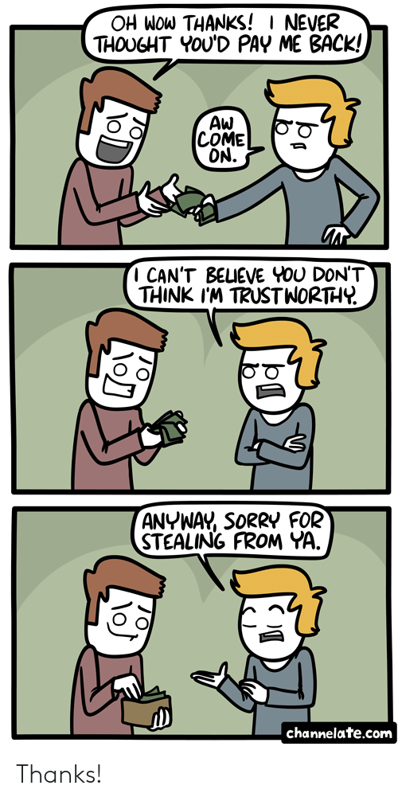
Reimbursements
Developer Constructs/ Finances Public Infrastructure
Developer Deeds Infrastructure to Government
Government Reimburses Developer for Some or All of Costs of Public Infrastructure

Slide 35
 | Public Enterprise Contract | Reimbursement Agreements
Statute | 153A-280 | 153A-451
Projects | Public enterprises | ”municipal infrastructure” (e.g. water, sewer, stormwater, streets, curbs, sidewalks, traffic control)
Scope | Cost of design and construction improvements; must be adjacent or ancillary to private land development; CANNOT pay for improvement required by development ordinances The improvements may be constructed on property owned or acquired by the private party or on property owned or acquired by the county. | Improvement must be included in the local government’s capital improvement plan and must serve the developer or property owner
Bidding | not subject to Article 8 of Chapter 143 of the General Statutes if the public cost will not exceed two hundred fifty thousand dollars ($250,000) and the county determines that: (i) the public cost will not exceed the estimated cost of providing for those improvements through either eligible force account qualified labor or through a public contract let pursuant to Article 8 of Chapter 143 of the General Statutes; or (ii) the coordination of separately constructed improvements would be impracticable. A county may enact ordinances and policies setting forth the procedures, requirements, and terms for agreements authorized by this section. | shall not be subject to Article 8 of Chapter 143 of the General Statutes, except as provided by this subsection. A developer or property owner who is party to a reimbursement agreement authorized under this section shall solicit bids in accordance with Article 8 of Chapter 143 of the General Statutes when awarding contracts for work that would have required competitive bidding if the contract had been awarded by the county.

