Slide 1
NC Local Government Water & wastewater Governance, Function, & Finance
Kara Millonzi, Robert W. Bradshaw Jr. Distinguished Professor of Public Law and Government
UNC Chapel Hill School of Government
2025
millonzi@sog.unc.edu

Slide 2
Public Enterprise
Service company owned or managed by the local government
Counties | Municipalities | Special Purpose Local Governments
Water Sewer Solid waste Airports Public transportation Off-street parking Stormwater management | Water Sewer Solid waste Airports Public transportation Off-street parking Stormwater management Cable television/broadband Electric Natural gas | Water & Sewer Authority County Water & Sewer District Metropolitan Water District Metropolitan Sewerage District Metropolitan Water & Sewerage District Sanitary District

Slide 3
Regulation
Public Utilities Commission
Governing Board Authority
Local Government Commission Oversight

Slide 4
Local Government Authority
Grants of Authority
Grant authority to undertake an activity
Grant authority to use a specific funding source for an activity
Set limitations on undertaking an activity
Detail process requirements for undertaking activity
Limits on Authority
General Laws
Federal Law
Local Acts
State Constitution
Charter Provisions
State Regulations

Slide 5
Powers & Authorities
Local government utilities have no inherent powers; they must act under express statutory authority.
Statutes define the types of utilities local governments may operate, authorize rate-setting and fee collection, and establish procedures for funding, construction, and service provision.
Statutory requirements also govern utility governance structures (e.g., boards or authorities), customer service obligations, and procurement.
01
STATUTES
CONSTITUTION
02
04
STATE RULES
03
COMMON LAW

Slide 6
Powers & Authorities
Local government utilities must operate within the limits of the North Carolina Constitution, including the public purpose requirement for use of public funds and exclusive privileges clause, which prohibits special treatment for a private entity or individual unless there are public benefits in exchange.
01
STATUTES
CONSTITUTION
02
04
STATE RULES
03
COMMON LAW

Slide 7
Powers & Authorities
There must be a rational, utility-based reason for differentiating among customer classes, setting rates, and making other operational decisions.
Rates and practices must be reasonable and not arbitrary.
01
STATUTES
CONSTITUTION
02
04
STATE RULES
03
COMMON LAW

Slide 8
Powers & Authorities
State agencies, primarily the NC Department of Environmental Quality (DEQ), issue and enforce rules related to system design, permitting, and operation.
Utilities must comply with administrative rules for water quality, wastewater treatment, stormwater management, and service extensions.
These rules often require documentation of system capacity, technical standards for infrastructure, and ongoing monitoring and reporting.
01
STATUTES
CONSTITUTION
02
04
STATE RULES
03
COMMON LAW

Slide 9
Public Enterprise
Service company owned or managed by the local government
Counties | Municipalities | Special Purpose Local Governments
Water Sewer Solid waste Airports Public transportation Off-street parking Stormwater management | Water Sewer Solid waste Airports Public transportation Off-street parking Stormwater management Cable television/broadband Electric Natural gas | Water & Sewer Authority County Water & Sewer District Metropolitan Water District Metropolitan Sewerage District Metropolitan Water & Sewerage District Sanitary District

Slide 10
Common Governance Structures at a Glance
 | County or Municipal Government | County Water & Sewer District | Water & Sewer Authority
Legal Authority | G.S. 153A, Art. 15; G.S. 160A, Art. 16 | G.S. 162A, Art. 6 | G.S. 162A, Art. 1
Governing Body | Board of County Commissioners; City Council | By Statute, same members as Board of County Commissioners | Appointed Board (members appointed by forming local govts)
Ownership of Assets | County; City | District or County | Authority
Rate-setting Authority | G.S. 153A-277; G.S. 160A-314 | G.S. 162A-88 | G.S. 162A-6
Tax Authority | Yes | Yes | No
Mandate Connections? | Yes | No, unless operated by county | Only if includes county with at least 40K population
Availability Fee? | Yes, G.S. 153A-284; G.S. 160A-317 | No, unless operated by county | Only is includes county with at least 40K population
System Development Fees? | Yes, G.S. 162A, Art. 8 | Yes, G.S. 162A, Art. 8 | Yes, G.S. 162A, Art. 8
Special Assessments? | Yes, G.S. 153A, Art. 9 | Yes, G.S. 162A-92 | G.S. 162A-6
Borrow Money? | GO, Revenue Bonds, Installment Financing | GO, Revenue Bonds, Installment Financing | Revenue Bonds, Installment Financing
See McNeil v. Harnett County, 97 NC App 41 (1990) (allowing county to operate pursuant to its authority and the water and sewer district authority when county operates water and sewer district by interlocal agreement)

Slide 11
Funding Options
WHO can you charge?
For WHAT purposes?
WHEN can fees be assessed?
HOW to evaluate revenue options?

Slide 12
Funding Options
There are several revenue sources available to choose from to fund a local government’s water and wastewater utilities.
Tap Fees
Contractual Charges
Assessed on property owner at time of connection to cover costs of connection
Special
Assessments
Regulatory Fees
User Fees
Assessed on water/sewer utility customers—typically has fixed and variable component
Availability Fees & Reserved Capacity
System
Development
Fees
Tap Fees &
User Fees

Slide 13
User Fees
Local government utility “may establish, revise and collect rates, fees or other charges and penalties for the use of or the services furnished or to be furnished by…. [the water and/or sewer utility system]”

Slide 14
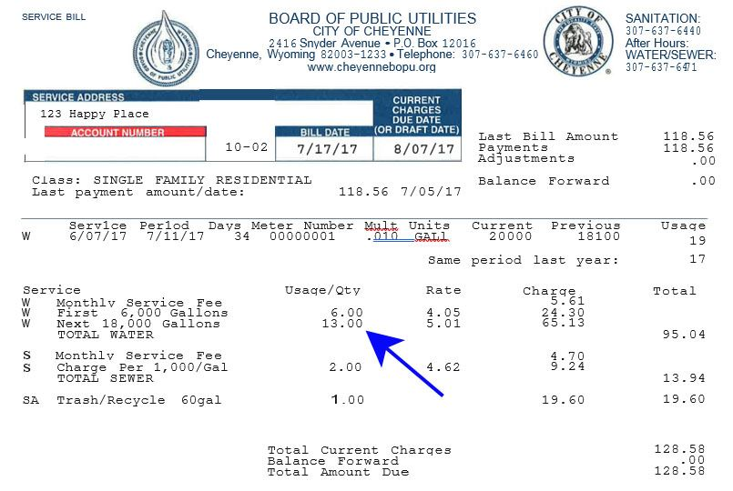
Fixed Cost
Variable Cost
Monthly Bill

Slide 15
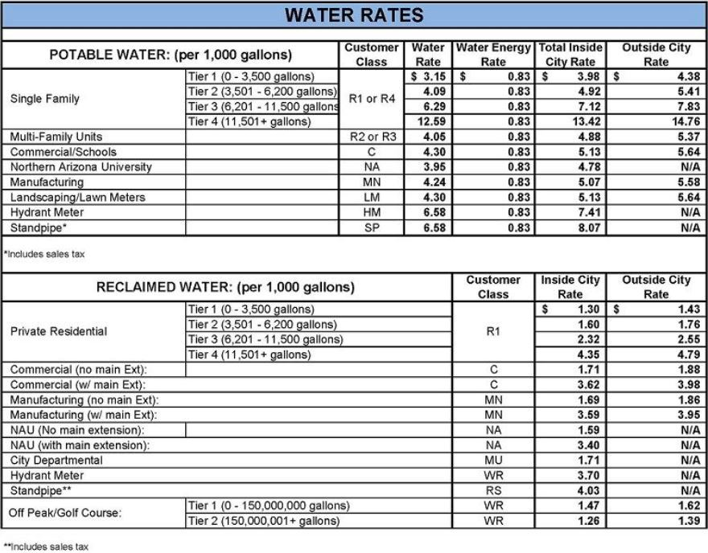
Rate Setting Legal Criteria
Rates may vary based on “class of service”
Must charge all customers in same class
No free service for nonprofits, government departments, firefighters, elected officials
Rate schedules outside territorial boundary may be different than inside territorial boundary
County rates may vary based on location within county
Differences in “classes of service” may be based upon such factors as cost or “the purpose for which the service or the product is received, the quantity or the amount received, the different character of the service furnished, the time of its use or any other matter which presents a substantial ground of distinction.”

Slide 16
User Fees
Account Set Up Fee
Deposit
Monthly/Bi-Monthly Fee
Late Fees
Disconnect Fee
Reconnect Fee
Inspection Fee
Other?
Meter Tampering Fee
Fees assessed on water and sewer customers

Slide 17
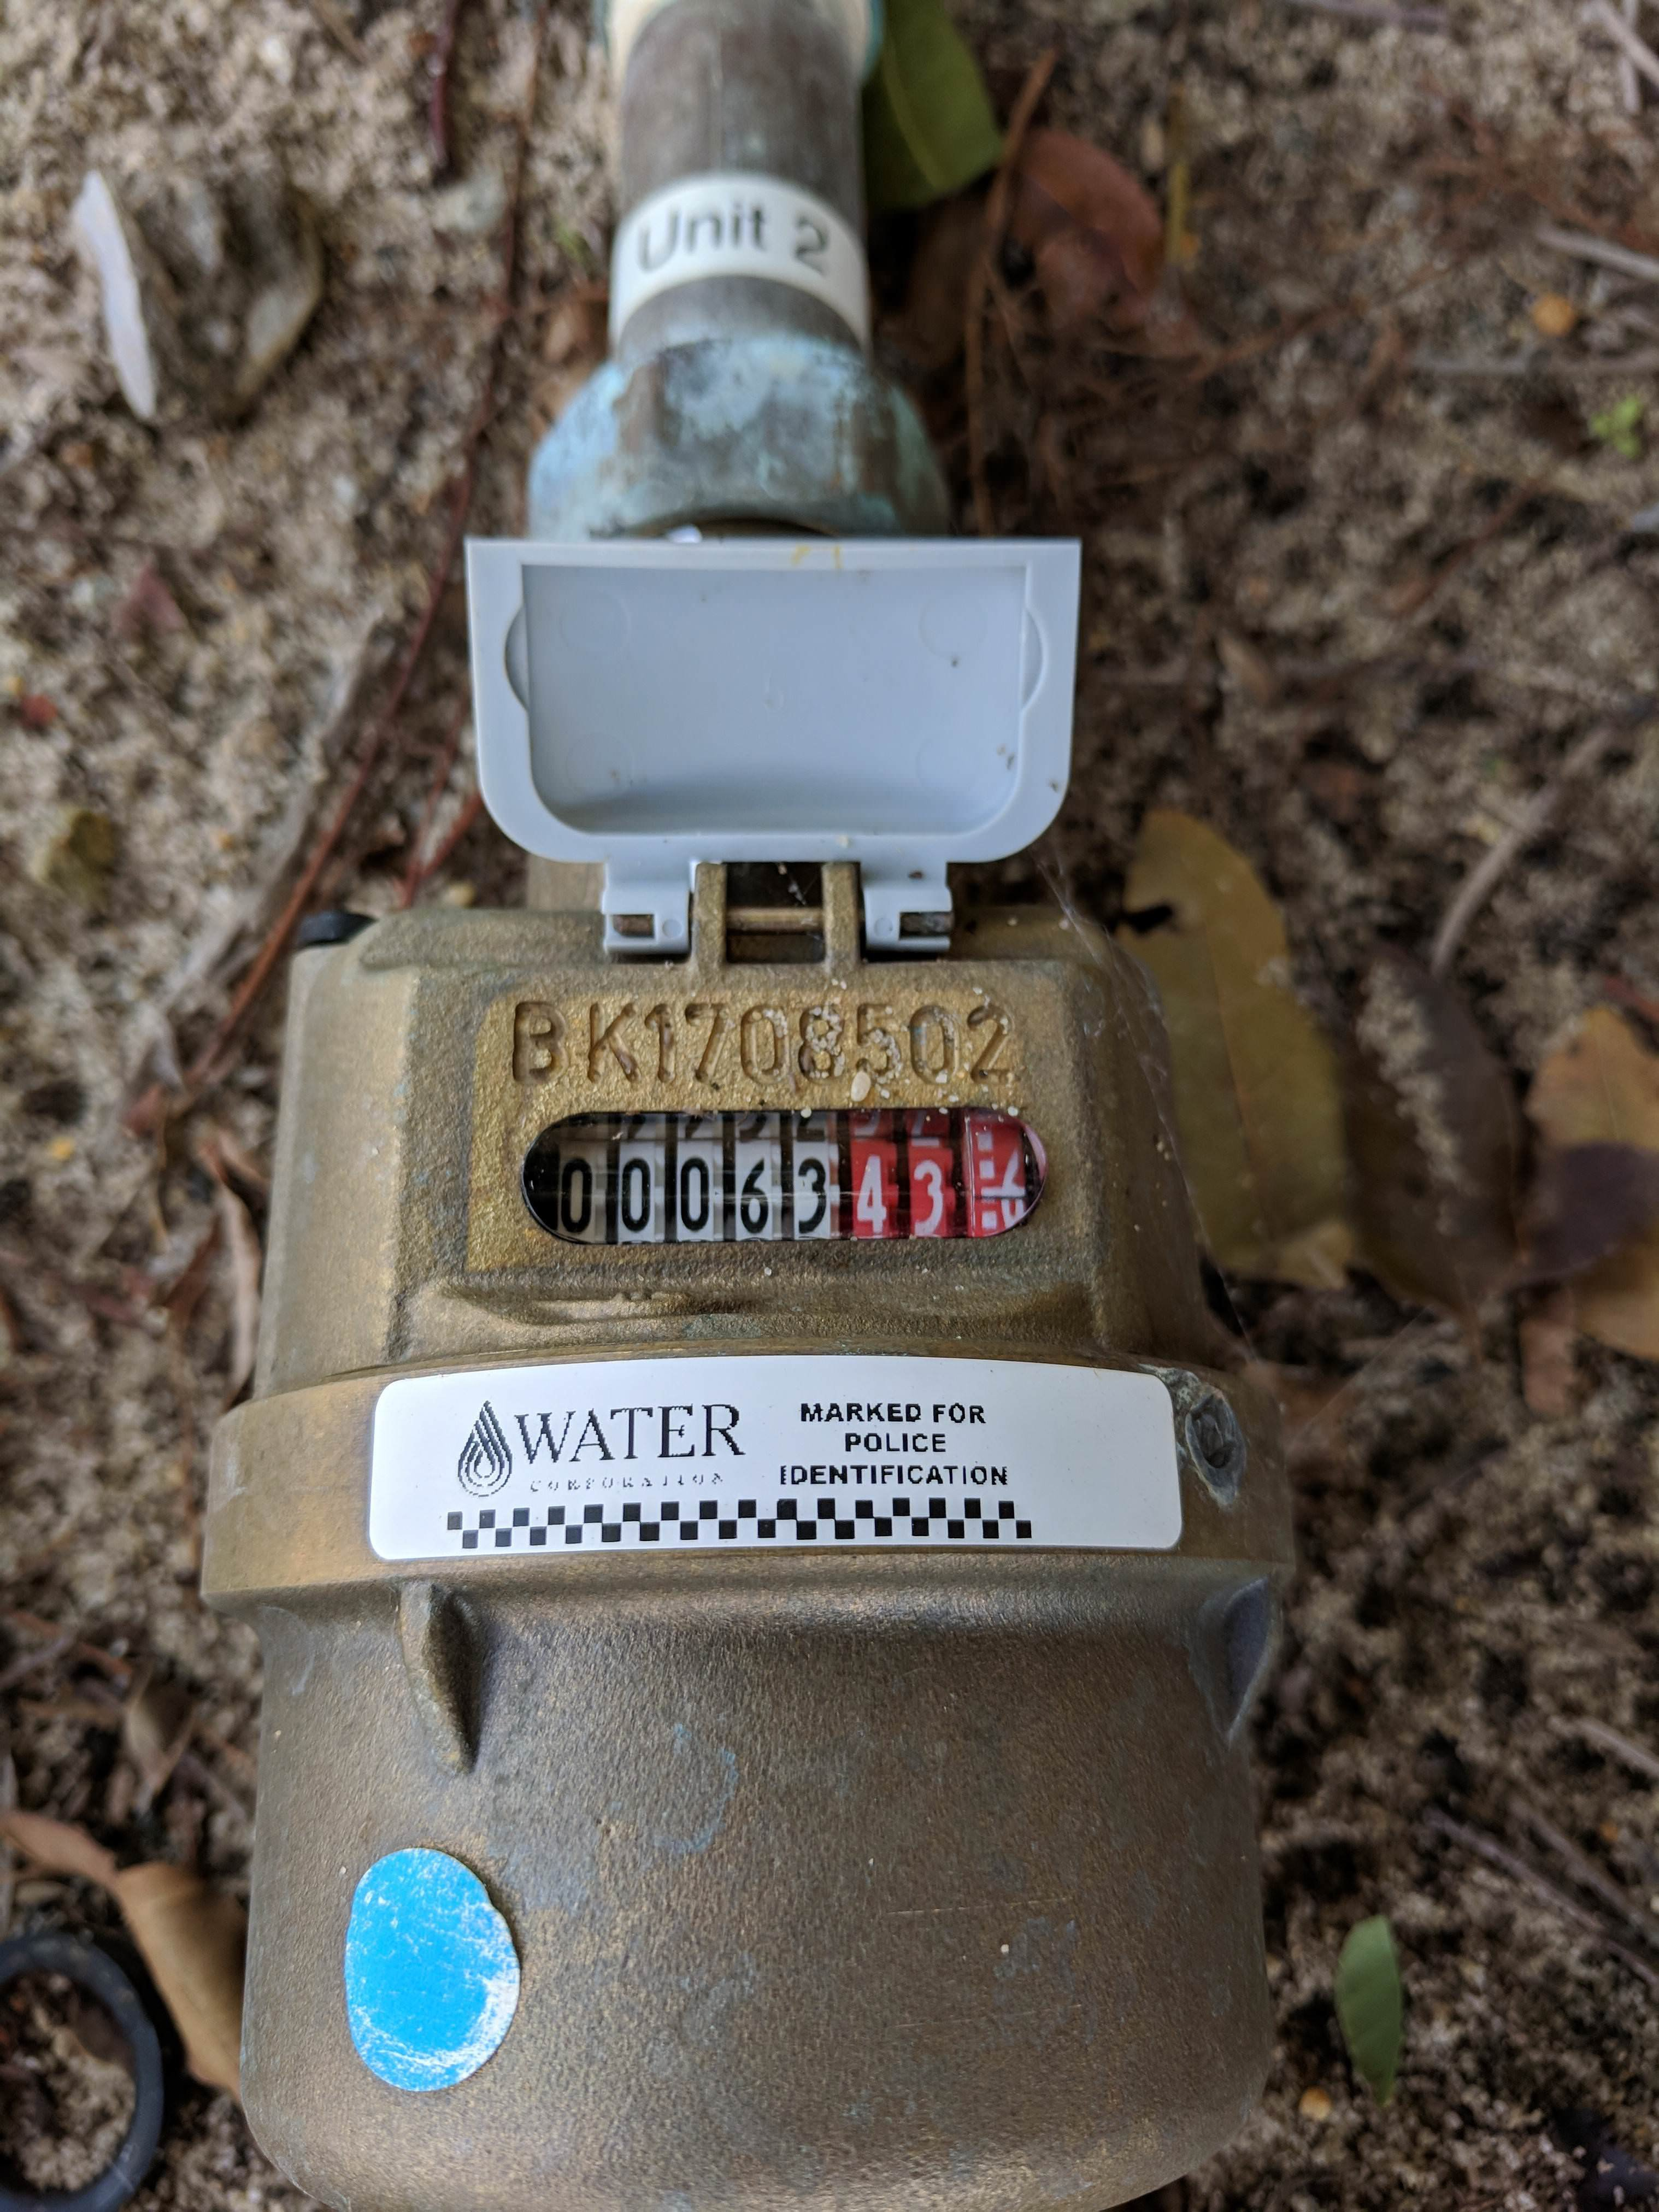
Meter Tampering
GS 14-151: Criminal prosecution or civil lawsuit
Local government pre-empted from charging penalties for anything covered by 14-151
But may charge account-holder (or potentially property owner) for costs of fixing/replacing damaged meters and other infrastructure.
Utility must address these costs in their utility ordinance and rate schedule.

Slide 18
Who is liable for the fees?

Slide 19
“We have heirs to a piece of property, 3 with 25% ownership and 3 with 8.3% ownership. There seems to be an argument between these heirs because one is living in the house and another has had the water disconnected. Is there any stipulation regarding ownership percentage and the ability to establish service? Also, how does the Utility avoid getting caught in the middle of an on/off feud?”

Slide 20
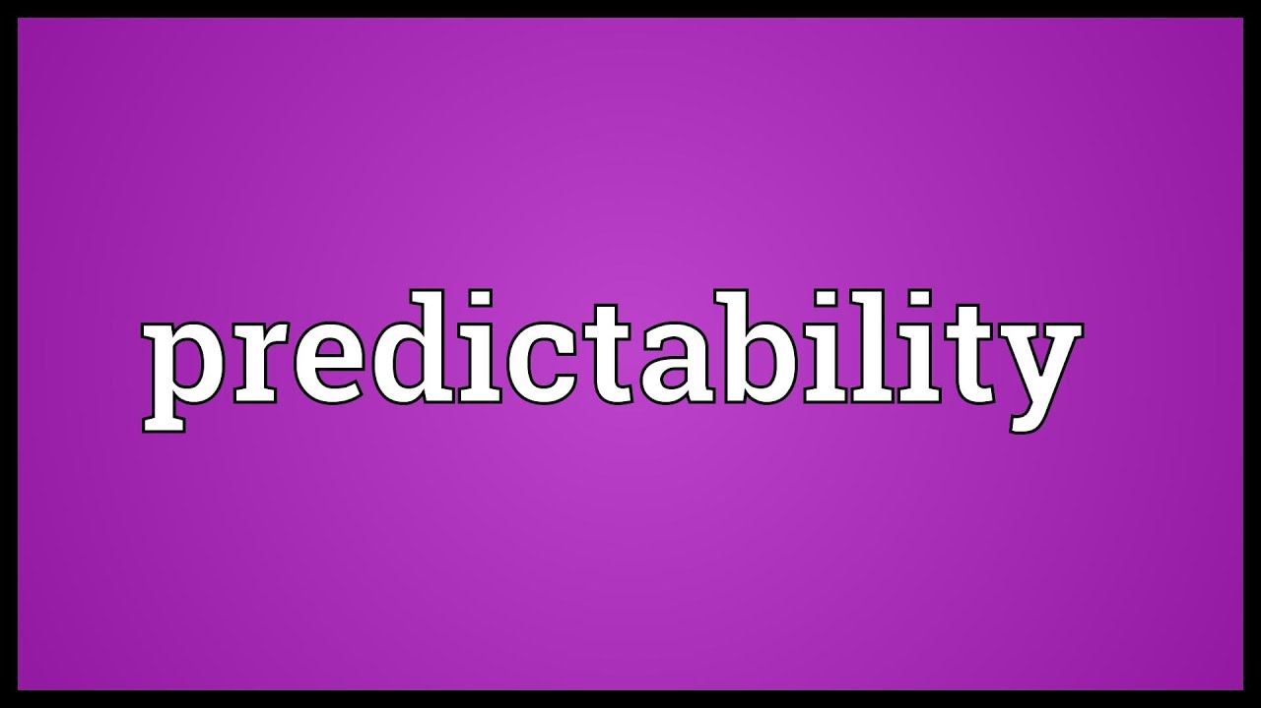
Know the Laws
Know statutory authority / limitations
Adopt Rules
Adopt utility ordinances that address all administrative issues
Inform Customers
Incorporate rules in customer contract
Inform customers of periodic changes to rules
Be Consistent
Consistently apply laws/rules
Train all staff regularly and monitor for compliance
Focus on customer service
The key to successful utilities administration is anticipating as many issues as possible, adopting rules and processes to address them, consistently following the rules and processes, and clearly communicating the rules and processes to customers and potential customers.

Slide 21
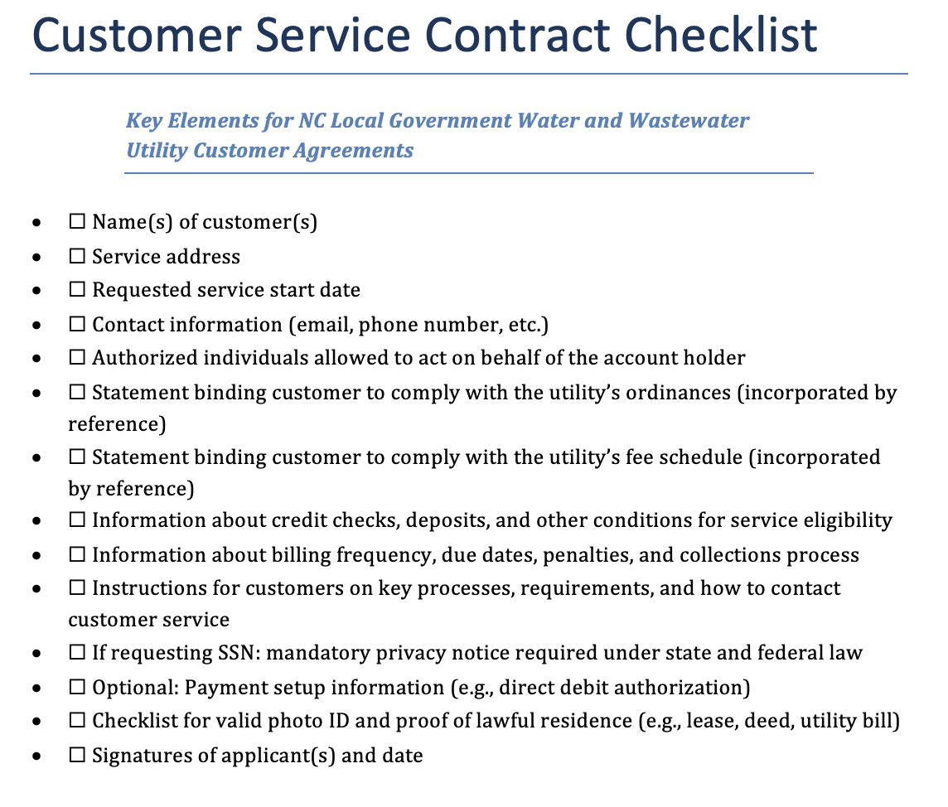
Incorporate by Reference

Slide 22
Collection Options
Disconnection
Late penalties
Debt Set-Off
Collection Agents & Civil Suites
Ordering Partial Payments
Can implement a multi-tiered penalty to have a lower penalty apply as soon as the bill goes delinquent and a higher penalty apply after a certain period of time that the bill is still outstanding
Can submit any amount over $50 owed on residential account to state’s debt set off program for collection against state tax refunds or lottery winnings
The most effective tool a local utility has to enforce collection is the ability to disconnect services. But a local unit needs to apply its disconnect policy uniformly.
State law requires a municipality & county to wait 10 days to disconnect after bill goes delinquent. A water and sewer authority must wait 30 days.
If a unit bills more than one utility service, the governing board can adopt an ordinance specifying how partial payments will be applied.

Slide 23
Customer Assistance
Payment Plans
Assistance PRograms
External Resources
Rate structure
Allowing customers who go delinquent to pay outstanding balance over a period of time
Using general fund monies (tax dollars) to set up a subsidy or assistance fund for low- or moderate- income customers
Connecting customers to outside resources for payment assistance
May use rate structure to help keep rates lower for lower-volume users

Slide 24
Rate Structures
Inside Rates
 | Residential | Fixed Rates Flat Unit Rates Increasing Block Rates Decreasing Block Rates Seasonal Rates
 | Commercial
 | Industrial
 | Other (based on cost difference or some other utility difference)
Outside Rates
 | Bulk Rate | Fixed Rates Flat Unit Rates Increasing Block Rates Decreasing Block Rates Seasonal Rates
 | May establish customer classes, but must treat similarly-situated customers the same

Slide 25
Funding Options
There are several revenue sources available to choose from to fund a local government’s water and wastewater utilities.
Tap Fees
Contractual Charges
Assessed on property owner at time of connection to cover costs of connection
Special
Assessments
Regulatory Fees
User Fees
Assessed on water/sewer utility customers—typically has fixed and variable component
Availability Fees & Reserved Capacity
System
Development
Fees
Tap Fees &
User Fees

Slide 26
Funding Options
There are several revenue sources available to choose from to fund a local government’s water and wastewater utilities.
System Development Fees
Contractual Charges
Special
Assessments
Regulatory Fees
Charges assessed on “new development” to cover past or future capital costs necessary to serve/continue to serve “new development”
Availability Fees & Reserved Capacity
System
Development
Fees
Tap Fees & User Fees

Slide 27
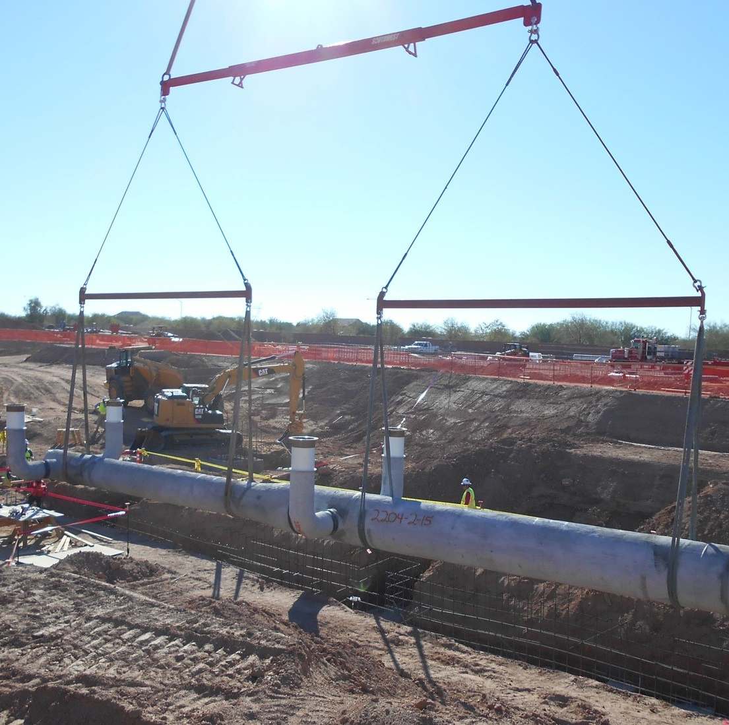
System Development Fees
A local government utility may assess a system development fee on “new development to fund costs of [water and sewer] capital improvements necessitated by and attributable to such new development, to recoup costs of existing [water and sewer] facilities which serve such new development, or a combination of those costs….”

Slide 28
Funding Options
There are several revenue sources available to choose from to fund a local government’s water and wastewater utilities.
System Development Fees
Contractual Charges
Special
Assessments
Regulatory Fees
Charges assessed on “new development” to cover past or future capital costs necessary to serve/continue to serve “new development”
Availability Fees & Reserved Capacity
System
Development
Fees
Tap Fees & User Fees

Slide 29
Funding Options
There are several revenue sources available to choose from to fund a local government’s water and wastewater utilities.
Special Assessments
Contractual Charges
Reimbursement charges for capital projects that benefit assessed properties
Special
Assessments
Regulatory Fees
Availability Fees & Reserved Capacity
System
Development
Fees
Tap Fees & User Fees

Slide 30
Special Assessments
Charges are a lien on property
Local government may use property tax collection methods to enforce
Charges assessed based on benefit to property
Fund single capital projects only
Charges levied against property to pay for public improvements that benefit that property

Slide 31
NC Special Assessment Projects
Unless specified otherwise, special assessments may only be levied for public capital projects.
Counties
Municipalities
County water systems
County wastewater/septic systems
Beach erosion and flood and hurricane protection on county property
Watershed improvement, drainage, water resources development on county property
Private subdivision streets to bring up to DOT standards*
Subdivision street lights and/or street lighting*
Maintenance of County beach erosion and flood and hurricane protection
Maintenance of county watershed improvement, drainage, water resources development
Municipal streets*
Municipal sidewalks in any public street*
Municipal water systems
Municipal wastewater/septic systems
Municipal stormwater and drainage systems
Beach erosion and flood and hurricane protection on municipal property
* Requires a petition from certain % of affected property owners

Slide 32
SPECIAL ASSESSMENT PROCESS
Description of project in general terms (which may be by reference to projects described in the preliminary resolution)
Basis on which the special assessments shall be levied
General description of the boundaries of the area benefited if the basis of assessment is either area or value added;
The percentage of the cost to be specially assessed;
The terms of payment, including the conditions under which assessments are to be held in abeyance, if any.
1
2
3
4
5
6
7
8
9
10
11
12
(Government receives petition)
Unit determines scope and cost of project
Board adopts preliminary assessment resolution
Unit publishes notice
Board holds public hearing
Board adopts final assessment resolution
Unit completes project
Unit prepares preliminary assessment roll
Unit publishes notice of assessment roll
Board holds public hearing
Board confirms assessment roll – assessments become lien on property assessed
Property owners make assessment payments
Frontage abutting project, equal rate per foot
Area of land served, equal rate per unit of area (can establish benefit zones)
Value added to land (difference between appraised values before and after project), equal rate per dollar of value added (can establish benefit zones)
Number of lots served if involves extension of existing system to residential or commercial subdivision, equal rate per lot
Combination of the above bases
Notes:
Scope of project and % of cost to be assessed may not differ from that stated in preliminary assessment resolution
Can’t alter terms of payment from those stated in final assessment resolution

Slide 33
Funding Options
There are several revenue sources available to choose from to fund a local government’s water and wastewater utilities.
Special Assessments
Contractual Charges
Reimbursement charges for capital projects that benefit assessed properties
Special
Assessments
Regulatory Fees
Availability Fees & Reserved Capacity
System
Development
Fees
Tap Fees & User Fees

Slide 34
Funding Options
There are several revenue sources available to choose from to fund a local government’s water and wastewater utilities.
Contractual Charges
Contractual Charges
Assessed pursuant to a contract with developer or property owner to extend water/sewer lines to property or do system changes / expansions to serve property
Special
Assessments
Regulatory Fees
Availability Fees & Reserved Capacity
System
Development
Fees
Tap Fees & User Fees

Slide 35
Reimbursements
 | Public Enterprise Contract | Roadway and Intersection Contract | Reimbursement Agreements
Statute | 153A-280; 160A-320 | 160A-309 (city only) | 153A-451; 160A-499
Projects | Public enterprises | Public intersection or roadway improvements | ”municipal infrastructure” (e.g. water, sewer, stormwater, streets, curbs, sidewalks, traffic control)
Scope | Cost of design and construction improvements; must be adjacent or ancillary to private land development; cannot pay for improvement required by development ordinances | Must be adjacent or ancillary to a private land development project | Improvement must be included in the local government’s capital improvement plan and must serve the developer or property owner
 | Not subject to public bidding if the public cost will not exceed two hundred fifty thousand dollars ($250,000) and the LG determines that: (i) the public cost will not exceed the estimated cost of providing for those improvements through either eligible force account qualified labor or through a public contract let pursuant to Article 8 of Chapter 143 of the General Statutes; or (ii) the coordination of separately constructed improvements would be impracticable. |  | Not be subject to competitive bidding, but developer or property owner who is party to a reimbursement agreement authorized under this section must solicit bids in accordance with Article 8 of Chapter 143 of the General Statutes when awarding contracts for work that would have required competitive bidding if the contract had been awarded by the LG.
Reimbursement Agreements
Local Government Pays Developer for Utility Capital Project

Slide 36
Funding Options
There are several revenue sources available to choose from to fund a local government’s water and wastewater utilities.
Contractual Charges
Contractual Charges
Assessed pursuant to a contract with developer or property owner to extend water/sewer lines to property or do system changes / expansions to serve property
Special
Assessments
Regulatory Fees
Availability Fees & Reserved Capacity
System
Development
Fees
Tap Fees & User Fees

Slide 37
Funding Options
There are several revenue sources available to choose from to fund a local government’s water and wastewater utilities.
Regulatory Fees
Contractual Charges
Assessed to cover costs of inspections, plan reviews, etc.
Special
Assessments
Regulatory Fees
Availability Fees & Reserved Capacity
System
Development
Fees
Tap Fees & User Fees

Slide 38
Funding Options
There are several revenue sources available to choose from to fund a local government’s water and wastewater utilities.
Availability Fees
Contractual Charges
State law also allows municipalities and counties to transfer property taxes and other general fund revenues to the water and wastewater funds, but this practice raises red flags for the LGC, DEQ, and any other potential lenders.
Assessed on certain properties when water/sewer available but property owners choose not to connect
Special
Assessments
Regulatory Fees
Reserved Capacity Charges
Availability Fees & Reserved Capacity
System
Development
Fees
Charges assessed to other local governments to reserve capacity in utility system
Tap Fees & User Fees

Slide 39
Mandating Water / Sewer Connections
Local government utilities authorized to mandate connection to water & sewer lines located within a reasonable distance of developed properties unless property has valid well permit
Counties
Municipalities
Sanitary Districts
Certain Water & Sewer Authorities
G.S. 153A-284
G.S. 160A-317
G.S. 130A-55(16)
G.S. 162A-6a(14(d)
S.L. 2023-90, 2023-108; 2023-137
made some changes

Slide 40
Can City Mandate Connection to Sewer System?
Comparative costs done by: (1) a licensed soil scientist, as defined in G.S.89F-3, (ii) an on-site wastewater contractor certified under Article 5 of Chapter 90A of the General Statutes, or (iii) a plumbing contractor licensed under Article 2 of Chapter 87 of the General Statutes.
Unclear who pays
1
City Limits
Property within city limits?
If YES
2
Developed
Developed property with one or more residential or commercial units?
If YES
3
Reasonable Distance
Reasonable distance of sewer line owned, leased, or operated by city or on behalf of city?
If YES
NEW
City has adequate capacity to transport and treat proposed new wastewater from premises at time of connection?
4
Adequate Capacity
If YES
NEW
Costs of connection (including underground piping and connections to unit) do not exceed the costs of installing on-site sewer system?
5
Connection Costs

Slide 41
Can City Mandate Connection to Water System?
To establish adequacy or inadequacy, property owner shall submit to the city a determination of same prepared by a professional engineer, licensed in accordance with the provisions of Chapter 89C of the General Statutes.
1
City Limits
Property within city limits?
If YES
2
Developed
Developed property with one or more residential or commercial units?
If YES
Reasonable Distance & No Well Permit
Reasonable distance of water line owned, leased, or operated by city or on behalf of city? No valid well permit?
3
If YES
NEW
Adequate water pressure can be achieved using the same piping size as the meter provides to the owner's premises?
4
Adequate Pressure
“Adequate water pressure" shall mean the average water pressure delivered to all connected customers within a one-quarter mile radius in either direction of the owner's point of connection.

Slide 42
Can County Mandate Connection to Sewer System?
1
Developed
Developed property with one or more residential or commercial units?
If YES
2
Reasonable Distance
Reasonable distance of sewer line owned, leased, or operated by city or on behalf of city?
If YES
NEW
County has adequate capacity to transport and treat proposed new wastewater from premises at time of connection?
3
Adequate Capacity

Slide 43
Can County Mandate Connection to Water System?
1
Developed
Developed property with one or more residential or commercial units?
If YES
2
Reasonable Distance
Reasonable distance of water line owned, leased, or operated by city or on behalf of city?
If YES
Well Permit
D Does the property parcel NOT have a valid well permit?
3

Slide 44
Availability Fees
Availability Fees
Counties
Water & Sewer Authorities
Sanitary Districts
Municipalities
In the case of improved property that would qualify for the issuance of a building permit for the construction of one or more residential dwelling units or commercial establishments and where the county has installed water or sewer lines or a combination thereof directly available to the property, the county may require payment of a periodic availability charge, not to exceed the minimum periodic service charge for properties that are connected.
In lieu of requiring connection under this subsection and in order to avoid hardship, the city may require payment of a periodic availability charge, not to exceed the minimum periodic service charge for properties that are connected.

Slide 45
Billing & Collecting Availability Fees
Collecting availability fees can be challenging because there is no threat of disconnecting service.
Stand-alone Bill
No lien
Sue
Debt set-off
Collection agency
Bill on Property Tax Bill
No lien
Sue
Debt set-off
Collection agency

Slide 46
Funding Options
There are several revenue sources available to choose from to fund a local government’s water and wastewater utilities.
State law also allows municipalities and counties to transfer property taxes and other general fund revenues to the water and wastewater funds, but this practice raises red flags for the LGC, DEQ, and any other potential lenders.
Contractual Charges
Special
Assessments
Regulatory Fees
Availability Fees & Reserved Capacity
System
Development
Fees
Tap Fees & User Fees

Slide 47
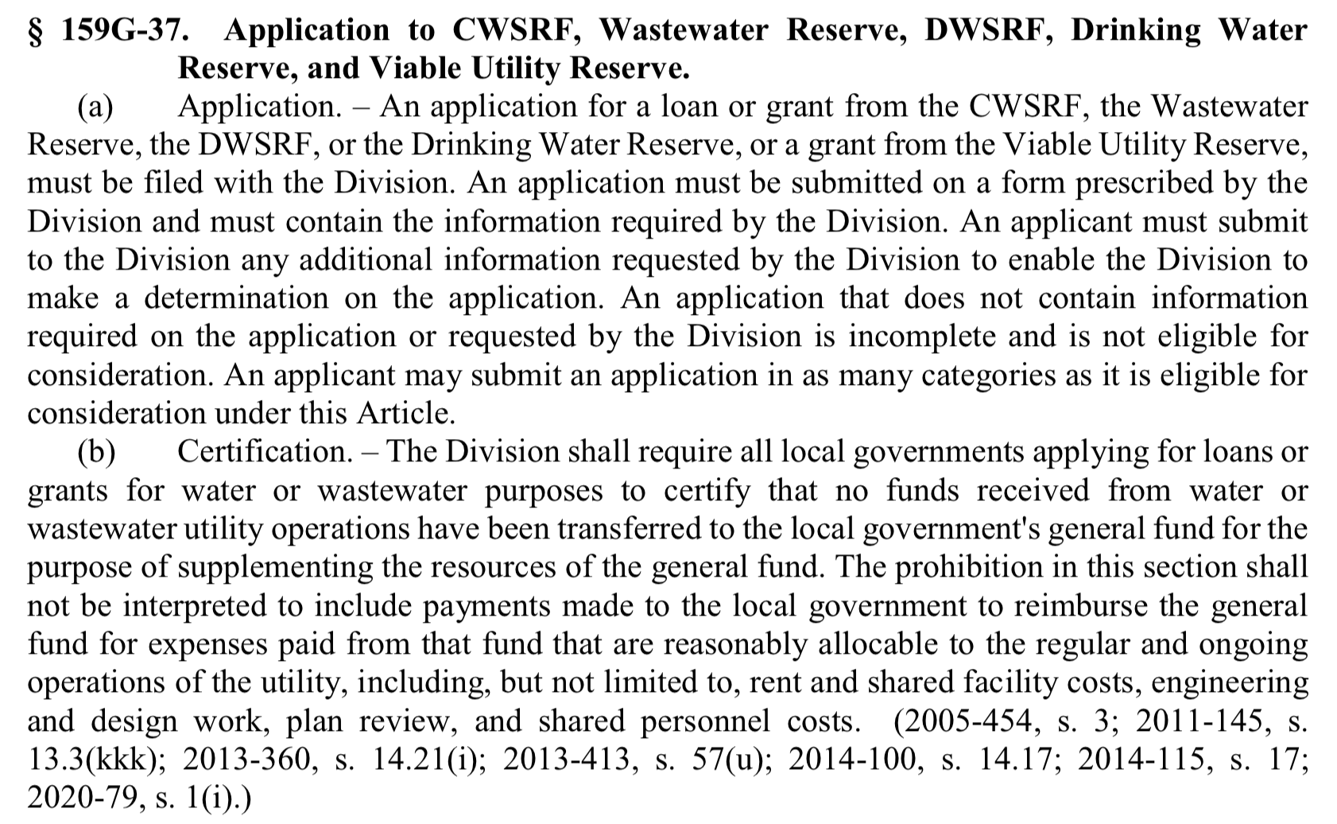
Transfers of Money
General Fund
Enterprise Fund
Legally allowed to transfer monies between these funds, including loans, BUT
Does not include “transfers” (reimbursements / cost allocations) for legitimate cost recovery purposes.
Those are allowed and will not trigger this consequence.

Slide 48
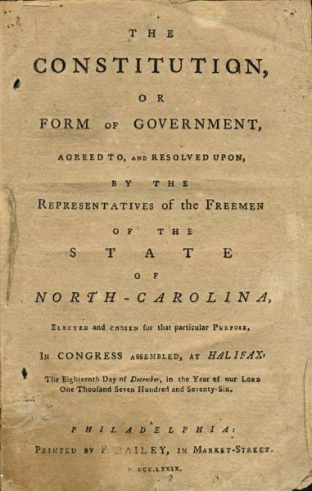
Public Purpose
“The power of taxation shall be exercised . . . for public purposes only . . .” N.C. Const. Art. V, Sect. 2(1)
You must have statutory authority to expend funds for any purpose
Public funds must be spent for benefit of citizens of your LG
Public funds must be spent for citizens generally and not solely to benefit private individual / entity
Exclusive Privileges & Emoluments
“No person or set of persons is entitled to exclusive or separate emoluments* or privileges from the community but in consideration of public services.”
N.C. Const. Art. I, Sect. 32
You may not provide direct benefit to private entities or individuals without receiving public benefit in return

Slide 49
Lawful?
A beloved city resident leaves his faucets running all day to accommodate his many cats. He has recently fallen behind on his rather high water bill. The department’s normal procedure is to shut off the water and impose a penalty for the delinquency. The city manager feels sorry for the resident and requests that the city’s governing board make an exception and waive his outstanding utility fees and late penalties. To a cheering crowd, the board votes unanimously to do so.

Slide 50
Lawful?
Lawful?
City sets up utility payment assistance program in the general fund, whereby it provides cash subsidies to low- income water customers who are also city residents to help them pay their water bills each month.

Slide 51
Lawful?
Town grants one-time-per-year adjustment to water bill if leak is discovered and bill amount is higher than comparable monthly bill, as long as customer provides proof from licensed plumber that leak is fixed.

Slide 52
Water & Wastewater Partnerships

Slide 53
LGC Must Approve Sale to (or Control of) Public Enterprise to Private Entity S.L. 2023-138
Control includes any of the following:
The authority to expend or otherwise manage during any fiscal year more than fifty percent (50%) of a public enterprise's adjusted revenues.
Responsibility for provision to the public of the services previously provided by the public enterprise.
Responsibility for operation and maintenance of a material portion of the assets and facilities of the public enterprise.
The authority to manage a material portion of the staff responsible for operation and maintenance of the assets and facilities of the public enterprise.
County, Municipality, County Water & Sewer District, Metropolitan Water Districts, Metropolitan Sewer Districts may not transfer or cede control of public enterprise to a private entity unless:
1
Governing board holds a public hearing
Governing board determines that deal is in the public interest after considering statutory factors
3
LGC Approval. LGC may approve only if it
determines that “the customers of the public enterprise will enjoy reasonable and material short-term and long-term savings and other net benefits from the arrangement during the term of the arrangement without the imposition of any material cost or charge on the unit of local government or its customers upon termination of the arrangement.”
2

Slide 54
Regional Partnerships
Regional Growth
Regional Growth
Better able to address regional growth needs.
Individual local gov’t has less control of growth management.
Tradeoffs
Financial Sustainability
Financial Sustainability
May be able to take advantage of economies of scale.
Individual local gov’t may not have control over rate-setting
Politics
Politics
Decision-making solely focused on utility system(s)
Individual local gov’t cannot compel annexation with water/sewer service. Less accountability by elected officials.

Slide 55
Regional Structures
1
2
3
LG Takes Over Some or All of Another LG’s Utility Operations
LG Assumes Complete Ownership and Operational Control of Another LG’s Utility
LGs Jointly Form New Regional Utility

Slide 56
Other Partnership Opportunities
01
Operational Efficiencies
Shared staffing agreements (e.g., engineers, finance officers).
Joint procurement of chemicals, meters, and other equipment.
Mutual aid for emergency response and operational support.
02
Infrastructure & Asset Management
Shared use of infrastructure (e.g., bulk treatment or wheeling agreements).
Joint capital project development for shared plants or interconnections.
Coordinated asset management using shared consultants or software.
03
Planning, Policy, and Development
Regional master planning that respects local implementation control.
Joint review of development projects and service extension impacts.
Shared rate benchmarking and financial performance comparisons.
04
Technology & Compliance
Joint SCADA or remote monitoring systems.
Shared GIS platforms for system mapping and analysis.
Regional pretreatment programs and joint laboratory testing.
05
Workforce & Governance
Utility consortiums or advisory councils for voluntary regional coordination.
Shared interns or staff training programs across utilities.
Shared consultants for rate, affordability, or policy studies.

Slide 57
06
Emergency & Growth Readiness
Standby service agreements for disaster backup capacity
Capacity leasing from underutilized facilities
Shard infrastructure reserve funds for regional upgrades.
07
Funding & Financial Tools
Joint grant applications for infrastructure and planning
MOUs to share costs for studies, software, or consultants.
Planning, Policy, and Development
- Regional master planning that respects local implementation control. - Joint review of development projects and service extension impacts. - Shared rate benchmarking and financial performance comparisons.
Technology & Compliance
This - Joint SCADA or remote monitoring systems. - Shared GIS platforms for system mapping and analysis. - Regional pretreatment programs and joint laboratory testing.
Workforce & Governance
- Utility consortiums or advisory councils for voluntary regional coordination. - Shared interns or staff training programs across utilities. - Shared consultants for rate, affordability, or policy studies.

Slide 58
Current Trends in Water & Wastewater Management

Slide 65
Improving Your Utility’s Financial Sustainability
COMMUNICATE
COMMUNICATE
THERE
COMMUNICATE
Regulatory & Legal
Financial Health
Rate Structures
Political Feasibility
Community & Market Factors
HERE
Collections & Affordability
Demand & Consump-
tion
Patterns
Detailed Cost Estimates
Capital Improvement Plans
Update Utility Ordinances to Adopt More Effective Billing, Collections, and Administration Practices
Regularly Review All These Factors and Update Rates

Slide 66
Getting from Here to There
3
This is a messy process
2
7
6
4
1
8
5

Slide 67
Demand and Consumption Patterns
Volume of Water Used: Understand the historical water consumption patterns, including peak usage periods, and how they relate to system costs.
Wastewater Flow and Load: Wastewater treatment costs depend on the volume of wastewater as well as the strength of the wastewater (e.g., pollutants and solids), which may require different treatment levels.
Seasonal and Geographic Variations: Some regions may have seasonal demand spikes, such as during summer months, or disparities in usage based on geography or socioeconomic factors.

Slide 68
Rate Structure
Increasing/decreasing block—rates increase over an initial range and decrease over subsequent ranges, or vice versa;
Flat Fee—one price per billing period for unlimited water consumption;
Tiered Flat Fee—one price per billing period for unlimited water consumption that varies by customer class;
Seasonal uniform—uniform rates that vary by season;
Uniform at One Block’s Rate—customer pays one rate per 1,000 gallons, but that rate is determined by their total usage.
Customer Classes: Consider whether there are utility-based reasons to differentiate among different customers
Flat vs. Volumetric Charges: Consider whether to charge a fixed fee (base charge) or a volumetric rate (per unit of water used). Volumetric rates can incentivize conservation, while base charges ensure a stable revenue stream.
Impact of Rate Increases: Consider how proposed rate increases will impact different customer classes, including low-income households or small businesses.
Inclining or Declining Block Rates: Determine if block rates should be progressive (higher rates for higher consumption) or regressive (lower rates for higher consumption).

Slide 69
Regulatory and Legal Considerations
Federal and State Requirements: Water and wastewater systems must comply with federal and state regulations (e.g., Clean Water Act, Safe Drinking Water Act). These regulations may impose costs on utilities, such as upgrades to meet water quality standards.
State Ratemaking Requirements: Vary by type of local government utility.
Public Participation and Transparency: Certain rate changes require a public hearing, which help ensure that the rate structure is transparent and the public is adequately informed. (In NC a board must hold a public hearing on any water or sewer rate change that will be assessed on development. And SDFs have additional process requirements.)

Slide 70
Financial Health of the Utility
Revenue Sufficiency: The rates must generate enough revenue to cover both operating expenses and capital investment needs without relying on external subsidies or emergency funding.
Debt Service Coverage: If the utility has outstanding bonds or loans, ensuring that rates provide sufficient revenue to cover debt service is critical for maintaining creditworthiness.
Reserve Funds: Consider the utility’s financial reserves (e.g., working capital or emergency funds) to ensure the system remains financially stable in the event of unexpected costs or a downturn in revenue.

Slide 71
LGC OVERSIGHT
The Local Government Commission can assume full control of a local government utility system if for 3 consecutive years the unit meets ANY of the following criteria:
Negative Working Capital
(current liabilities are greater than current assets)
Quick ratio of less than 1.0
(measure of cash on hand and ability to pay bills)
Net loss of revenue from operations using modified accrual
The LGC must find the impact threatens the financial stability of the unit and that the unit has failed ot make corrective changes in its operations after warning from the LGC.

Slide 72
Community & Market Factors
Socioeconomic Considerations: Assess the economic condition of the community.
Comparison with Regional or Statewide Rates: Compare local utility rates with those of neighboring jurisdictions to ensure the rates are competitive and not unnecessarily high or low.
External Market Trends: Factor in trends such as rising energy prices (which can drive up operational costs), changes in water availability, or emerging technologies that may lower future costs.

Slide 73
Collections & Affordability
Affordability Studies: Understanding the economic burden of utility rates on households is crucial.
Assistance Programs: Offer assistance programs for low-income customers, as authorized by state law and as local government resources allow
Collections: Study collection percentages and make targeted efforts to increase collections. Update ordinances to address common delinquency and other issues.

