Slide 1
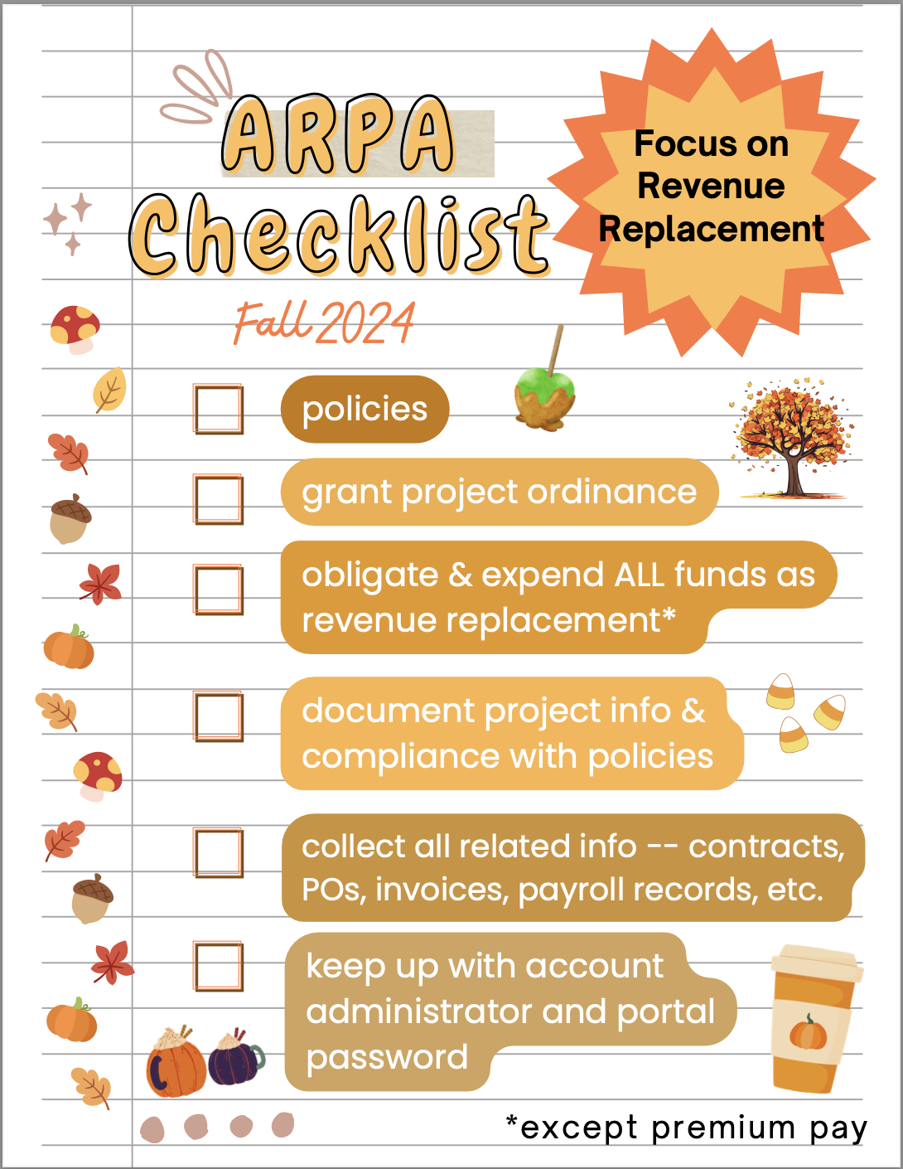
American Rescue Plan Act of 2021 Coronavirus State and Local Fiscal Recovery Fund: Revenue Replacement Fall 2024
Kara A. Millonzi
UNC School of Government
millonzi@sog.unc.edu

Slide 2
ARP/CSLFRF Spending Categories
ADDRESS COVID PUBLIC HEALTH & NEGATIVE ECONOMIC IMPACT
Support public health expenditures, by funding COVID-19 mitigation efforts, medical expenses, behavioral healthcare, and certain public health and safety staff;
Address negative economic impacts caused by the public health emergency, including economic harms to workers, households, small businesses, impacted industries, and the public sector;
Support disproportionately impacted communities
REPLACE LOST REVENUE
Replace lost public sector revenue, using this funding to provide government services to the extent of the reduction in revenue experienced due to the pandemic;
$10 million standard allowance OR formula approach
PREMIUM PAY
Provide premium pay for essential workers, offering additional support to those who have borne and will bear the greatest health risks because of their service in critical infrastructure sectors;
Target low-and moderate- income employees or employees who face(d) added risks during pandemic
INFRASTRUCTURE INVESTMENTS
Invest in water, sewer, and broadband infrastructure, making necessary investments to improve access to clean drinking water, support vital wastewater and stormwater infrastructure, and to expand access to broadband internet.
ARP/CSLFRF FLEX
Disaster response/mitigation
Certain CDBG (Title I) projects
Certain Surface Transportation Projects
Know Your Category!

Slide 3
Federal Compliance Requirements
Award Terms | Prohibited Expenditures | Uniform Guidance (UG)
All funds obligated by December 31, 2024 & fully expended by December 31, 2026 Reporting requirements Project & Expenditure reports (quarterly or yearly, depending on size) -- Document data elements for certain EC’s Performance Plan reports (for largest units only) Civil rights compliance / nondiscrimination policy Compliance with all applicable Uniform Guidance provisions Records retention policy with retention for at least 5 years after award term ends Special audit requirements Other federal laws | NO: Pension fund contributions NO: Borrowing money NO: Financial reserves / rainy day fund NO: Settlement/judgement/consent decree NO: Undermines or discourages compliance with CDC guidelines NO: Violates conflict of interest provisions NO: Violates state law or other federal laws and regulations, including applicable Uniform Guidance | General Financial Management Internal Controls Eligible Projects Determination & Documentation Policy Cost Principles/Allowable Costs Policy Procurement, Suspension, & Debarment Policy Subaward Policy Program Income Policy Property Management Policy
Applies to ALL projects
Applies ONLY TO SOME projects and DOES NOT apply to Revenue Replacement
What local government agreed to as condition of receiving funds. Applies to ALL categories.
The Final Rule prohibits certain expenditures no matter what. Applies to ALL categories
Set of federal compliance regulations that apply to federal awards.

Slide 4
Revenue Replacement Compliance: Exempt from Some UG Provisions
Award Terms | Prohibited Expenditures | Uniform Guidance (UG)
All funds obligated by December 31, 2024 & fully expended by December 31, 2026 Reporting requirements Project & Expenditure reports (quarterly or yearly, depending on size) – Document data elements for certain ECs Performance Plan reports (for largest units only) Civil rights compliance / nondiscrimination policy Compliance with all applicable some Uniform Guidance provisions Records retention policy with retention for at least 5 years after award term ends Special audit requirements Other federal laws | NO: Pension fund contributions NO: Borrowing money NO: Financial reserves / rainy day fund NO: Settlement/judgement/consent decree NO: Undermines or discourages compliance with CDC guidelines NO: Violates conflict of interest provisions NO: Violates state law or other federal laws and regulations, including applicable Uniform Guidance | General Financial Management Internal Controls Eligible Projects Determination & Documentation Policy Cost Principles/Allowable Costs Policy (limited review) Procurement, Suspension, & Debarment Policy Subaward Policy Program Income Policy Property Management Policy

Slide 5
General Compliance:
Adopt and Implement these Policies
Record Retention
This policy supplements a local government’s regular records retention policy to establish procedures to retain all ARP/CSLFRF-related information for at least 5 years after the end of the award term (through December 31, 2031). (Sample policy here.)
Civil Rights Compliance
This policy reaffirms the local government’s commitment to compliance with federal civil rights laws and establishes processes for reporting potential violations and tracking complaints and resolutions. (Sample policy here.)
Eligible Use
This is a simple policy that indicates allowable and unallowable projects, based on the expenditure categories in the ARP/CSLFRF Final Rule. It requires a local government to identify staff to document and review ARP/CSLFRF expenditures. That documentation must be retained according to the record retention requirements. (Sample policy here.)
Allowable Cost
This is a more complex policy that requires a local government to do a detailed review of each cost item and ensure compliance with special limitations and documentation mandates for certain cost items. (Sample policy here.) [If using Revenue Replacement ARP/CSLFRF, there will be a more limited allowable cost review.]
Conflict of Interest
The UG requires recipients and subrecipients of federal financial assistance to maintain written standards of conduct covering conflicts of interest and governing the actions of its employees engaged in the selection, award, and administration of contracts. (Sample policy here.)
BACK

Slide 6
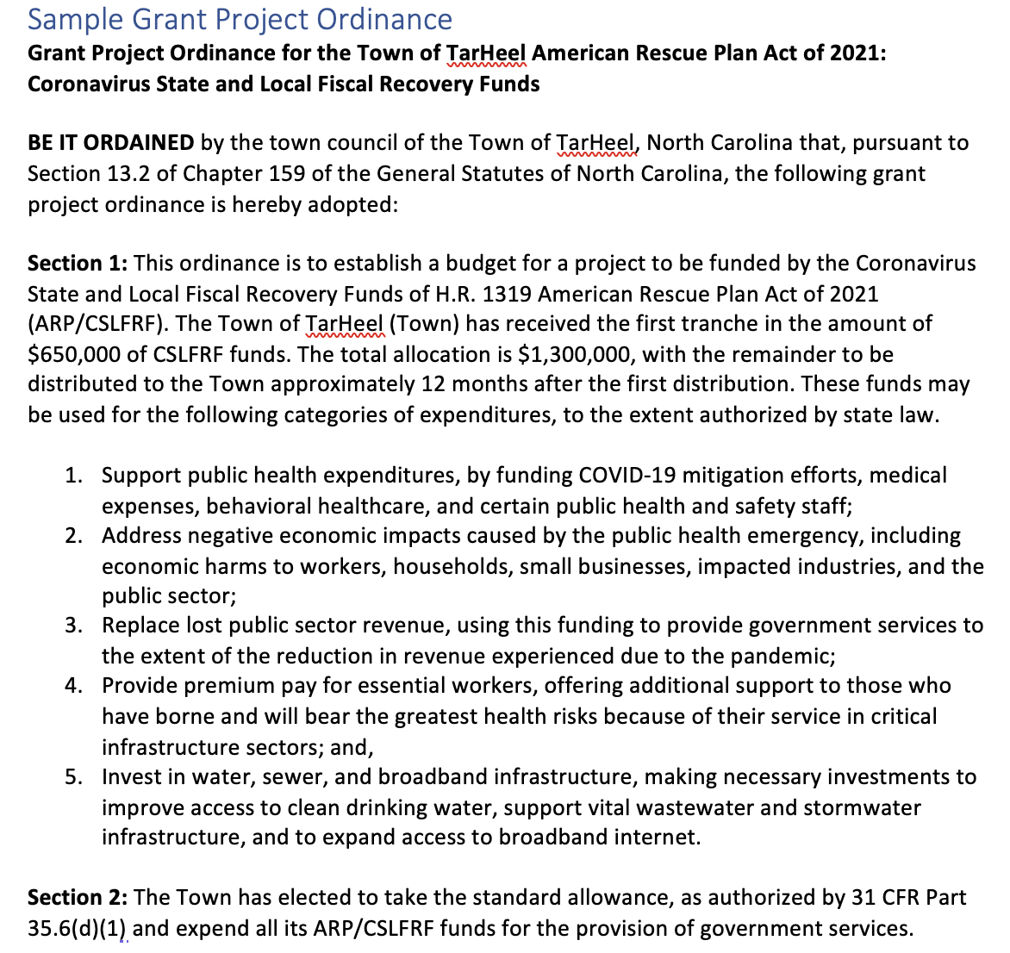
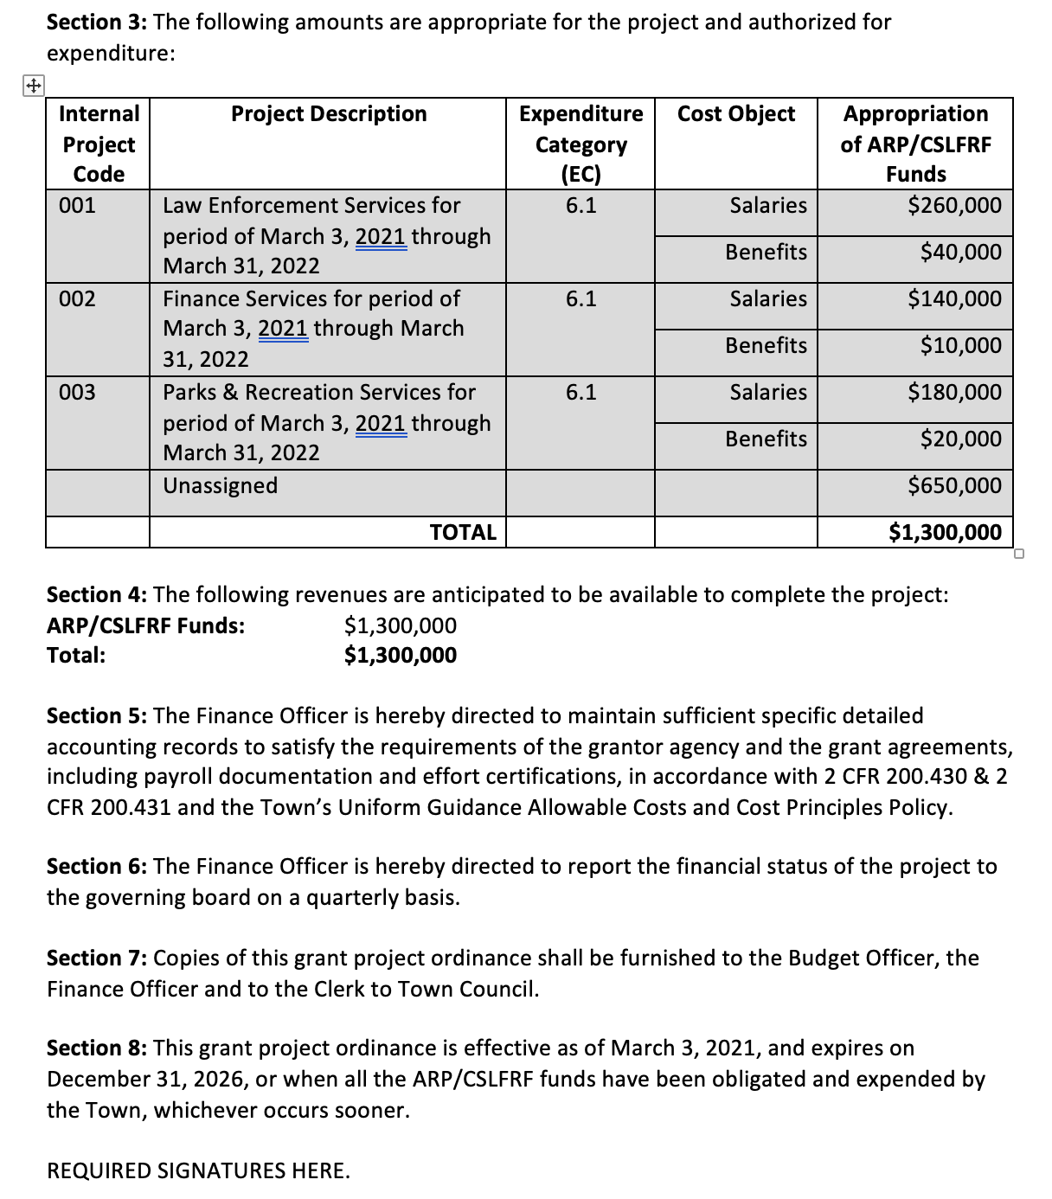

Slide 7
P&E Report
Report all expenditures as single project – EC 6.1
Exceptions:
If used revenue replacement as non-federal match for other federal program, report as EC 6.2
If paid premium pay under a lawful premium pay program, continue to report that as EC 4

Slide 8
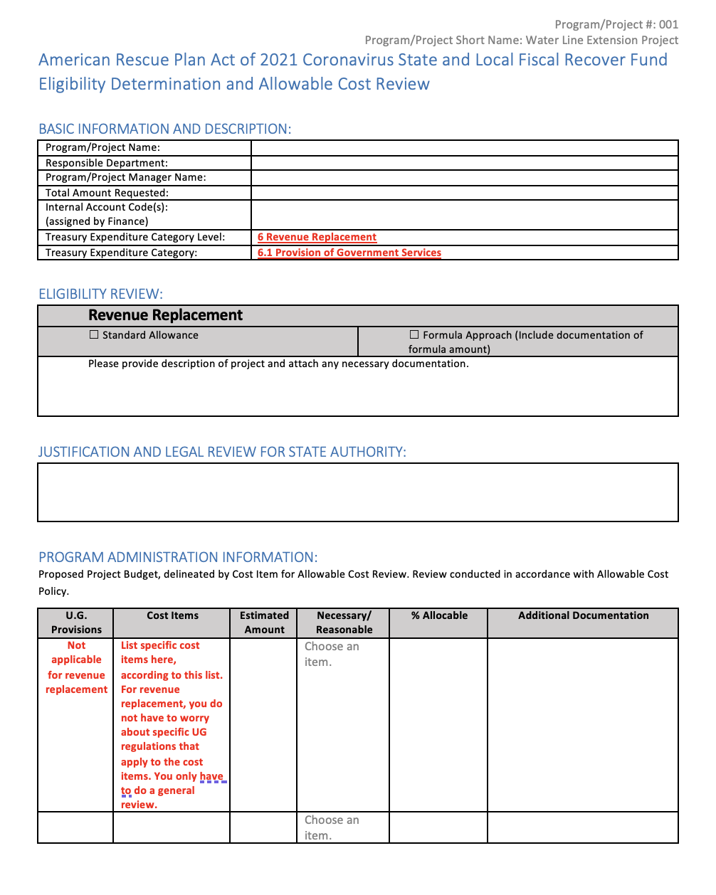

Slide 9
Revenue Replacement: Reimbursements ONLY
1
Adopt and implement 5 BASIC policies
Adopt or amend general written internal controls
Have attorney review for compliance with Award Terms & Conditions
Identify eligible reimbursement expenditures (including salaries & benefits)
Complete eligible use and allowable cost review documentation (template here) and keep documentation of original expenditures (eg. contracts, invoices, payments, payroll records, etc.)
Adopt grant project ordinance making specific reimbursement appropriations (ARP funds are now both obligated and expended)
Do journal entry to move reimbursement cash from special revenue fund to general fund and/or enterprise fund (the cash is now unrestricted fund balance)
Track and report obligations and expenditures during reporting period (April-March) as EC 6.1 on P&E report, with brief description of reimbursement expenditures. [Or EC 6.2 if match on other federal grant]
Retain all documentation for at least 5 years after expenditure of final dollar of ARP/CSLFRF funds
2
3
4
5
Eligible reimbursement expenditures include everything except contract payments that would have violated federal conflict of interest provision, litigation/settlement payments, debt service (loan) payments or other debt-related payments, and expenditures that were specifically covered/reimbursed with other funds.
6
7
8
9

Slide 10
Revenue Replacement: Future Salaries / Benefit Expenditures
1
Adopt and implement 5 BASIC policies
Adopt or amend general written internal controls
Have attorney review for compliance with Award Terms & Conditions
Estimate salary/benefit expenditures by department
Complete eligible use and allowable cost review documentation (template here)
Adopt grant project ordinance appropriating transfer of ARP revenues to annual budget ordinance for estimated amounts that will be paid the rest of this fiscal year for salaries/benefits
Do journal entry to move cash from special revenue fund to general fund and/or enterprise fund(s)
Amend annual budget ordinance to recognize ARP revenue transfer to cover salaries/benefits for rest of fiscal year (to keep budget balanced, either reduce appropriated fund balance by same amount or add new appropriations to be paid from freed up non-grant revenues)
Retain payroll records for each covered pay period (DO NOT need individual employee effort certification forms)
Track obligations and expenditures by reporting period (April - March) and report as 6.1 EC on P&E report
Retain all documentation for at least 5 years after expenditure of final dollar of ARP/CSLFRF funds
Periodically review revenue estimates to actuals and make adjustments
Repeat each fiscal year until expend all ARP funds or grant period expires (Note that must incur all obligations by December 31, 2024)
2
3
4
5
6
7
A local government may use revenue replacement funds to cover any employee’s or official’s salaries and benefits, unless specifically covered or reimbursed with other earmarked funds.
Only documentation required is payroll records
8
9
10
11
12
13

Slide 11
Revenue Replacement: Future Other Expenditures
1
Adopt and implement 5 BASIC policies
Adopt or amend general written internal controls
Have attorney review for compliance with Award Terms & Conditions
Identify eligible project(s) and estimate costs
Complete eligible use and allowable cost review documentation (template here)
Adopt grant project ordinance appropriating ARP/CSLFRF funds for each project
Obligate and expend funds for project(s) directly out of grant project ordinance (or transfer to capital project ordinance)
Retain all documentation of contracts, agreements, invoices, expenditures, and other records
Track obligations and expenditures by reporting period (April - March) and report as 6.1 EC on P&E report
Retain all documentation for at least 5 years after expenditure of final dollar of ARP/CSLFRF funds
Periodically review revenue estimates to actuals to make adjustments to ensure all funds are obligated by December 31, 2024 and expended by December 31, 2026
2
3
4
5
Only INELIGIBLE EXPENDITURES ARE:
NO: Pension fund contributions
NO: Borrowing money
NO: Financial reserves / rainy day fund
NO: Settlement/judgement/consent decree
NO: Undermines or discourages compliance with CDC guidelines
NO: Violates conflict of interest provisions
NO: Not authorized by state law
6
7
8
9
10
11
Adv Compliance

Slide 12
General Compliance:
Adopt and Implement these Policies
Record Retention
This policy supplements a local government’s regular records retention policy to establish procedures to retain all ARP/CSLFRF-related information for at least 5 years after the end of the award term (through December 31, 2031). (Sample policy here.)
Civil Rights Compliance
This policy reaffirms the local government’s commitment to compliance with federal civil rights laws and establishes processes for reporting potential violations and tracking complaints and resolutions. (Sample policy here.)
Eligible Use
This is a simple policy that indicates allowable and unallowable projects, based on the expenditure categories in the ARP/CSLFRF Final Rule. It requires a local government to identify staff to document and review ARP/CSLFRF expenditures. That documentation must be retained according to the record retention requirements. (Sample policy here.)
Allowable Cost
This is a more complex policy that requires a local government to do a detailed review of each cost item and ensure compliance with special limitations and documentation mandates for certain cost items. (Sample policy here.) [If using Revenue Replacement ARP/CSLFRF, there will be a more limited allowable cost review.]
Conflict of Interest
The UG requires recipients and subrecipients of federal financial assistance to maintain written standards of conduct covering conflicts of interest and governing the actions of its employees engaged in the selection, award, and administration of contracts. (Sample policy here.)
BACK

Slide 13
Audits Test Effectiveness of Internal Controls
Audit category is based on total funds expended, not the receipt of funds.
Financial Audit: All local governments must undergo an annual financial audit (G.S. 159-34)
Yellow Book Audit: Expend $100,000 or more in combined federal or state dollars
Alternative Compliance Engagement:
For local governments receiving $0-$10 million in ARP/CSLFRF
If only reason triggering Single Audit is ARP/CSLFRF, then can do this as alternative to Single Audit.
Federal Single Audit
Expend $750,000 or more in federal dollars during the non-federal entity’s fiscal year
Expenditures of ALL federal funds (even passed through from the State) count towards the totals!
2022 Compliance Supplement (treasury.gov)
BACK
Notes:
In other words, if the only reason you triggered a single audit is because of ARP/CSLFRF expenditures, and you received 10 million or less in ARP/CSLFRF funds, you are eligible for the alternative audit.
Yellow Book Audit: Expend $100,000 or more in combined federal or state dollars
Federal Single Audit: Expend $750,000 or more in federal dollars
Alternative compliance examination for qualifying recipients
1. Financial audit. generally accepted auditing standards (GAAS).
If you haven’t spent more than $100K in combined federal and state money, all that is required is the financial audit.
2. The Yello Book is an audit performed in accordance with the Generally Acceptable Government Auditing Standards (“GAGAS”). It is required if a unit expends$100,000 or more in combined federal or State financial assistance. This audit includes both financial and compliance components
The Single Audit requirement is triggered when the federal expenditures reported on the SEFA exceed $750,000 or more over the organization’s fiscal year.
-the federal funds are determined to be expended when the organization becomes obligated to the subrecipient for payment. Generally, that is when the disbursement is made to the subrecipient.
Schedule of expenditures of federal awards.
Use the Schedule of Expenditure of Federal Awards (SEFA) to determine if this threshold is met

