Slide 1
Helene Finance Response
Action Items & Resources For Finance Officers
October 14, 2024

Slide 2
Fees
SL 2024-51: For counties designated under major disaster declaration for Helene: Notwithstanding any other provision of law, for any single commercial or residential project, the Department of Insurance, counties, and cities shall not impose any fee associated with a permit, inspection, or certificate of occupancy required by law for construction, reconstruction, alteration, repair, movement to another site, removal, or demolition of a manufactured home, building, dwelling, or structure damaged as a direct result of Hurricane Helene. Applies to applications for issuance of a permit dated on or after September 26, 2024. This section expires December 31, 2024.
Prohibited Fees | Grey Area | Allowable Fees
Building permit application fees | System Development Fees (SDFs), but likely still allowed | Any other fees
Building inspection fees
Certificate of occupancy fees
Zoning fees & other development approval fees
Local governing board may reduce or eliminate fees prospectively (going forward). Need to follow any applicable processes.
Local government MAY NOT waive fees or penalities that have already applied to individuals or entities, absent specific statutory authority to waive or reduce. (Constitutional issue)

Slide 3
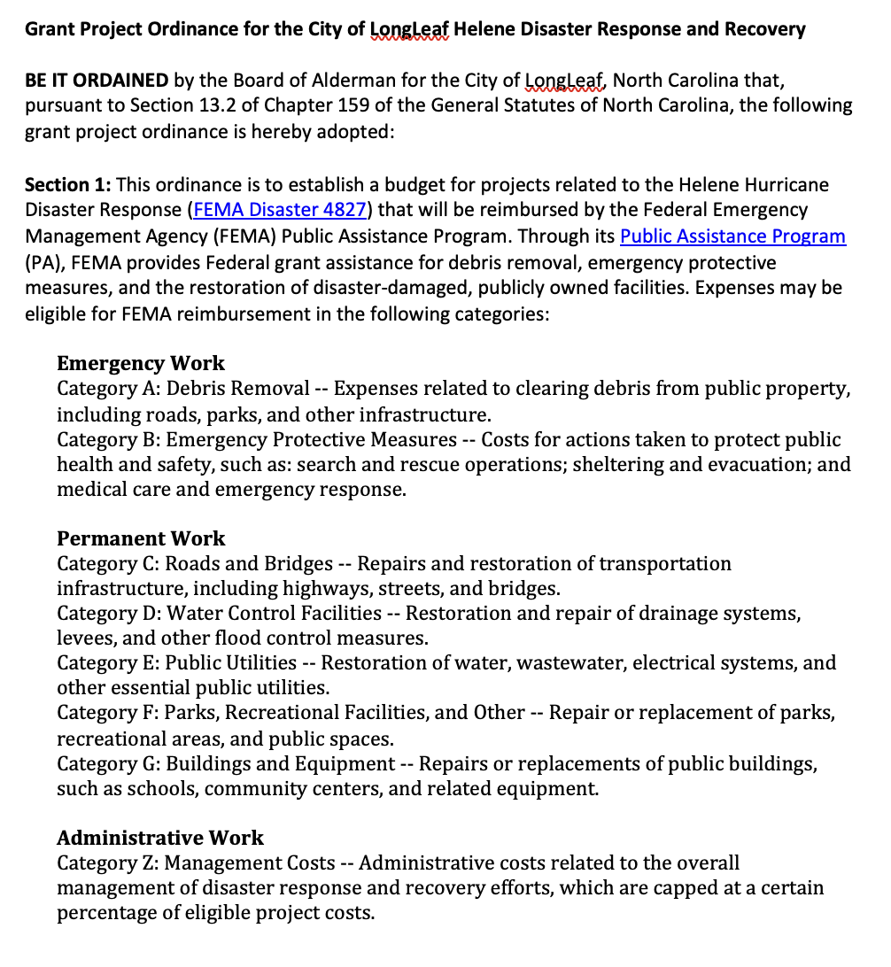
Budgeting Methods
Sample Grant Project Ordinance for Helene
Annual Budget Ordinance
Grant Project Ordinance
Capital Project Ordinance
Capital projects only
Revenues can be expected FEMA reimbursements over life of grant
One year only
Revenues can be expected FEMA reimbursements during current fiscal year or appropriated fund balance
Can serve as part of compliance documentation

Slide 4
Mutual Aid
Who Authorizes?
What’s the Process?
What are Reimbursement Requirements?
State Building Code Mutual Aid. G.S. 160D-1107 authorizes two or more counties or municipalities to provide mutual aid assistance in the administration and enforcement of State and local laws related to the State Building Code. Mutual aid contracts may include provisions “addressing the scope of aid provided, for reimbursement or indemnification of the aiding party for loss or damage incurred by giving aid, for delegating authority to a designated official or employee to request aid or to send aid upon request, and any other provisions not inconsistent with law.”
Fire Mutual Aid. G.S. 58-83-1 authorizes a county, municipality, fire protection district, or sanitary district fire department to send firemen and apparatus to assist outside their territorial boundaries.
Law Enforcement Mutual Aid. There are several statutory provisions that allow for local law enforcement mutual aid. This 2021 Guide from the North Carolina Sheriffs’ Association provides a detailed overview of these statutes. The provision most likely to be invoked when providing aid to another jurisdiction during Helene is G.S. 160A-288 (made applicable to counties by G.S. 153A-212). It allows the head of any law enforcement agency (e.g. police chief, sheriff), or their designee, to temporarily aid another law enforcement agency if requested in writing by the head of the requesting agency, unless specifically prohibited or limited by an ordinance adopted by the unit’s governing board. The local government does not need to execute a mutual aid agreement for a local law enforcement agency to provide this aid. But, as discussed below, there may be good reasons to execute an agreement to cover issues such as liability and reimbursements that are not directly addressed by the statute.
Emergency Response Mutual Aid. G.S. 166A-19.72(c) authorizes the chief executive (ie. manager, administrator, mayor, or board chair) of a county or municipality, with the concurrence of the unit’s governing board, to execute mutual aid agreements for reciprocal emergency management aid and assistance. The agreements must be consistent with the State emergency management program and plans, whose purpose is to
Reduce vulnerability of people and property of this State to damage, injury, and loss of life and property.
Prepare for prompt and efficient rescue, care, and treatment of threatened or affected persons.
Provide for the rapid and orderly rehabilitation of persons and restoration of property.
Provide for cooperation and coordination of activities relating to emergency mitigation, preparedness, response, and recovery among agencies and officials of this State and with similar agencies and officials of other states, with local and federal governments, with interstate organizations, and with other private and quasi‐official organizations. G.S. 166A-19.1.
The mutual aid agreements may cover “the furnishing or exchange of such supplies, equipment, facilities, personnel, and services as may be needed; the reimbursement of costs and expenses for equipment, supplies, personnel, and similar items; and on such terms and conditions as deemed necessary.” Other terms may be negotiated by the parties, consistent with the State emergency management program and plans.

Slide 5
FEMA Reimbursement
ELIGIBLE COSTS
Emergency Work (Categories A & B)
Emergency Utility Restoration (Category B or F)
Certain Grant Management Activities
Same eligibility criteria as contract work
Costs to transport
Straight time & Overtime (but if backfilling LG personnel, overtime only)
Use of equipment (including repairs)
INELIGIBLE COSTS
Preparing to deploy
Dispatch operations outside the receiving State
Training and exercises
Support for long-term recovery and mitigation operations
Process Requirements for Reimbursement. For mutual aid to qualify for FEMA reimbursement, the following requirements must be met:
Emergency Declaration. A disaster must be declared by the US President or the state governor to activate FEMA’s public assistance grant program.
Request for Assistance. For the work done by the Providing Entity to qualify for reimbursement, the Requesting Entity must have formally requested the resources that were provided. FEMA recognizes that some states, like North Carolina, have a state-coordinated mutual aid program. The request is made through the state system and FEMA allows the State to pay the Providing entity on behalf of the local government and seek reimbursement from FEMA.
Documentation. The Requesting Entity or State, if applicable, must provide a description of the services requested and received, along with documentation of associated costs (e.g., labor, equipment, supplies, or materials) to FEMA in support of a request for PA funding. The Providing Entity must document required information, in accordance with FEMA requirements. That requires coordination between the Requesting and Providing entities and among personnel (manager, department heads, law enforcement head, finance staff) within the Providing Entity.
Written Mutual Aid Agreement. If the Requesting and Providing Entities don’t have a written agreement, or if their agreement doesn’t mention reimbursement, they can make a verbal agreement about what resources will be provided and the terms, conditions, and costs involved. This agreement should align with how they’ve handled mutual aid in the past. For example, if the Requesting Entity usually doesn’t reimburse the Providing Entity, they shouldn’t agree to do so just for this incident. Prior to funding, the Requesting Entity must write down the verbal agreement, have it signed by authorized representatives from both entities, and send it to FEMA, ideally within 30 days of the Applicant’s Briefing.

Slide 6
HB 149: State Disaster Relief Law (1)
Helene
PTC8
Cash Flow Loans
NCEM given $250m to, among other things, provide cash flow loans to local governments & state agencies
Aid for Local Governments
Stakeholder Assistance
OSBM given $2m to distribute to NCACC, NCLM, and NCARCOG to help with technical assistance. Must prioritize grants to counties with a population of less than 250K
Elections
State Bd. Of Elections given $5m to assist county boards with technology, printing, emergency communication systems, temporary staff, mobile voting

Slide 7
HB 149: State Disaster Relief Law (1)
Helene
PTC8
Emergency Loans
DEQ can transfer funds between CW Reserve and DW reserve to provide emergency loans to local governments
Drinking Water and Clean Water Revolving Fund Loans
Normal Statutory Limits on Amounts do NOT apply
LGC Approval Required
Water / Wastewater
LG Project Changes
DEQ may authorize local governments to use any previous infrastructure funding from DEQ to mitigate or remediate disaster-related damage or provide temporary measures to allow preservation or restoration of drinking water and wastewater service or emergency operations at a drinking water or wastewater facility

Slide 8
HB 149: State Disaster Relief Law (1)
Helene
PTC8
Emergency Loans
DEQ can transfer funds between CW Reserve and DW reserve to provide emergency loans to local governments
Water / Wastewater
LG Project Changes
DEQ may authorize local governments to use any previous infrastructure funding from DEQ to mitigate or remediate disaster-related damage or provide temporary measures to allow preservation or restoration of drinking water and wastewater service or emergency operations at a drinking water or wastewater facility

Slide 9
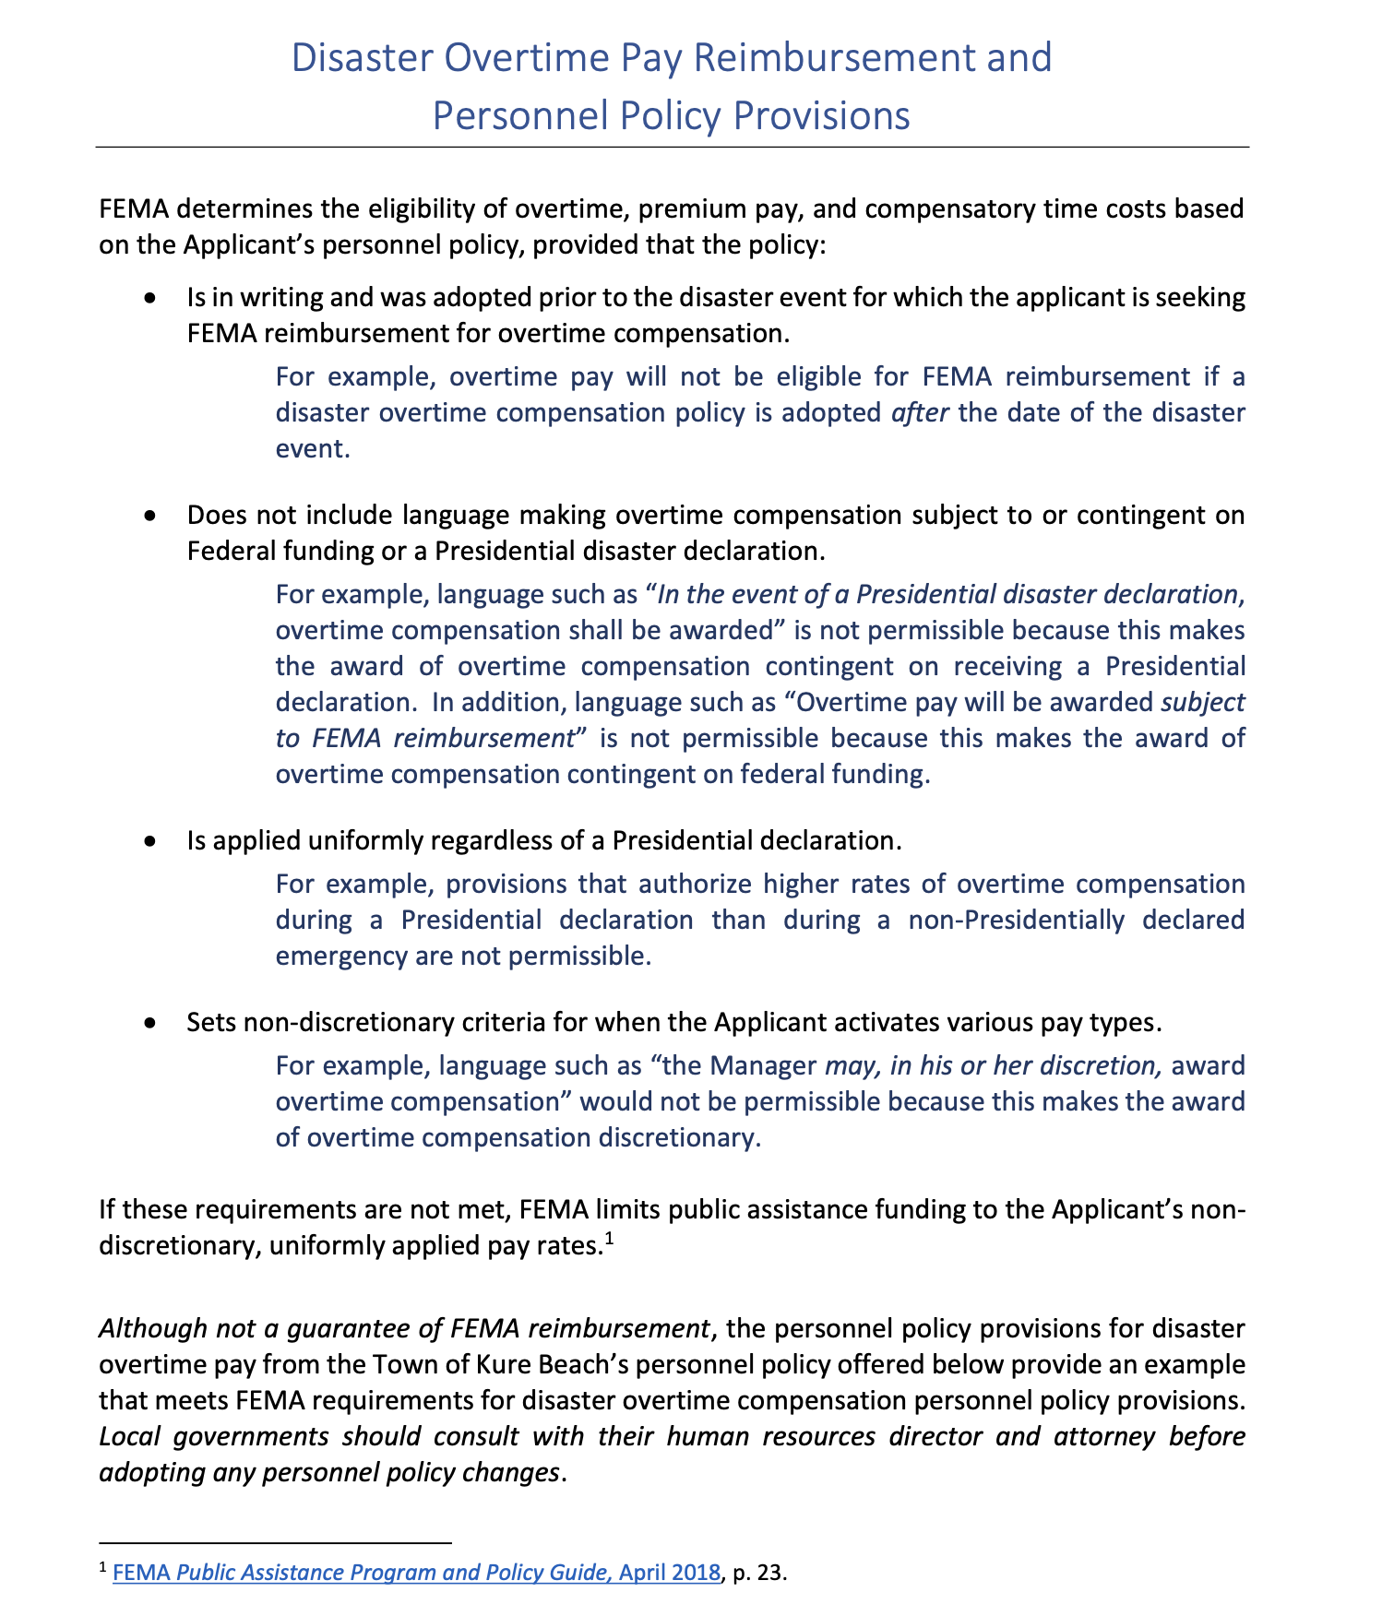
Employee Compensation, Comp-Time, Overtime, & Reimbursement
FEMA determines the eligibility of overtime, premium pay, and compensatory time costs based on the Applicant’s pre-disaster written labor policy, provided the policy:
Does not include a contingency clause that payment is subject to Federal funding;
Is applied uniformly regardless of a Presidential declaration; and
Has set non-discretionary criteria for when the Applicant activates various pay types.
If these requirements are not met, FEMA limits funding to the Applicant’s non-discretionary, uniformly applied pay rates.
All costs must be reasonable and equitable for the type of work being performed.
FEMA determines whether the number of hours claimed are reasonable and necessary by evaluating:
The severity of the incident;
Whether the work was performed at a time when it was necessary to work extraordinary hours based on the circumstances of the incident;
The function of the employee for which the hours are claimed; and
The number of consecutive hours the employee worked.

Slide 10
FEMA Eligibility Criteria Based on
Type of Employee and Work Performed
FEMA's criteria for reimbursing straight-time labor costs differ depending on the type of employee and whether that employee is performing Emergency Work or Permanent Work. Permanent Work: Straight-time and overtime labor costs are eligible for both budgeted and unbudgeted employees Budgeted Employees Hours Permanent employee Seasonal employee working during normal season of employment Unbudgeted Employees Hours Reassigned employee funded from external sources Essential employee called back from furlough Temporary employee hired to perform eligible work Part-time or Seasonal employee working outside normal hours or season of employment Types of employees include: Reassigned employees Backfill employees Supervisors Other Emergency Work: For budgeted employees only, overtime labor is eligible For unbudgeted employees performing Emergency Work, both straight-time and overtime labor are eligible. Under the Alternative Procedures authorized by Section 428 of the Stafford Act, straight-time labor costs are eligible for budgeted employees conducting eligible debris removal (Category A) activities.

Slide 11
Helene Finance Response
Action Items & Resources For Finance Officers
October 10, 2024

Slide 12
HB 149: State Disaster Relief Law (1)
Helene
PTC8
Cash Flow Loans
NCEM given $250m to, among other things, provide cash flow loans to local governments & state agencies
Aid for Local Governments
Stakeholder Assistance
OSBM given $2m to distribute to NCACC, NCLM, and NCARCOG to help with technical assistance. Must prioritize grants to counties with a population of less than 250K
Elections
State Bd. Of Elections given $5m to assist county boards with technology, printing, emergency communication systems, temporary staff, mobile voting

Slide 13
HB 149: State Disaster Relief Law (1)
Helene
PTC8
Cash Flow Loans
NCEM given $250m to, among other things, provide cash flow loans to local governments & state agencies
Aid for Local Governments
Stakeholder Assistance
OSBM given $2m to distribute to NCACC, NCLM, and NCARCOG to help with technical assistance. Must prioritize grants to counties with a population of less than 250K
Elections
State Bd. Of Elections given $5m to assist county boards with technology, printing, emergency communication systems, temporary staff, mobile voting

Slide 14
HB 149: State Disaster Relief Law (1)
Helene
PTC8
Cash Flow Loans
NCEM given $250 million to, among other things, provide cash flow loans to local governments & state agencies
Aid for Local Governments
Stakeholder Assistance
OSBM given $2m to distribute to NCACC, NCLM, and NCARCOG to help with technical assistance. Must prioritize grants to counties with a population of less than 250K
Elections
State Bd. Of Elections given $5 million to assist county boards with technology, printing, emergency communication systems, temporary staff, mobile voting

Slide 15
HB 149: State Disaster Relief Law (1)
Helene
PTC8
Nutrition Staff
NCDPI given $16m to cover school nutrition employees
Teacher Pay
Aid for Schools
Teachers will be paid regular salary for days missed due to hurricane

Slide 16
HB 149: State Disaster Relief Law (1)
Helene
PTC8
Nutrition Staff
NCDPI given $16m to cover school nutrition employees
Teacher Pay
Aid for Schools
Teachers will be paid regular salary for days missed due to hurricane

Slide 17
HB 149: State Disaster Relief Law (1)
Helene
PTC8
Emergency Loans
DEQ can transfer funds between CW Reserve and DW reserve to provide emergency loans to local governments
Drinking Water and Clean Water Revolving Fund Loans
Normal Statutory Limits on Amounts do NOT apply
Water / Wastewater
LG Project Changes
DEQ may authorize local governments to use any previous infrastructure funding from DEQ to mitigate or remediate disaster-related damage or provide temporary measures to allow preservation or restoration of drinking water and wastewater service or emergency operations at a drinking water or wastewater facility

Slide 18
HB 149: State Disaster Relief Law (1)
Helene
PTC8
Emergency Loans
DEQ can transfer funds between CW Reserve and DW reserve to provide emergency loans to local governments
Water / Wastewater
LG Project Changes
DEQ may authorize local governments to use any previous infrastructure funding from DEQ to mitigate or remediate disaster-related damage or provide temporary measures to allow preservation or restoration of drinking water and wastewater service or emergency operations at a drinking water or wastewater facility

Slide 19
Helene
PTC8
Helene
PTC8
HB 149: State Disaster Relief Law (1)
Can hire retired LG staff to help with Hurricane Helene Recovery Efforts During State of Emergency
For individuals who retired prior to October 1, 2024, any earnings received between September 25, 2024, and [when the emergency declaration ends] shall not be treated as earned by a beneficiary of the Local Governmental Employees Retirement System (LGERS) under the provisions of G.S. 128-24(5)c., provided those earnings are related to a position needed due to the state of emergency related to Hurricane Helene or associated Hurricane Helene recovery efforts, as certified to the Retirement Systems Division of the Department of State Treasurer by the employing unit.
Any benefits received by or paid to a law enforcement officer, retired law enforcement officer, sheriff, or retired sheriff under Article 12D or Article 12H of Chapter 143 of the General Statutes shall not be impacted by any work performed between September 25, 2024, and the time that subsection (a) of this section expires, provided that work performed is needed due to the state of emergency related to Hurricane Helene or associated Hurricane Helene recovery efforts, as documented by the employing unit or agency.

Slide 20
Helene Finance Response
Action Items & Resources For Finance Officers
October 4, 2024

Slide 21
What to do NOW: Guidance from the Field
Separate Fund, Project Codes, and Project File
Track
Expenses
Create a separate fund in the general fund for budgeting and accounting purposes
Separate pay codes
Make copies of timesheets
Assign a separate project/account code in your accounting software for disaster-response expenditures
Create a shared file so that everyone can deposit digital invoices, receipts, documentation to a single place
Separate Fund, Codes, & Files
Establish
contact with
FEMA
Finance
Office
Response
Document
Document
Document
Prepare for
Procurement
Damage
Inventory

Slide 22
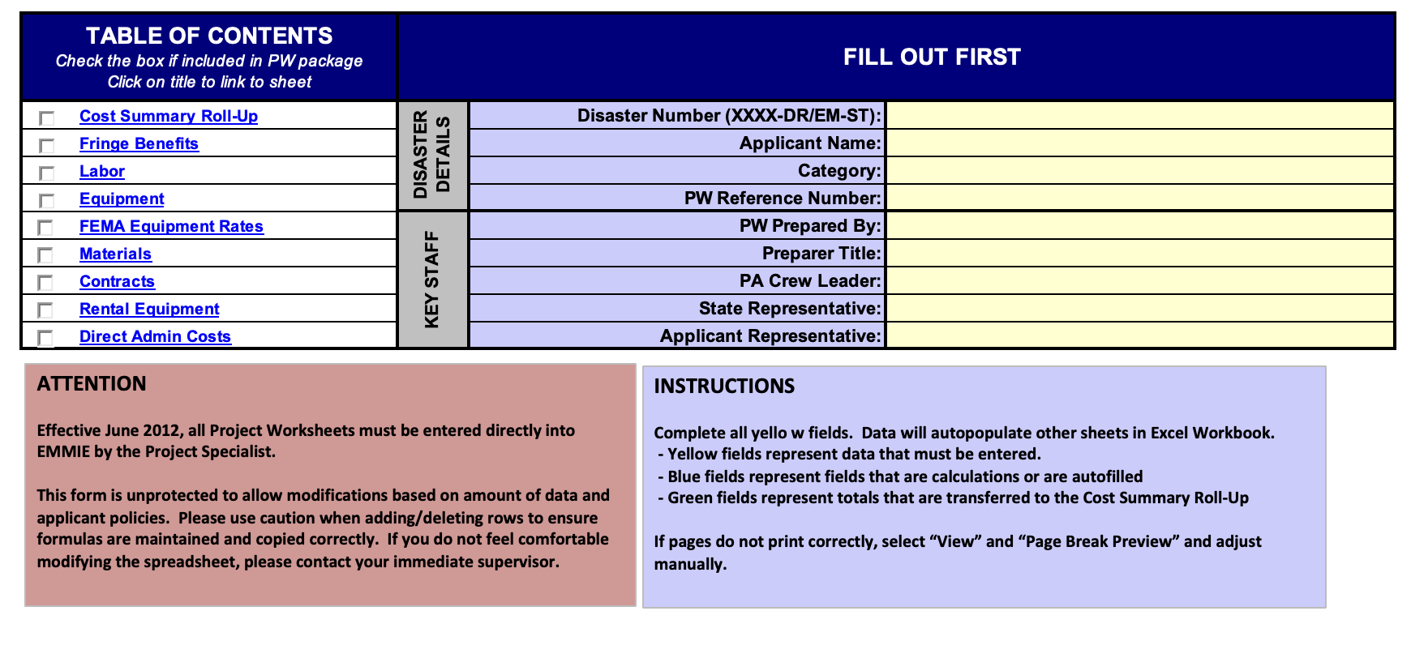
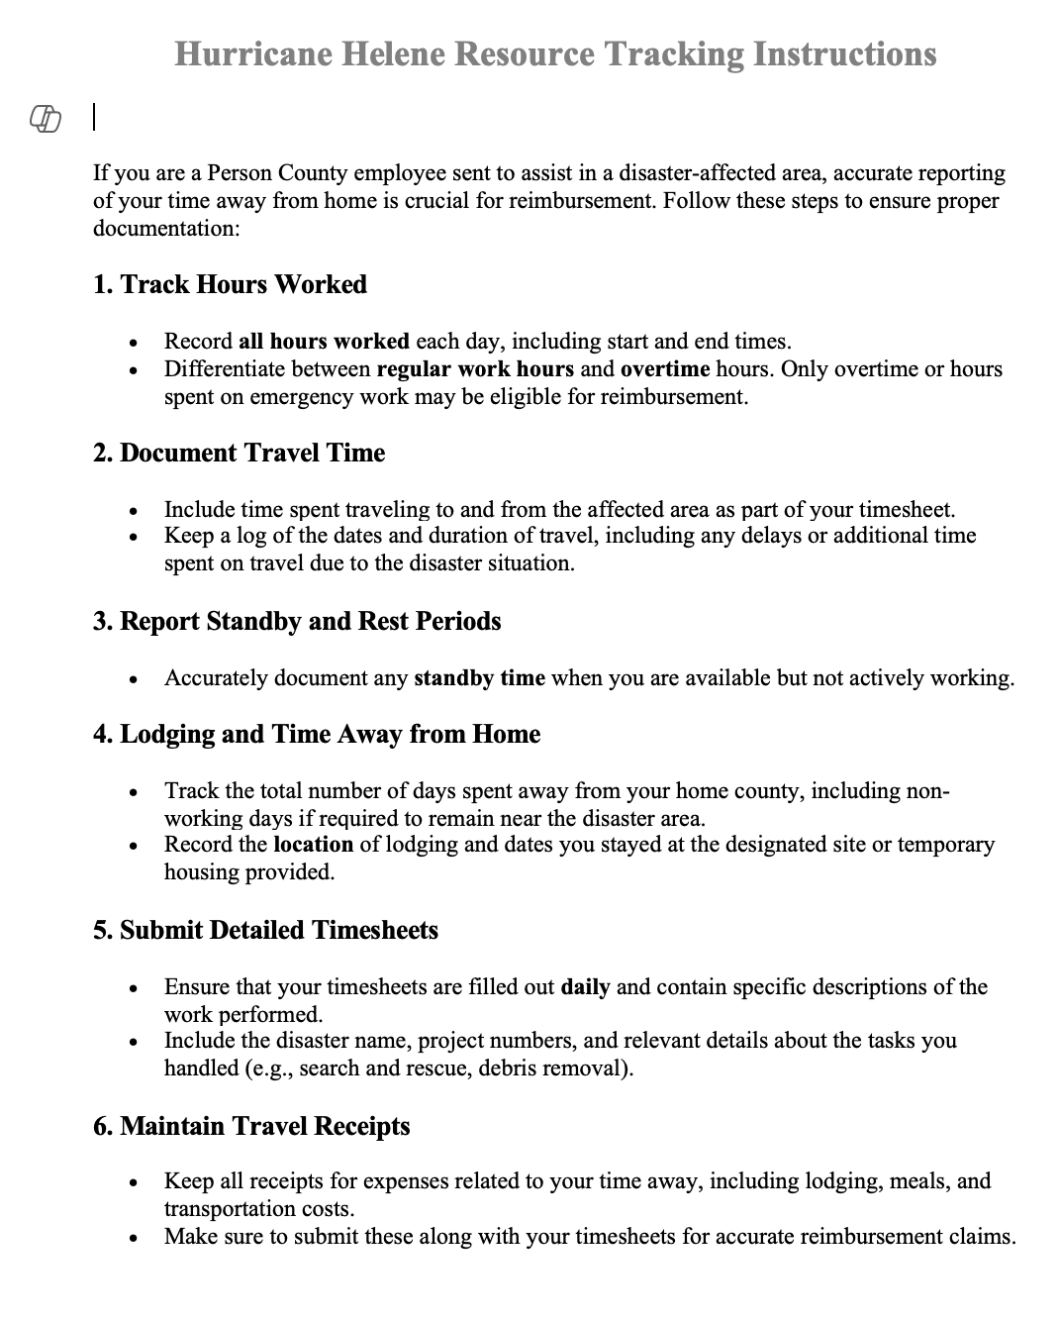
What to do NOW: Guidance from the Field
Track All Expenses
Reimbursement is going to depend on accurate and precise recordkeeping.
Set up systems now and provide instructions for all staff.
Upload everything to a common digital file
Document expenses as you go along.
Write notes on receipts and invoices as they are turned in so you can remember what the purchase was for and how it is related to the disaster event
Use an excel spreadsheet to track expenses and include column for notes to document how each expense was related to the disaster.
Track
Expenses
Separate Fund, Codes, & Files
Labor Activity Sheet and an Equipment/Materials Information Sheet for departments to track all expenditures related to Hurricane Helene, including purchases for preparations, relief efforts, travel, and cleanup.
Establish
contact with
FEMA
Finance
Office
Response
Prepare for
Procurement
Person County Sample Resource Tracking Instructions
Cash Flow
Damage
Inventory
FEMA Form 214 Activity Log
NCDPS Form 214 Activity Log

Slide 23
Employee Compensation, Comp-Time, Overtime, & Reimbursement
FEMA determines the eligibility of overtime, premium pay, and compensatory time costs based on the Applicant’s pre-disaster written labor policy, provided the policy:
Does not include a contingency clause that payment is subject to Federal funding;
Is applied uniformly regardless of a Presidential declaration; and
Has set non-discretionary criteria for when the Applicant activates various pay types.
If these requirements are not met, FEMA limits funding to the Applicant’s non-discretionary, uniformly applied pay rates.
All costs must be reasonable and equitable for the type of work being performed.
FEMA determines whether the number of hours claimed are reasonable and necessary by evaluating:
The severity of the incident;
Whether the work was performed at a time when it was necessary to work extraordinary hours based on the circumstances of the incident;
The function of the employee for which the hours are claimed; and
The number of consecutive hours the employee worked.

Slide 24
FEMA Eligibility Criteria Based on Type of Employee and Work Performed
FEMA's criteria for reimbursing straight-time labor costs differ depending on the type of employee and whether that employee is performing Emergency Work or Permanent Work. Permanent Work: Straight-time and overtime labor costs are eligible for both budgeted and unbudgeted employees Budgeted Employees Hours Permanent employee Seasonal employee working during normal season of employment Unbudgeted Employees Hours Reassigned employee funded from external sources Essential employee called back from furlough Temporary employee hired to perform eligible work Part-time or Seasonal employee working outside normal hours or season of employment Types of employees include: Reassigned employees Backfill employees Supervisors Other Emergency Work: For budgeted employees only, overtime labor is eligible For unbudgeted employees performing Emergency Work, both straight-time and overtime labor are eligible. Under the Alternative Procedures authorized by Section 428 of the Stafford Act, straight-time labor costs are eligible for budgeted employees conducting eligible debris removal (Category A) activities.

Slide 25
What to do NOW: Guidance from the Field
Establish Contact With FEMA
Track
Expenses
Meet with FEMA field manager and NCDPS staff
To the extent possible, get any guidance or interpretations in writing
Sign up for FEMA grants portal so that you can start submitting reimbursement requests. Learn about proper documentation (training available here)
Public Assistance Policy Guide
Separate Fund, Codes, & Files
Establish
contact with
FEMA
Hire a consultant?
SAMPLE RFQ and Scoring Criteria from Morehead City for Public Assistance / Hazard Mitigation & Grant Management Consulting / Disaster Recovery Services
SAMPLE RFQ from Dare County fpr EM services
Finance
Office
Response
Cash Flow
Prepare for
Procurement
Damage
Inventory

Slide 26
What to do NOW: Guidance from the Field
Prepare for Procurement
Track
Expenses
Procurement Guidance
FEMA Procurement Disaster Assistance Team (PDAT) resources
FEMA Contracting Checklist
FEMA Procurement Guidance
FEMA and State Procurement Requirements Cross-Walk (2024 version)
Adopt procurement policy that is consistent with state law and FEMA requirements
Look for ways to piggy-back off existing contracts
NCDPS Debris Management
Separate Fund, Codes, & Files
Establish
contact with
FEMA
Finance
Office
Response
Cash Flow
Prepare for
Procurement
Damage
Inventory

Slide 27
What to do NOW: Guidance from the Field
Damage Inventory
Track
Expenses
Start damage inventory. Take pictures.
Do preliminary cost estimates.
File any applicable claims with insurance company.
Separate Fund, Codes, & Files
Establish
contact with
FEMA
Finance
Office
Response
Cash Flow
Prepare for
Procurement
Damage
Inventory

Slide 28
What to do NOW: Guidance from the Field
Cash Flow
Evaluate your cash flow over the next 3 months. How has your burn rate changed?
Set regular schedule for submitting reimbursement requests for Category B expenses (emergency protective measures) so you don’t have to do it all at one time at the end of the disaster (ex: submit overtime each time payroll is processed). [Periodic reimbursements typically take 30-45 days. Close-out reimbursements can take years.]
Are there regular expenditures you can cut or reduce?
Watch for:
General Assembly appropriations?
Loans from NC Office of Recovery & Resiliency?
Track
Expenses
Separate Fund, Codes, & Files
Establish
contact with
FEMA
Keep track of insurance proceeds and other sources of disaster funding (like private grant or other federal funds) to avoid duplication of benefits – remember, FEMA is funder of last resort.
Finance
Office
Response
Cash Flow
Prepare for
Procurement
Damage
Inventory

Slide 29
Other Finance Considerations
Staffing Issues
Banking Issues
Budget Amendments
Donations / Payment Collections
Preaudit & Other Processes
Is your staff depleted? How can you adjust duties? Try to allow for breaks? Focus on core requirements and controls
Can you physically get to the bank for a deposit? If not, are funds secured?
Make sure to get budget amendments for new expenditures to the board at their next meeting.
Do your best to comply with existing processes. Make use of p-cards and other automated payments if available. Prioritize FEMA reimbursement requirements
How are you managing routine payments and donations?

Slide 30
Local Governments Helping Other Local Governments
Allowed
Not Allowed
Mutual aid, pursuant to state or local mutual aid agreement (typically qualifies for reimbursement)
Cash payments / donations
Transfers of real or personal property (160A-274)
Donations of personnel property (160A-280)
Informal assistance
Facilitate community assistance efforts

Slide 31
Deadlines
ARPA Project & Expenditure October Report: Submit it when you are able, even if after the deadline
Audit?:
Other?:

Slide 32
Mutual Aid
G.S. 160A-288 (applicable to cities and counties, see G.S. 153A-212):
Cooperation between law enforcement agencies
G.S. 166A-19.72 (applicable to all political subdivisions):
“Mutual aid agreements may include, but are not limited to, the furnishing or exchange of such supplies, equipment, facilities, personnel, and services as may be needed; the reimbursement of costs and expenses for equipment, supplies, personnel, and similar items; and on such terms and conditions as deemed necessary.”
State Mutual Aid Agreement

Slide 33
Mutual Aid (MAA) and FEMA Reimbursements
Emergency protective measures to save lives, protect public health and safety, and protect improve property may be eligible for Public Assistance reimbursement. When an applicant does not have adequate resources to respond to an incident, it (“Requesting Entity”) may request resources from another jurisdiction through an MAA. Mutual aid work is subject to the same eligibility criteria as contract work, and the Requesting Entity must provide a description of the services requested and received, along with documentation of associated costs (e.g., labor, equipment, supplies, or materials) to FEMA. In order to be eligible, costs must be adequately documented and directly tied to the performance of eligible work. FEMA policy provides a list of documentation the applicant should submit to support MAA costs claimed, but states the list is not all-inclusive.The list of items includes services requested and received; information pertaining to labor, equipment, and supplies; and invoices

Slide 34
Mutual Aid Documentation
ncmutualaid@ncdps.gov
Requesting Local Governments
Assisting Local Governments
Should Provide:
Description of conditions – if disaster has happened, damages and that request is made pursuant to this agreement.
Type of assistance needed– including amounts and type of personnel, equipment, materials, and supplies
Estimated length of time assistance is needed
Need for relief centers, staging areas, and storage outside the requesting city
Time and place to meet staff from providing city
Must Provide:
Provide basic needs of employees from the provider city, unless otherwise specified (including paying for food, housing, transportation and reasonable out-of-pocket costs)
Coordinate requests for state or federal assistance through the local emergency management agency
Assign work via resource provider’s supervisor
Reimburse provider for all documented costs and expenses, including personnel, equipment, and materials (using pre-established rates)
Provide directions and assistance in record keeping to provider
Should Provide:
Agree or decline to provide assistance;
Description of available personnel, equipment, and other resources
Length of time assistance is available
Date and time assistance will arrive
Supervisor's name and contact of any personnel being sent
Must Provide:
Provide direct supervision of all personnel and equipment
Provide adequate communications equipment among own personnel
Maintain daily records for staff time, materials, and equipment costs
Report regularly on work progress
Pay its own employees as usual but maintain records and submit invoices for reimbursement to requesting entity
ncmutualaid@ncdps.gov

